Slide 1
Spring Curriculum Night 2025
11th Grade

Slide 2
Agenda
IB Diploma Programme and the Course Program
11th and 12th Grade Course Options
Overview of the Student Support Program
Questions and Answers

Slide 3
IB Diploma Programme & Course Program at WPS

Slide 4
IB Middle Years Program
IB Diploma
Program
Lower Middle School
5th Grade
6th Grade
Upper Middle School
7th Grade
8th Grade
Pre-DP High School
9th Grade
10th Grade
DP High School
11th Grade
12th Grade
The Student Academic Experience

Slide 5
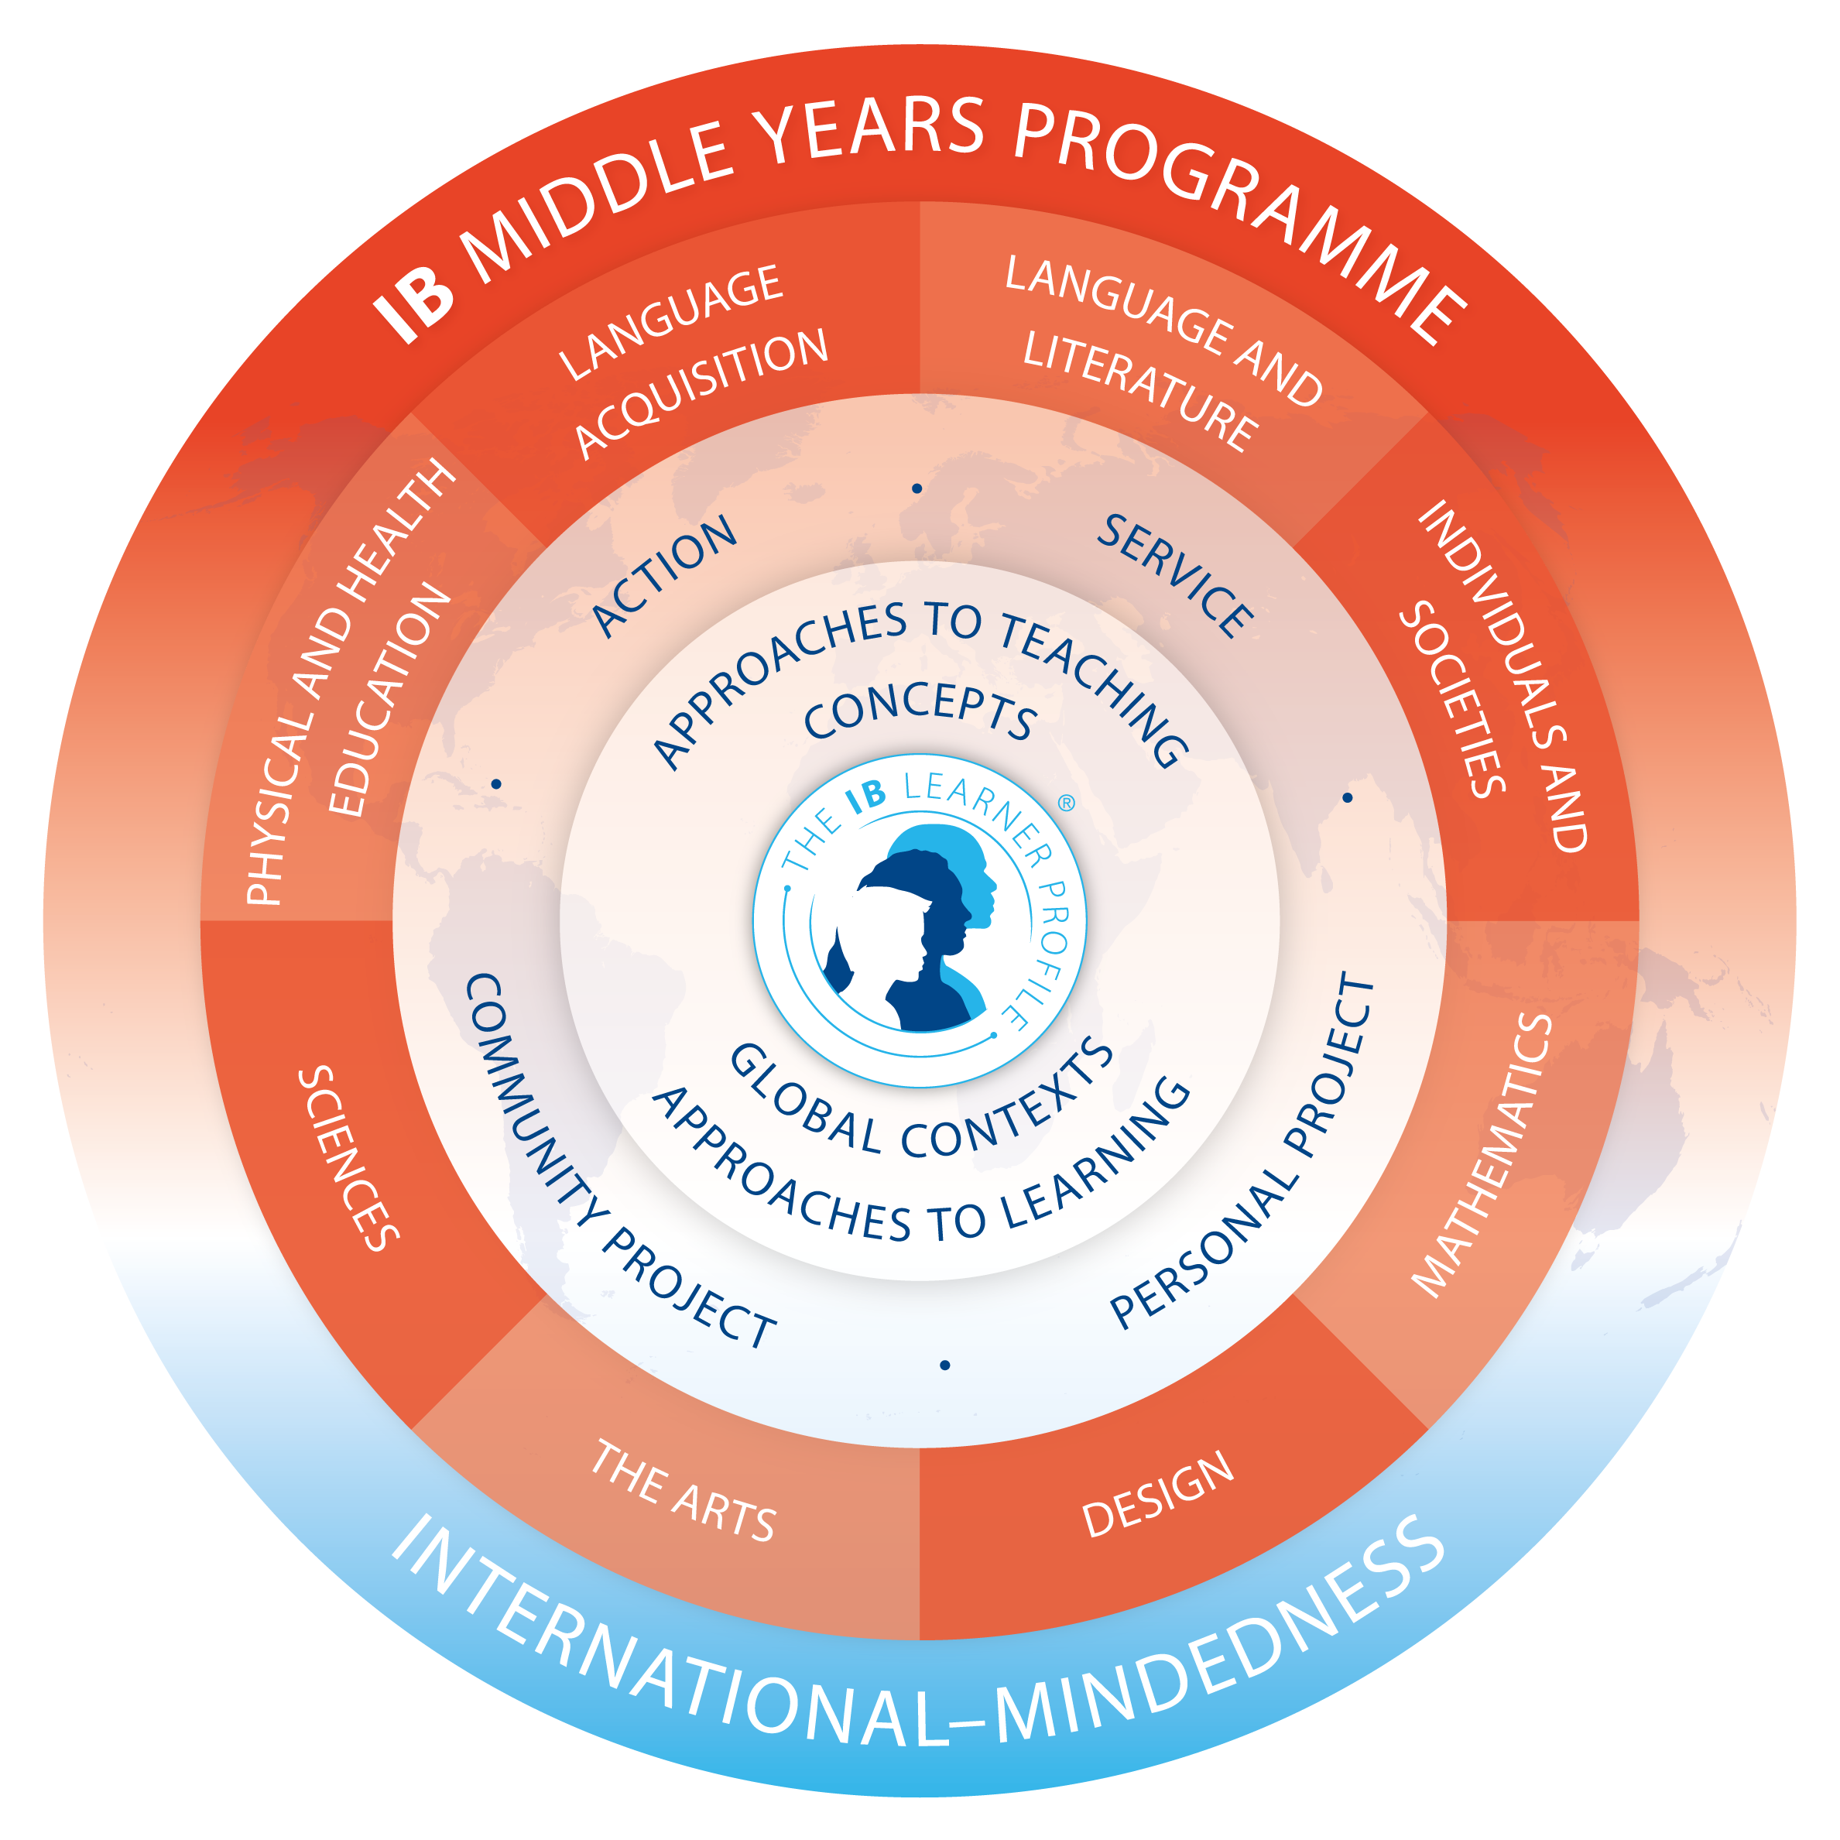
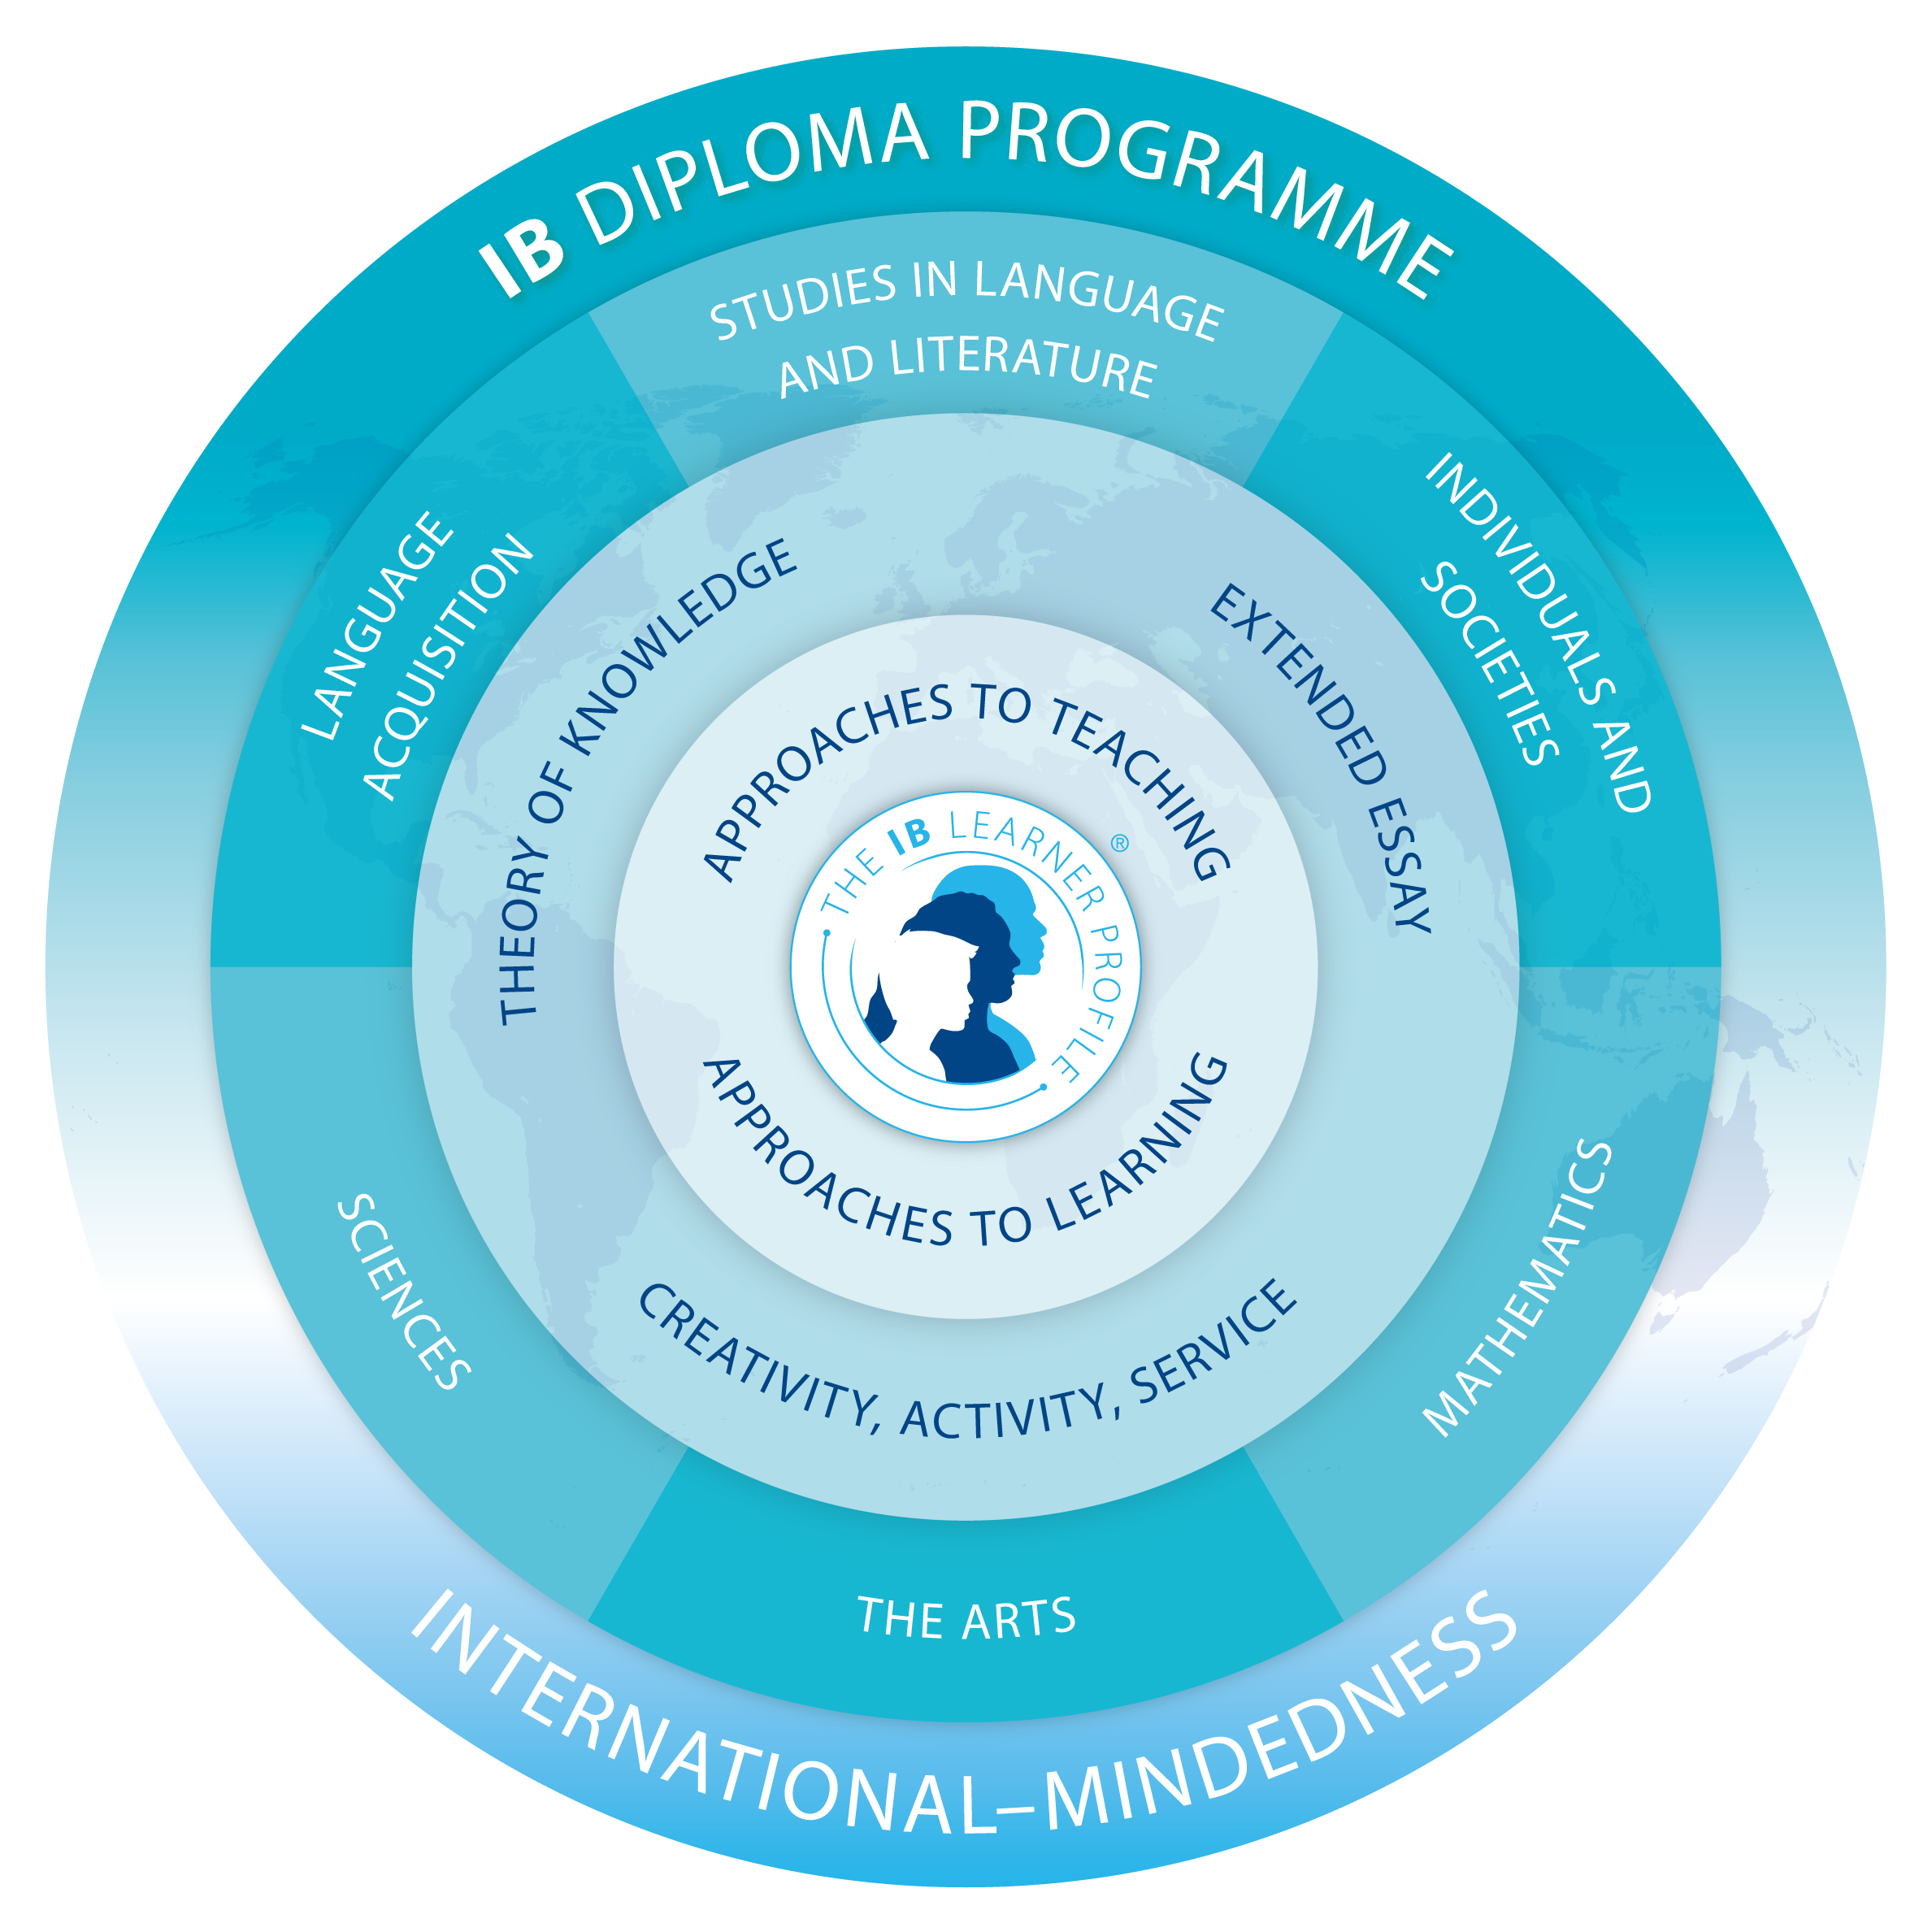
High School IB Alignment
Willows Preparatory School
Middle Years Programme (MYP)
9th & 10th Grade
Diploma Programme (DP) 11th & 12th Grade

Slide 6
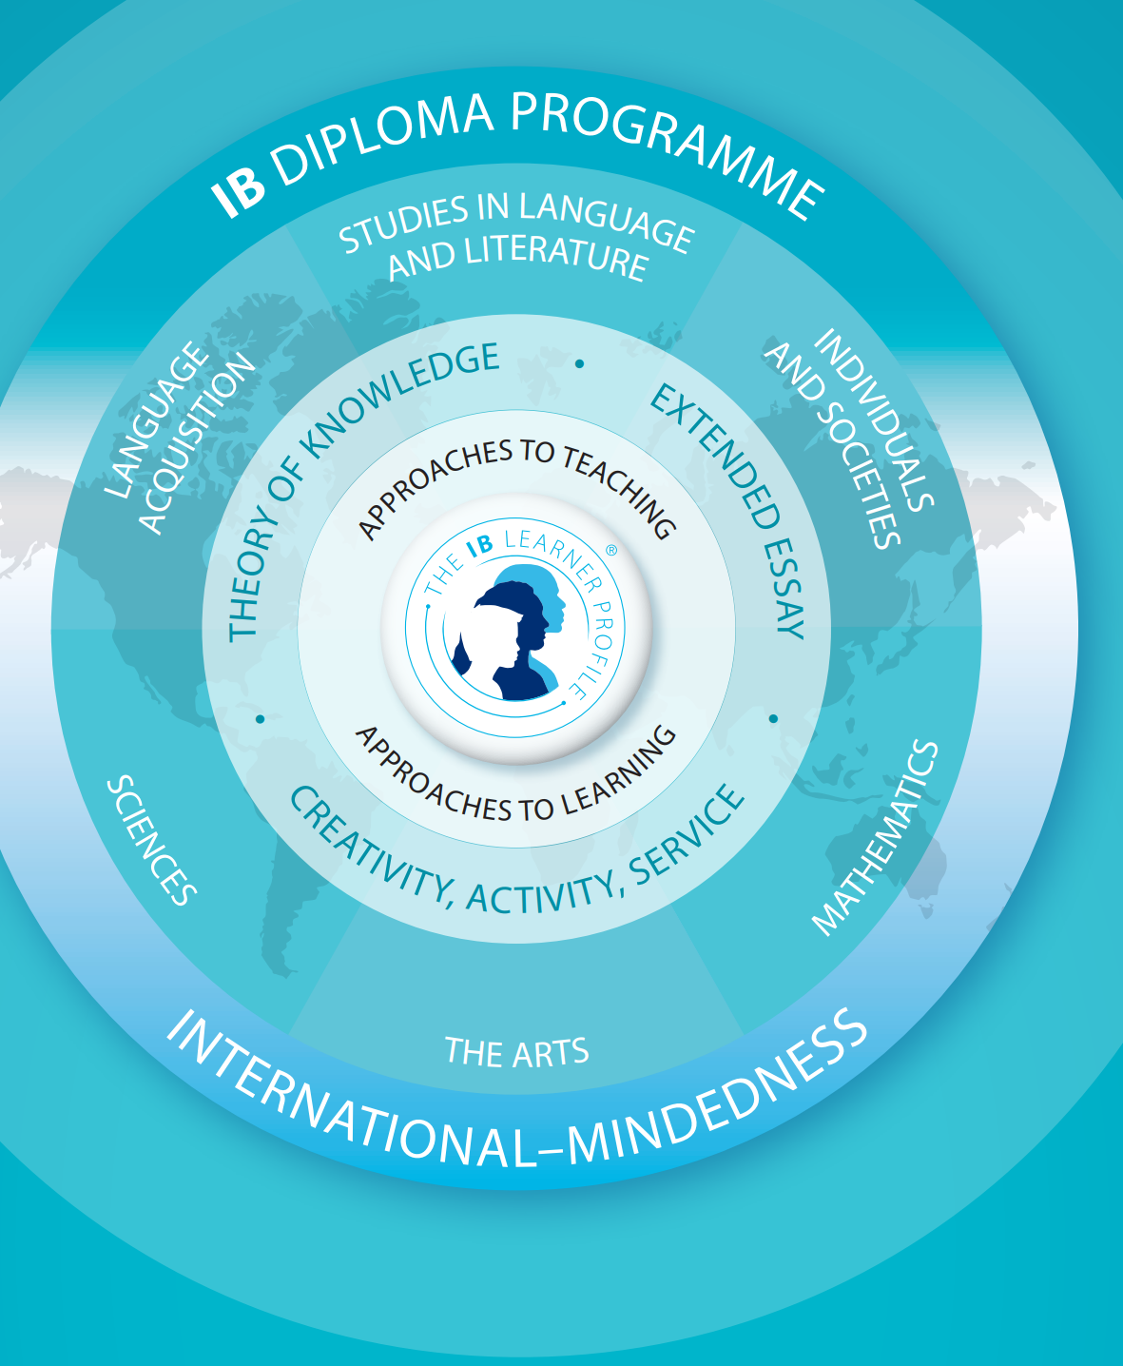
What is the IB Diploma Programme?
The IB Diploma Programme is an academically challenging and balanced programme of education, with final examinations, that prepares students aged 16 to 19 for success at university and in life beyond. It has been designed to address the intellectual, social, emotional and physical well-being of students. The programme has gained recognition and respect from the world’s leading universities.
All WPS 11th and 12th grade courses are designed for the Diploma Programme.

Slide 7
WPS: Course Program or Diploma Programme Assessment
Course Program
Option to take any DP Course exams which includes completing an Internal Assessment (IA)
Potential to earn college credit and IB Certificate for each successful completion of a DP course
Do NOT submit TOK Exhibition, EE, or CAS portfolio to IB
Can choose the combination of SL and HL courses
Diploma Programme
Required to take all DP Course exams which includes completing Internal Assessments (IAs)
Potential to earn college credit and IB Diplomma with a score of 24 or higher total
Do submit TOK Exhibition, EE and CAS portfolio
Must have 3 (or 4) HL courses and 3 (or 2) SL courses

Slide 8
WPS: Course Program or Diploma Programme
Course Program
Diploma Program
Course Choices:
Language & Literature – SL or HL
Individuals & Societies – SL or HL
Science – SL or HL
Mathematics – SL or HL
Choose an additional course from I&S or Sciences
Recommend Language B: Spanish SL or HL
Choose an additional course(s) from I&S or Sciences
Any combination of SL/HL.
Must complete Theory of Knowledge (TOK), Extended Essay (EE) and Creativity, Activity and Service (CAS).
Course Choices:
Language & Literature – SL or HL
Individuals & Societies – SL or HL
Science – SL or HL
Mathematics – SL or HL
Language B: Spanish* – SL or HL
Choose an additional course(s) from I&S or Sciences
3 courses at SL, 3 at HL. Option for 2 at SL, 4 at HL with approval.
Must complete and submit Theory of Knowledge (TOK), Extended Essay (EE) and Creativity, Activity and Service (CAS).
SL = Standard Level ~ 150 hours of content HL = Higher Level ~ 240 hours of content

Slide 9
Language & Literature

Slide 10
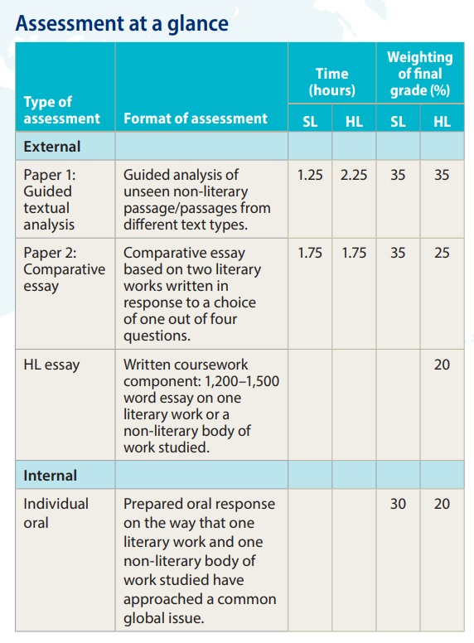
Language & Literature Course Options
Language A: Language & literature - SL or HL
“The language A: language and literature course aims at studying the complex and dynamic nature of language and exploring both its practical and aesthetic dimensions. The course will explore the crucial role language plays in communication, reflecting experience and shaping the world, and the roles of individuals themselves as producers of language. Throughout the course, students will explore the various ways in which language choices, text types, literary forms and contextual elements all effect meaning.”

Slide 11
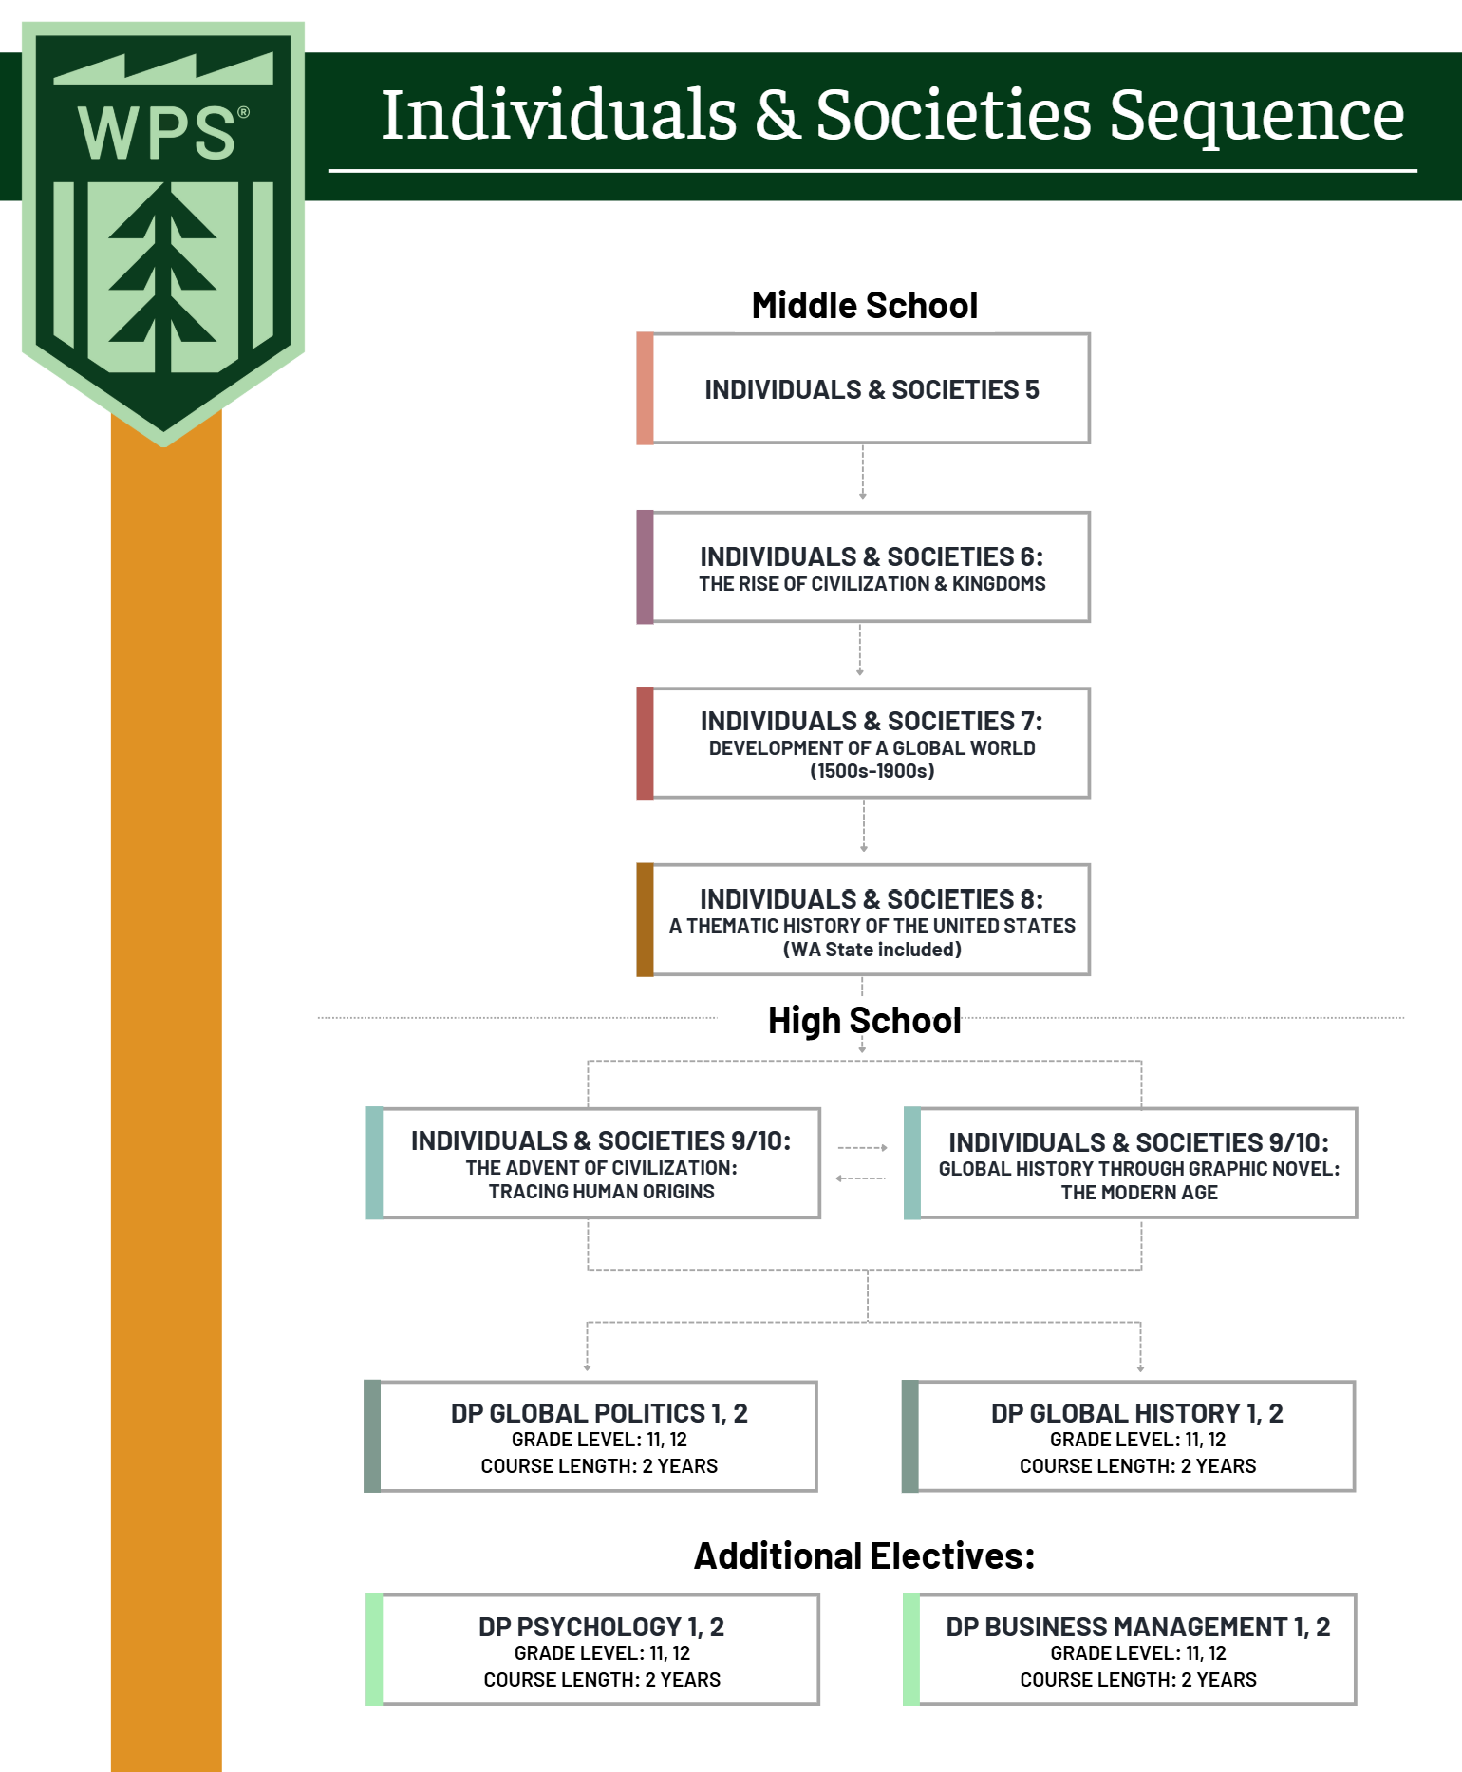
Individuals & Societies Course Sequence

Slide 12
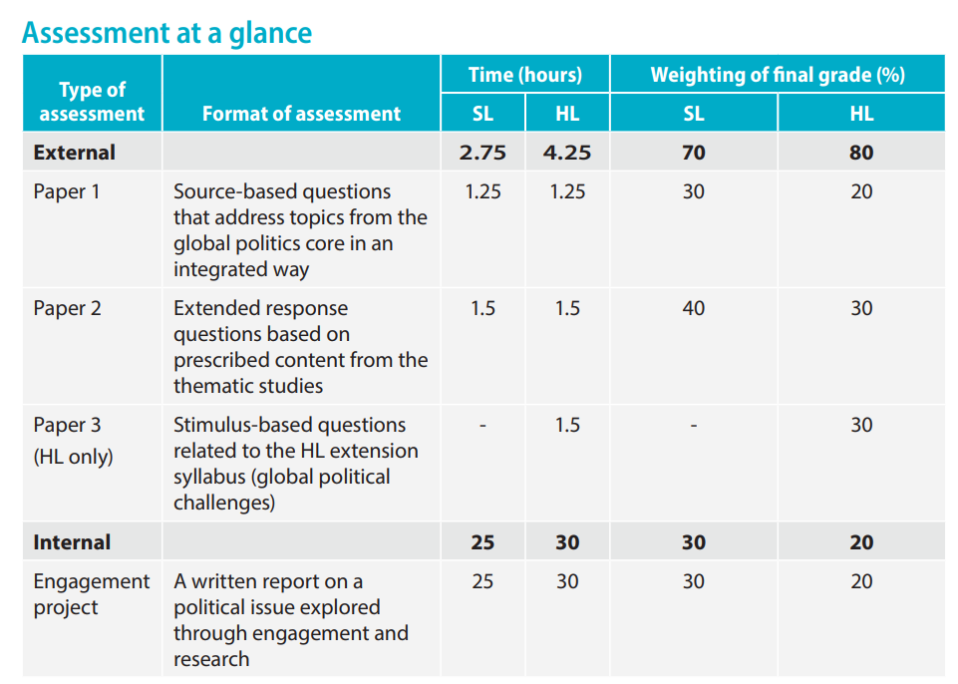
Individuals & Societies Course Options
Individuals & societies: Global politics
SL or HL
“DP global politics is a course for students who want to understand more about how the world they live in works, and what makes it change (or prevents it from changing). The course draws on a variety of disciplinary traditions in the study of politics and international relations, and more broadly in the social sciences and humanities. Students build their knowledge and understanding of the local, national, international, and global dimensions of political activity and processes by critically engaging with contemporary political issues and challenges.”

Slide 13
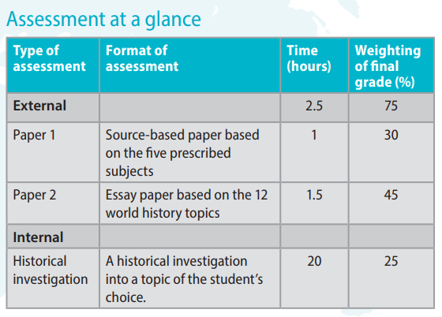
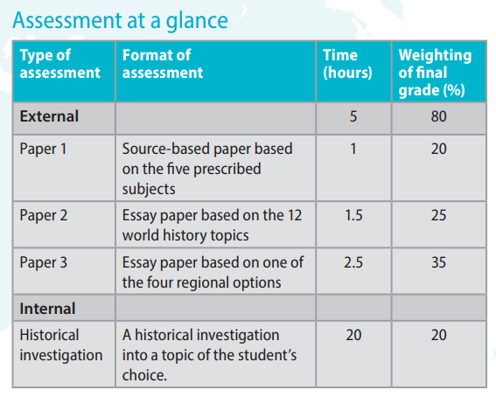
Individuals & Societies Course Options
Individuals & societies: History
SL or HL
“The DP history course is a world history course based on a comparative and multi-perspective approach to history. It involves the study of a variety of types of history, including political, economic, social and cultural, and provides a balance of structure and flexibility. The course emphasizes the importance of encouraging students to think historically and to develop historical skills as well as gaining factual knowledge. It puts a premium on developing the skills of critical think-ing, and on developing an understanding of multiple interpretations of history. In this way, the course involves a challenging and demanding critical exploration of the past. Teachers explicitly teach thinking and re-search skills such as comprehension, text analysis, transfer, and use of primary sources.”

Slide 14
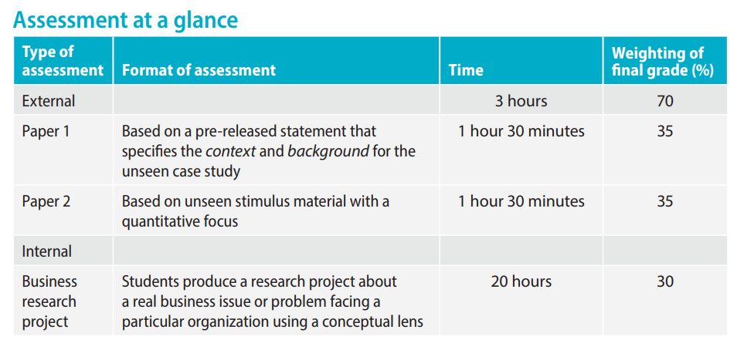
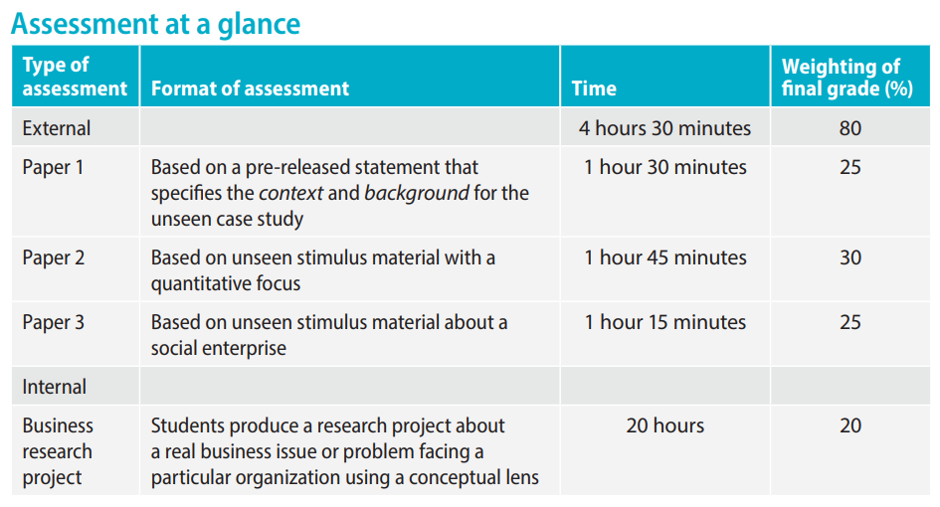
Individuals & Societies Course Options
Individuals & societies: Business Management
SL or HL
“The business management course is designed to meet the current and future needs of students who want to develop their knowledge of business content, concepts and tools to assist with business decision making. Future employees, business leaders, entrepreneurs or social entrepreneurs need to be confident, creative and compassionate as change agents for business in an increasingly interconnected global marketplace. The business management course is designed to encourage the development of these attributes.”

Slide 15
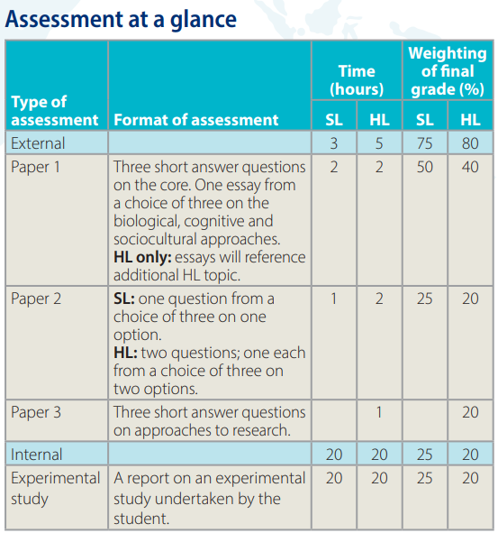
Individuals & Societies Course Options
Individuals & societies: Psychology
SL or HL
“At the core of the DP psychology course is an introduction to three different approaches to understanding behaviour: the biological, cognitive and sociocultural approaches. Students study and critically evaluate the knowledge, concepts, theories and research that have developed the understanding in these fields.“

Slide 16
Language Acquisition

Slide 17
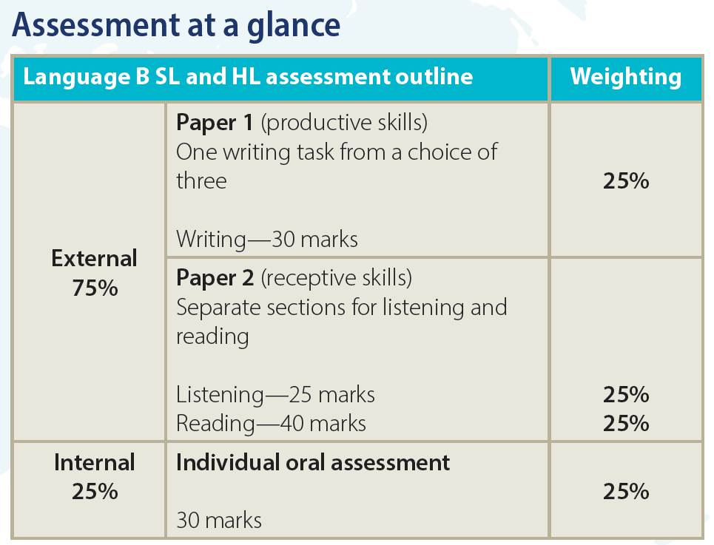
Language Acquisition Course Options
Language B: Spanish
SL or HL
“Language B is a language acquisition course designed for students with some previous experience of the target language. Students further develop their ability to communicate through the study of language, themes and texts. There are five prescribed themes: identities, experiences, human ingenuity, social organization and sharing the planet.”

Slide 18
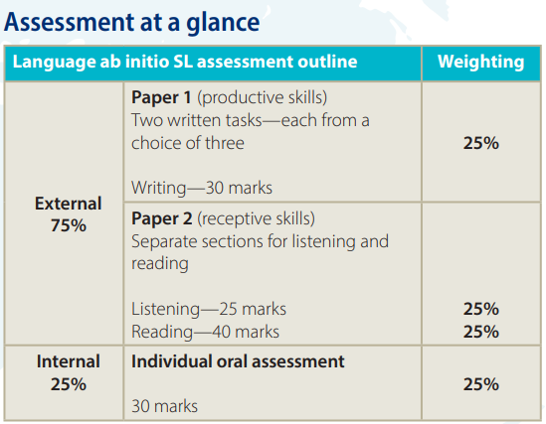
Language Acquisition Course Options
Language ab initio: Spanish
SL or HL
“Offered at SL only, language ab initio is a language acquisition course designed for students with no previous experience in—or very little exposure to—the target language. Language ab initio students develop their receptive, productive and interactive skills while learning to communicate in the target language in familiar and unfamiliar contexts. Students develop the ability to communicate through the study of language, themes and texts. There are five prescribed themes: identities, experiences, human ingenuity, social organization and sharing the planet. While the themes are common to both language ab initio and language B, the language ab initio syllabus additionally prescribes four topics for each of the five themes, for a total of 20 topics that must be addressed over the two years of the course.”

Slide 19
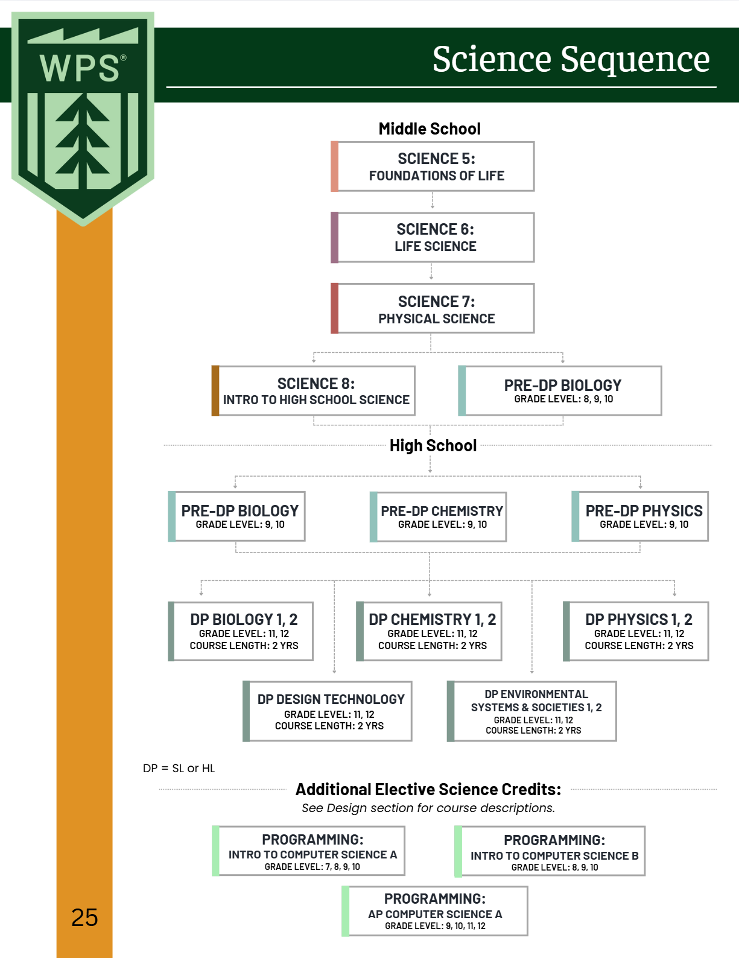
Sciences Course Sequence

Slide 20
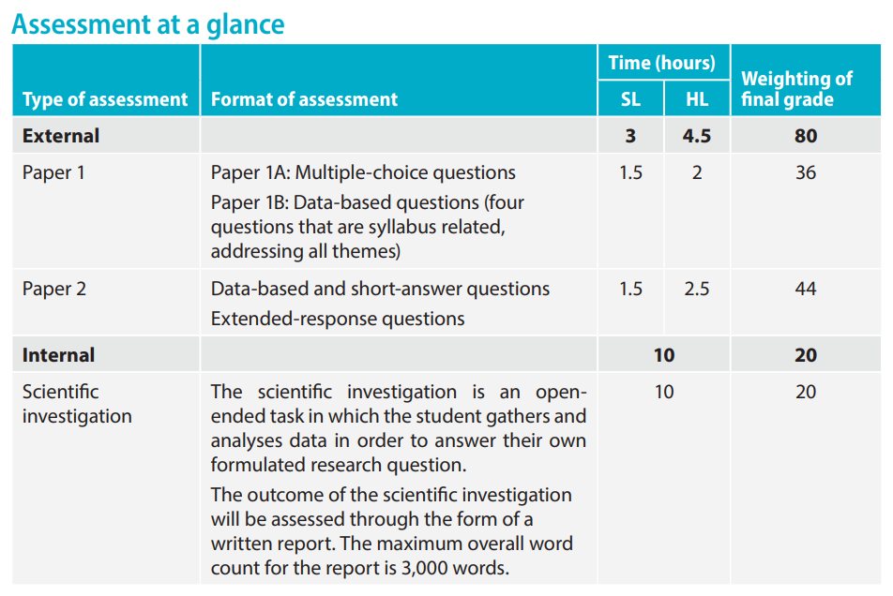
Sciences Course Options
Sciences: Biology
SL or HL
“As one of the three natural sciences in the IB Diploma Programme, biology is primarily concerned with the study of life and living systems. Biologists attempt to make sense of the world through a variety of approaches and techniques, controlled experimentation and collaboration between scientists. At a time of global introspection on human activities and their impact on the world around us, developing and communicating a clear understanding of the living world has never been of greater importance than it is today.”
*Students take the external exams at the end of the course.

Slide 21
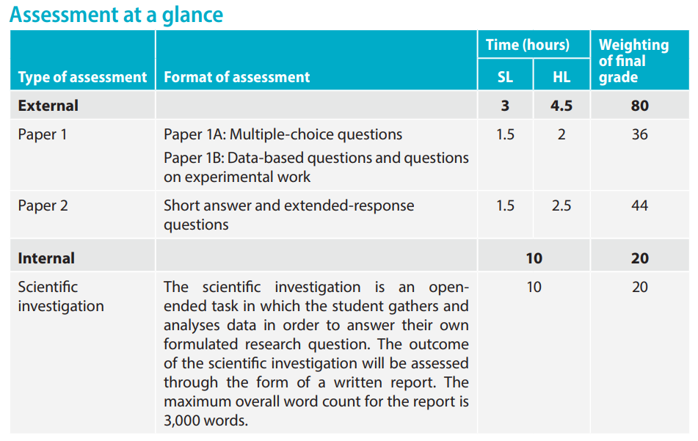
Sciences Course Options
Sciences: Chemistry
SL or HL
“As one of the three natural sciences in the IB Diploma Programme, chemistry is primarily concerned with identifying patterns that help to explain matter at the microscopic level. This then allows matter’s behaviour to be predicted and controlled at a macroscopic level. The subject therefore emphasizes the development of representative models and explanatory theories, both of which rely heavily on creative but rational thinking.”

Slide 22
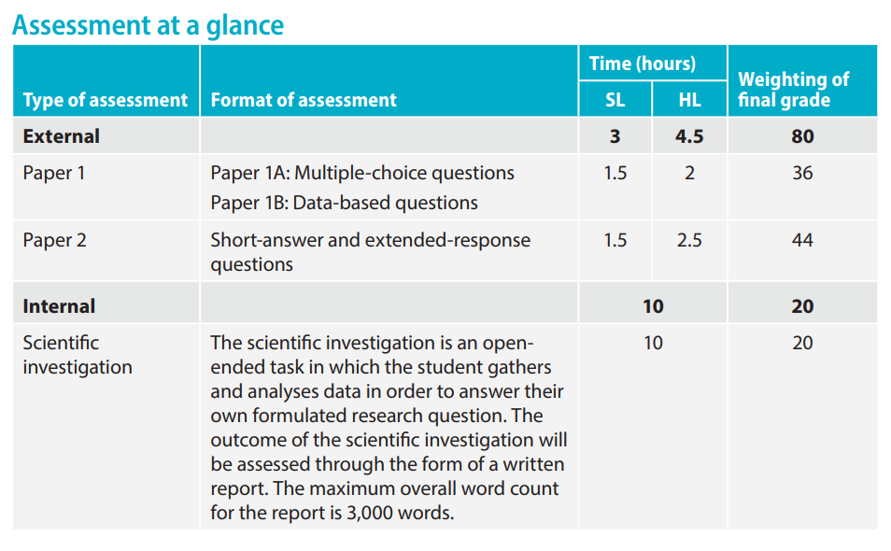
Sciences Course Options
Sciences: Physics
SL or HL
“As one of the three natural sciences in the IB Diploma Programme, physics is concerned with an attempt to understand the natural world; from determining the nature of the atom to finding patterns in the structure of the universe. It is the search for answers from how the universe exploded into life to the nature of time itself. Observations are essential to the very core of the subject. Models are developed to try to understand observations, and these themselves can become theories that attempt to explain the observations. Besides leading to a better understanding of the natural world, physics gives us the ability to alter our environments.”

Slide 23
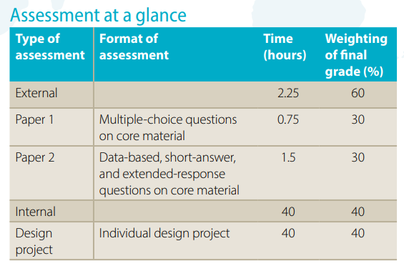
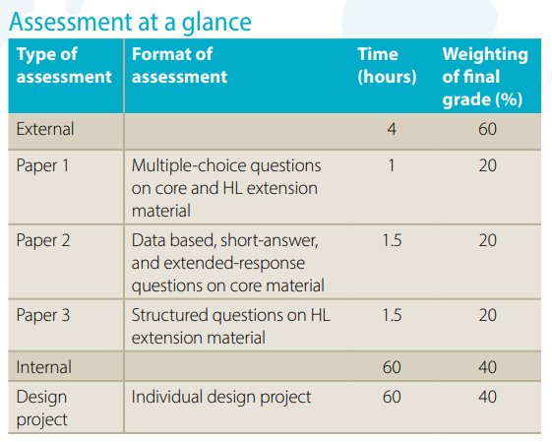
Sciences Course Options
Sciences: Design Technology
SL or HL
“The Diploma Programme design technology course aims to develop internationally minded people whose enhanced understanding of design and the technological world can facilitate our shared guardianship of the planet and create a better world. Inquiry and problem-solving are at the heart of the subject. DP design technology requires the use of the design cycle as a tool, which provides the methodology used to structure the inquiry and analysis of problems, the development of feasible solutions, and the testing and evaluation of the solution. A solution can be defined as a model, prototype, product or system that students have developed independently.”

Slide 24
Sciences Course Options
Sciences: Environmental Systems and Societies
SL or HL
“Environmental systems and societies (ESS) is an interdisciplinary course, encompassing both the sciences and individuals and societies and is offered at both standard level (SL) and higher level (HL)..ESS is both a complex and contemporary course that engages students in the challenges of 21st century environmental issues…Students develop a scientific approach through explorations of environmental systems. They also acquire understandings and methods from individuals and societies subjects whilst studying sustainability issues within social, cultural, economic, political, and ethical contexts…It also emphasizes the ability to perform research and investigations and to participate in philosophical, ethical, and pragmatic discussions of the issues involved from the local through to the global level.”

Slide 25
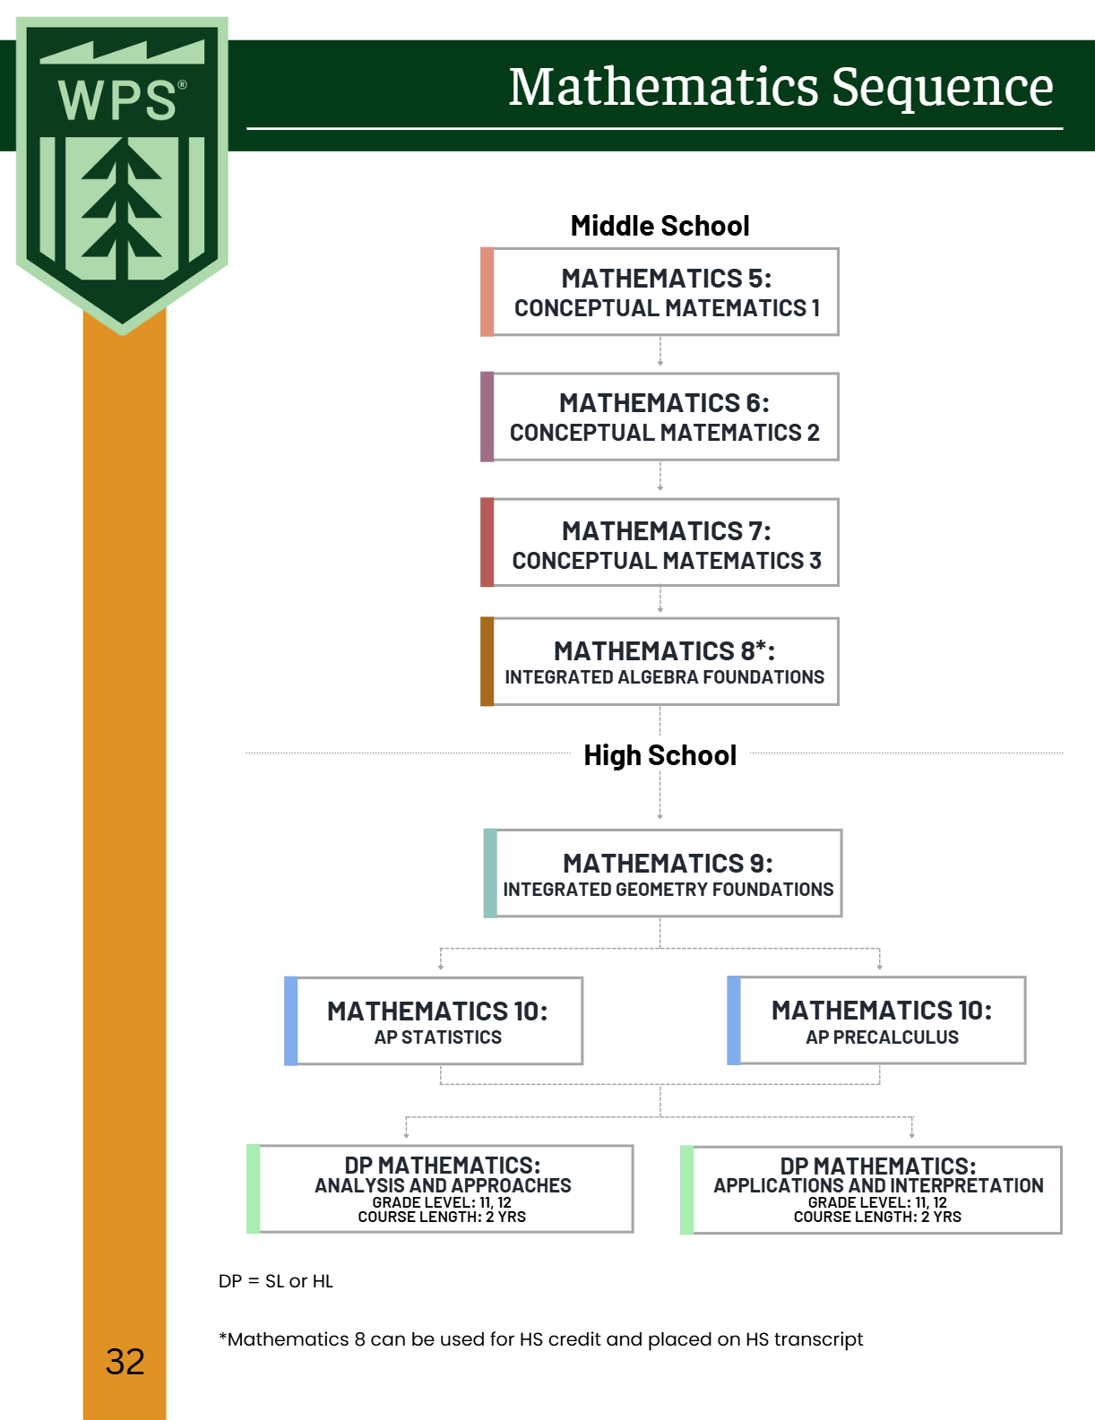
Mathematics Course Sequence

Slide 26
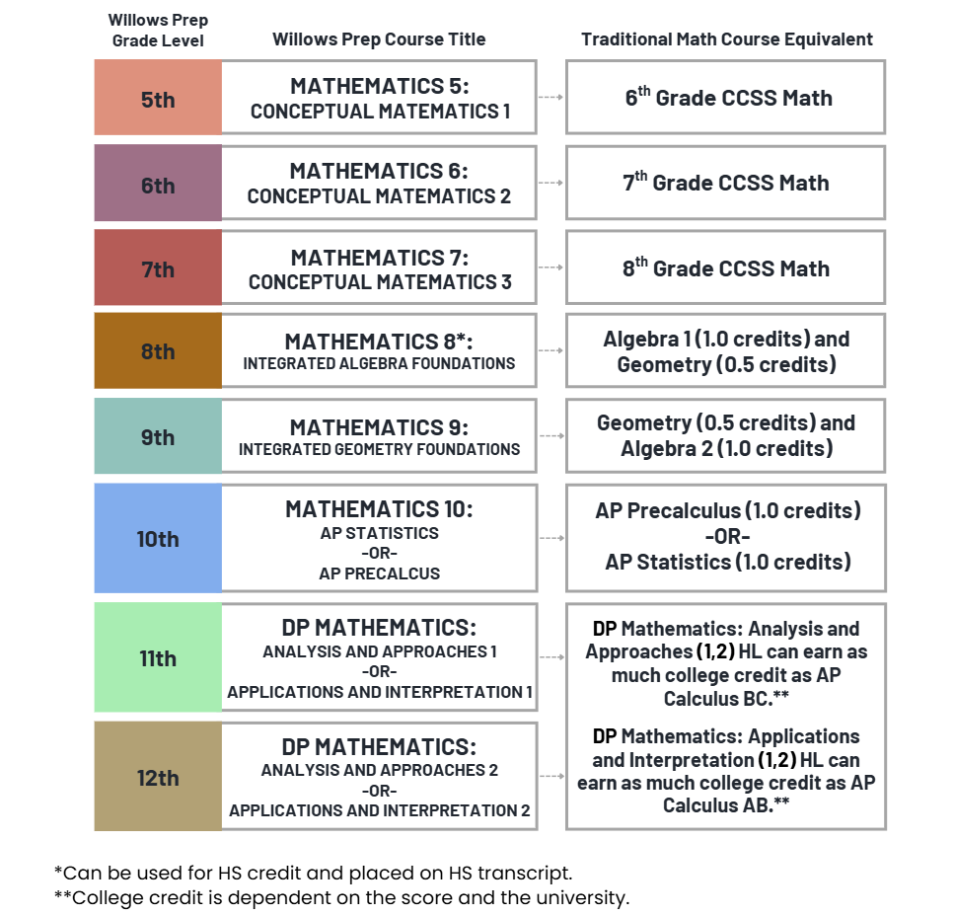
Integrated Mathematics vs Traditional Sequencing

Slide 27
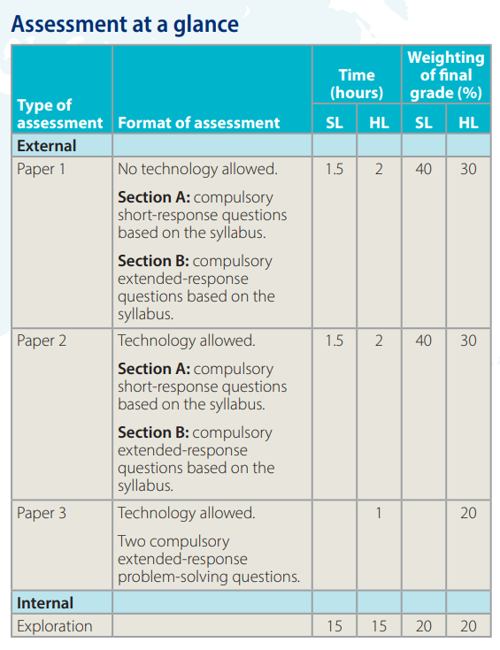
Mathematics Course Options
Mathematics: Analysis and approaches
SL or HL
“The IB DP Mathematics: analysis and approaches course recognizes the need for analytical expertise in a world where innovation is increasingly dependent on a deep understanding of mathematics. The focus is on developing important mathematical concepts in a comprehensible, coherent and rigorous way, achieved by a carefully balanced approach. Students are encouraged to apply their mathematical knowledge to solve abstract problems as well as those set in a variety of meaningful contexts. Mathematics: analysis and approaches has a strong emphasis on the ability to construct, communicate and justify correct mathematical arguments.”

Slide 28
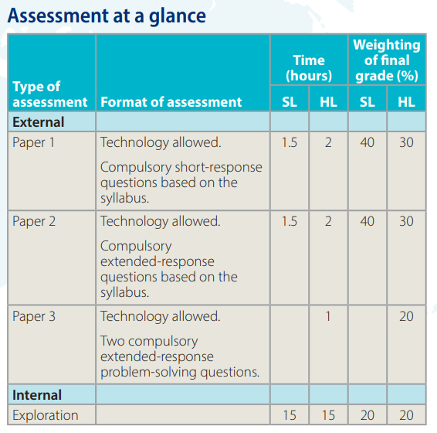
Mathematics Course Options
Mathematics: Applications and interpretation
SL or HL
“The IB DP Mathematics: applications and interpretation course recognizes the increasing role that mathematics and technology play in a diverse range of fields in a data-rich world. As such, it emphasizes the meaning of mathematics in context by focusing on topics that are often used as applications or in mathematical modelling. To give this understanding a firm base, this course includes topics that are traditionally part of a pre-university mathematics course such as calculus and statistics. Students are encouraged to solve real-world problems, construct and communicate this mathematically and interpret the conclusions or generalizations.”

Slide 29
Mathematics Course Options
Analysis & Approaches
Applications & Interpretation

Slide 30
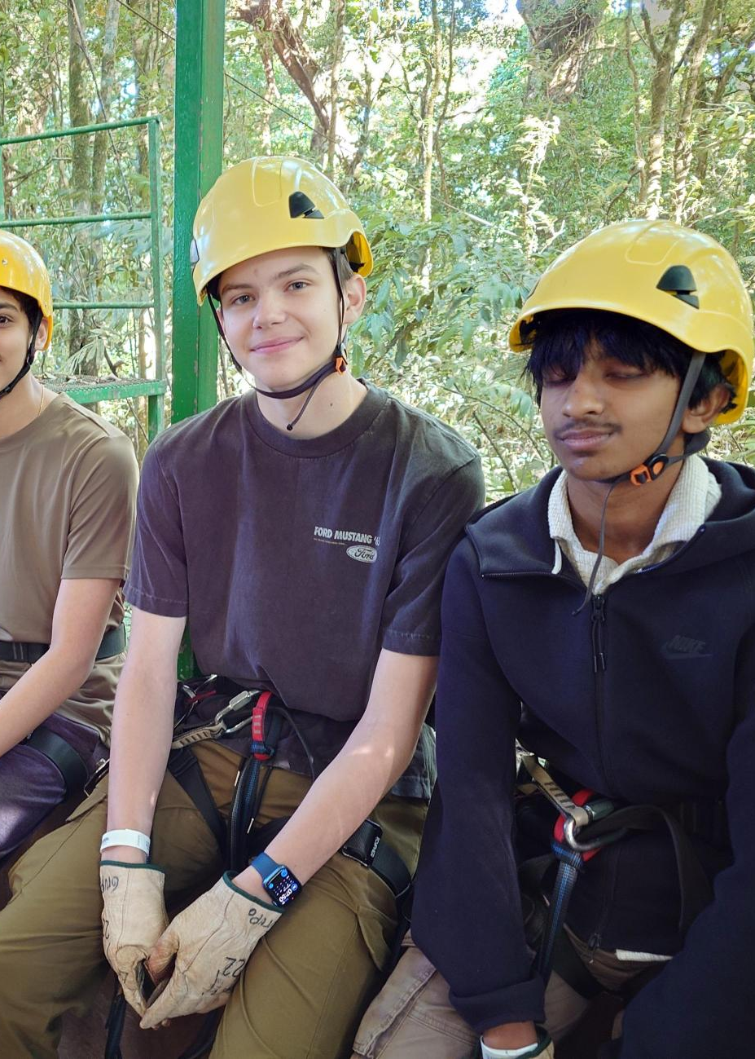
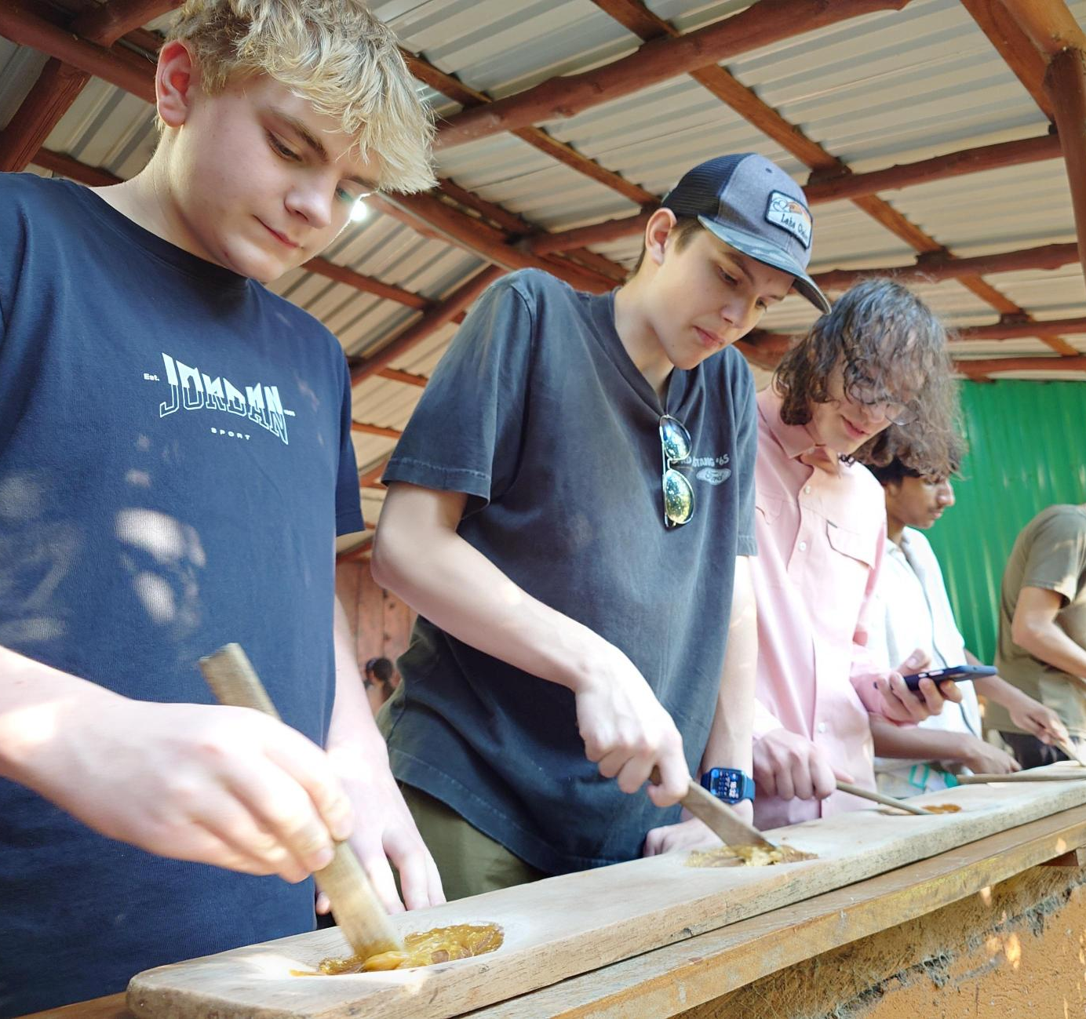
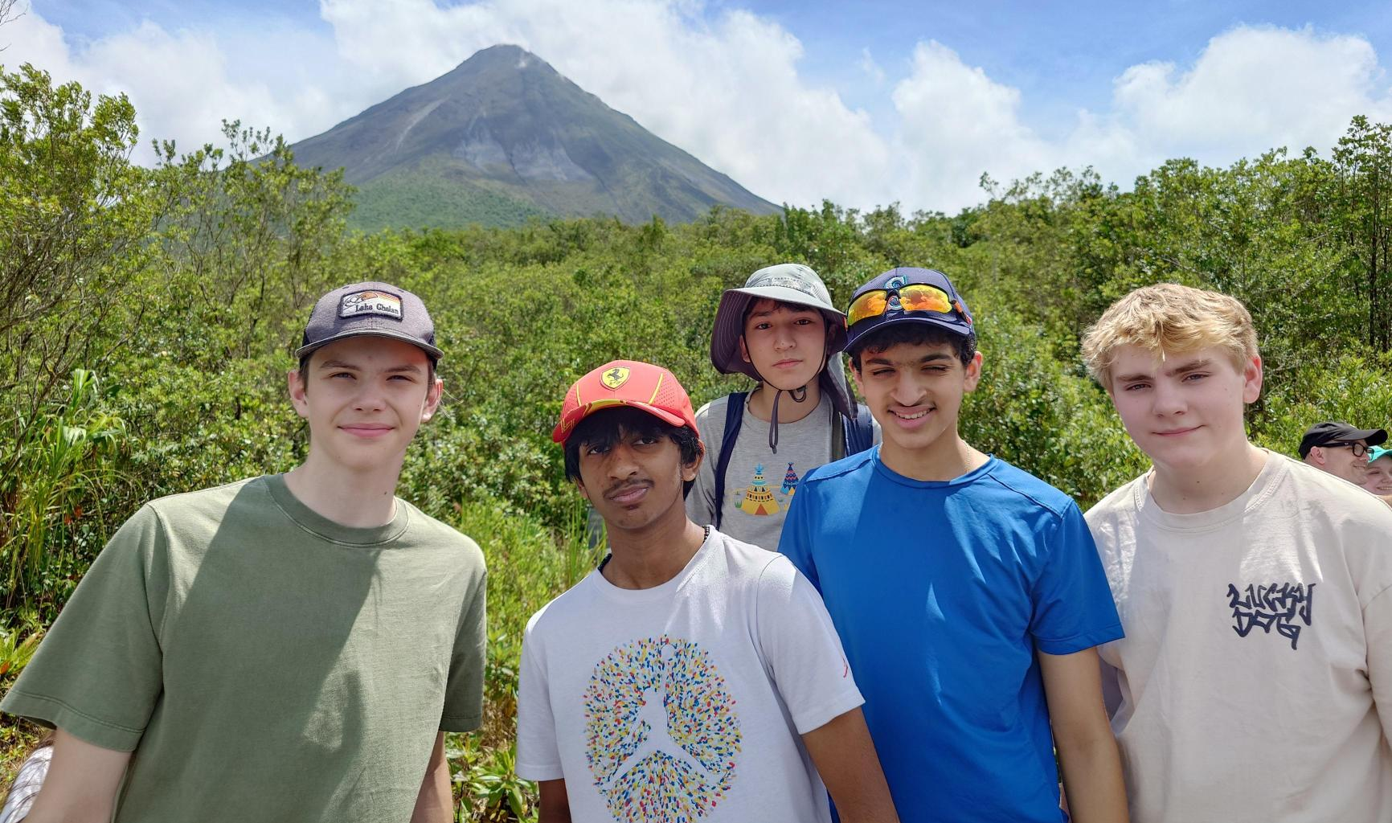
Experiential Education
High School Overnight Trip
Costa Rica

Slide 31
Technology at Willows Prep

Slide 32
Devices 2025-2026
5th and 6th Grade
Lenovo devices
Owned by families but purchased through Willows Prep
Windows Pro
Accidental Warranty - does not include damage through carelessness or play
Managed through Microsoft Intune for policies and software installation
Filtering on-site through the Firewall
Cloud Filtering being deployed for 25-26
Aware Software being deployed for 25-26
7th – 12th Grade
BYOD
Owned by families
Recommended device
Not managed through Microsoft Intune

Slide 33
Student Agreements
Internet Use Agreement
Describes the policies for Internet use.
Student Agreement
Acknowledgement of Filtering software, Aware software, data responsibilities and consequences of device misuse. AI philosophy for school use.
Student Access Contract
Seeking family consent to create accounts for students below the age of 13 in compliance with the COPPA* act.
Students and Families will sign a Student Agreement, an Internet Use Agreement and a Student Access Contract to use technology on the Willows Prep campus.
During the first weeks of school, students will participate in a presentation on device care and responsibilities.
*COPPA – Children’s Online Privacy Protection Rule - prohibits unfair or deceptive acts or practices in connection with the collection, use, and/or disclosure of personal information from and about children on the Internet

Slide 34
Get in touch
Amanda Lawrie-Hall
Director of Technology
Computer help can be found in the Library or the Tech Desk across from the Front Desk
Contact via email at
tech@willowsprep.com

Slide 35
Academic Support Program
At Willows Preparatory School, we are committed to supporting the diverse learning needs of our students in an inclusive and welcoming environment. Our Student Support team partners with students, families, and faculty to provide guidance on learning differences, executive functioning, testing and classroom accommodations. We offer flexible levels of support to meet individual needs—ranging from daily structured executive functioning and study skills classes to weekly check-ins and coaching, and to as-needed consultations. These supports are offered by quarter or semester. We believe every student learns differently and strive to create a community where a variety of strengths and approaches are recognized and supported.
Notes:
Whether you child has had a 504 plan, IEP, or a formal diagnosis, or has none of the above, but would benefit from direct instruction in executive functioning skills, this program is for them.
The Director of Student Support serves as a key advocate for students, helping them navigate their learning accommodations and effectively communicate with their teachers. They act as the connection between students, families, and teachers. By working closely with classroom teachers, she stays informed about assignment expectations and help ensure that each student's unique learning profile is understood and supported. They also maintain regular communication with parents to provide updates on assignment completion, academic progress, and overall support needs.

Slide 36
Academic Support Program
Who does this program benefit?
Students who enroll in the Academic Support Program offerings benefit from consistent, individualized support, in one or more of the following areas, including:
Organization and planning (e.g., consistently losing materials, trouble breaking tasks into steps)
Time and task management (e.g., procrastinating, underestimating how long tasks take, frequently missing deadlines)
Task Initiation (e.g., knowing what needs to be done but unable to get started)
Attention and Focus (e.g., easily distracted, difficulty sustaining focus on non-preferred tasks)
Managing the demands of a rigorous academic environment beyond the support typically available in a traditional classroom setting
Self-monitoring

Slide 37
Daily Elective Course
Daily Class – elective course credit
Develop self-awareness of strengths and challenges in executive functioning.
Strategies for Success
Build practical skills in organization, task initiation, task prioritization, ask and assignment breakdown, time management, goal setting, and self-regulation, etc.
students are learning to apply these skills to their existing coursework from their content area classes
Organization and materials management of current course load.
Notes:
Students work on goals based on their own specific learning profile. Additionally, the group setting allows them to work collaboratively on similar assignments or learn different strategies from peers. Initial emphasis is on developing habits for tracking assignments, time management, willingness to ask for and accept help, and metacognition. Once students have established regular habits around turning assignments in on time, higher order study skills are introduced. Rather than a separate study skills curriculum (e.g. stand-alone unit on note taking or mnemonic memory strategies), students are learning to apply these skills to their existing coursework from their content area classes. While the teacher can help support students in their content area classes, the class does not provide basic skill remediation, and teachers are not necessarily content area specialists across subjects.
The teacher serves as a key advocate for students, helping them navigate their learning accommodations and effectively communicate with their teachers. They often act as the connection between students, families, and teachers. By working closely with classroom teachers, the strategies for success teacher stays informed about assignment expectations and help ensure that each student's unique learning profile is understood and supported. They also maintain regular communication with parents to provide updates on assignment completion, academic progress, and overall support needs.

Slide 38
Weekly Student Check-in
Weekly 1:1 Meeting (~20 minutes)
Academic Organization – equip students with tools to manage assignments and deadlines
Personalized guidance – address unique needs or concerns students may have regarding their coursework
Skill development – foster self-advocacy, time management, and problem-solving skills.
Accountability – encourage students to take ownership of their learning by tracking their progress.
Build trust and rapport to create a safe space for academic growth and open communication.
Notes:
Weekly check-ins are designed to provide targeted, individualized support for your student through regular, structured meetings with students, ensuring they stay on track with their academic responsibilities and feel supported in their learning journey.
Grade and Assignment Tracking
Review grades and progress in all classes.
Identify missing assignments or upcoming deadlines.
Help prioritize tasks and develop action plans for success.
1:1 Support
Provide a dedicated space to discuss challenges or concerns.
Share resources and strategies for academic improvement.
Celebrate successes to promote motivation and confidence.
The teacher serves as a key advocate for students, helping them navigate their learning accommodations and effectively communicate with their teachers. They often act as the connection between students, families, and teachers. By working closely with classroom teachers, the strategies for success teacher stays informed about assignment expectations and help ensure that each student's unique learning profile is understood and supported. They also maintain regular communication with parents to provide updates on assignment completion, academic progress, and overall support needs.

Slide 39
Social Skills Group
Foundational Social Skills
Starting conversations
Active Listening
Non-verbal communication
Expressing feelings
Giving and receiving compliments
Peer interactions
Building Relationships
Making and keeping friends
Conflict resolution
Empathy and perspective-taking
Managing emotions
Anxiety in social situations
Managing frustration or anger
Navigating peer pressure
Self-advocacy
Groups meet once a week during Lunch and/or Recess
(25-45 minutes)

Slide 40
After School Support
Introduce organizational tools (planners, digital apps like Google Calendar, task lists).
Practice setting up a planner or digital calendar with upcoming tasks and due dates.
Practice routine skills of checking grades, assignments.
Assignment tracking & prioritization
Homework support
1-3x A Week
Mon, Tue - 3:30-4:30pm
Wed – 2:30-3:30pm

Slide 41
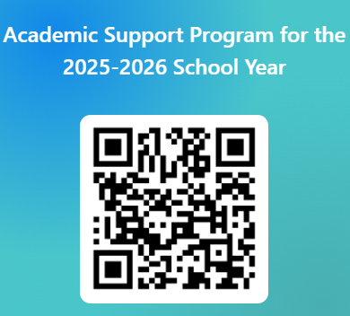
The offerings within the Academic Support Program are fee-based opportunities. Please indicate your interest using the QR code (right) or e-mail (below) and the Director of Student Support will contact you to answer questions and determine if the option(s) is right for your child before finalizing enrollment.
Caitlin Bank
cbank@willowsprep.com
https://forms.office.com/r/wA3Q0ETgYc

Slide 42
