Slide 1
Spring Curriculum Night 2025
Rising 6th Grade

Slide 2
Devices 2025-2026
5th and 6th Grade
Lenovo devices
Owned by families but purchased through Willows Prep
Windows Pro
Accidental Warranty - does not include damage through carelessness or play
Managed through Microsoft Intune for policies and software installation
Filtering on-site through the Firewall
Cloud Filtering being deployed for 25-26
Aware Software being deployed for 25-26
7th – 12th Grade
BYOD
Owned by families
Recommended device
Not managed through Microsoft Intune

Slide 3
Student Agreements
Internet Use Agreement
Describes the policies for Internet use.
Student Agreement
Acknowledgement of Filtering software, Aware software, data responsibilities and consequences of device misuse. AI philosophy for school use.
Student Access Contract
Seeking family consent to create accounts for students below the age of 13 in compliance with the COPPA* act.
Students and Families will sign a Student Agreement, an Internet Use Agreement and a Student Access Contract to use technology on the Willows Prep campus.
During the first weeks of school, students will participate in a presentation on device care and responsibilities.
*COPPA – Children’s Online Privacy Protection Rule - prohibits unfair or deceptive acts or practices in connection with the collection, use, and/or disclosure of personal information from and about children on the Internet

Slide 4
Get in touch
Amanda Lawrie-Hall
Director of Technology
Computer help can be found in the Library or the Tech Desk across from the Front Desk
Contact via email at
tech@willowsprep.com

Slide 5
Overview of 6th Grade Curriculum

Slide 6
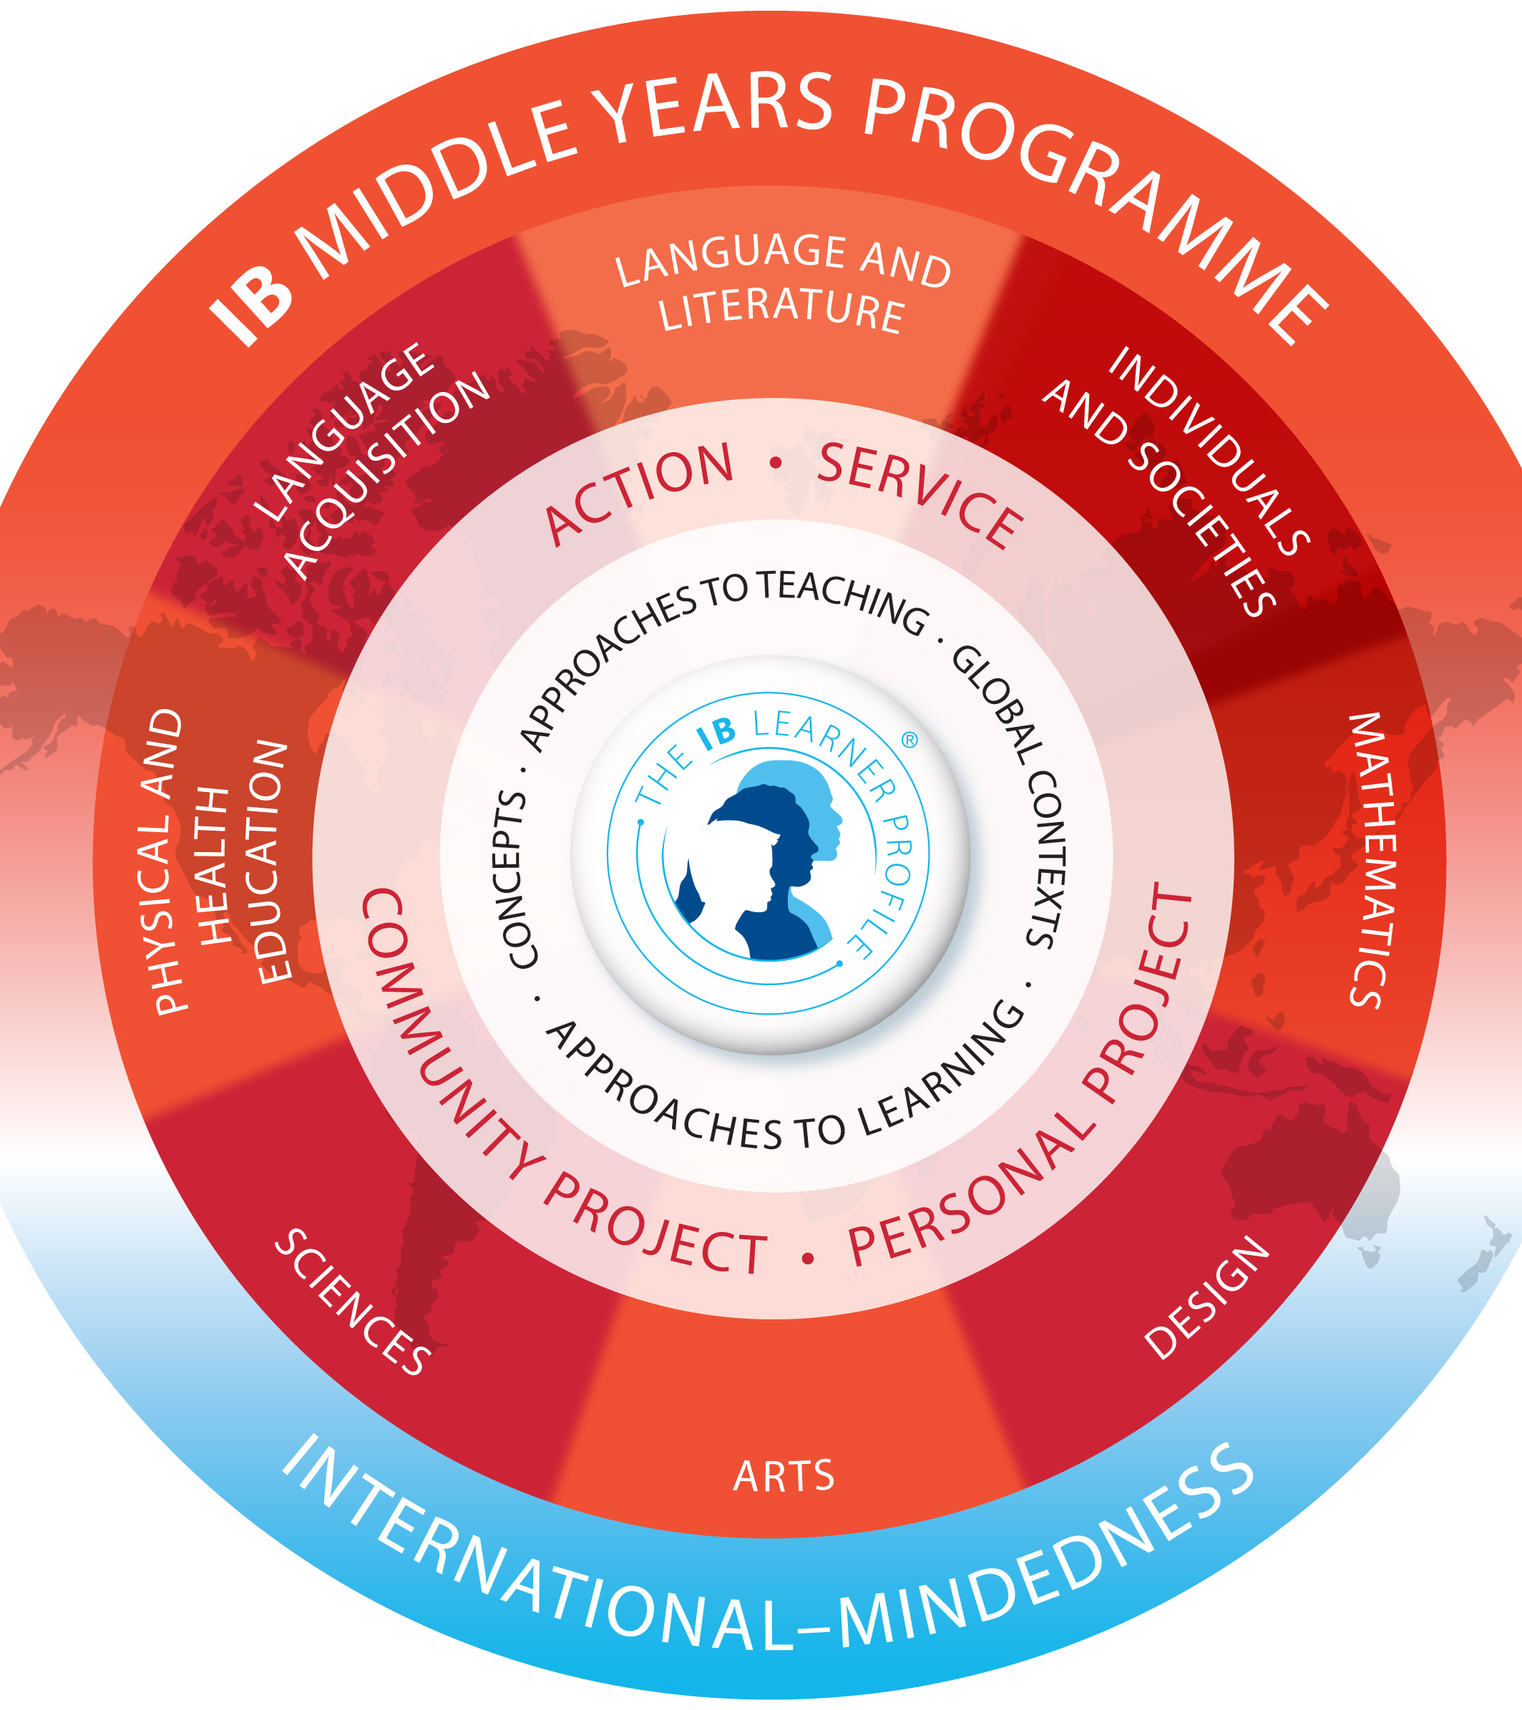
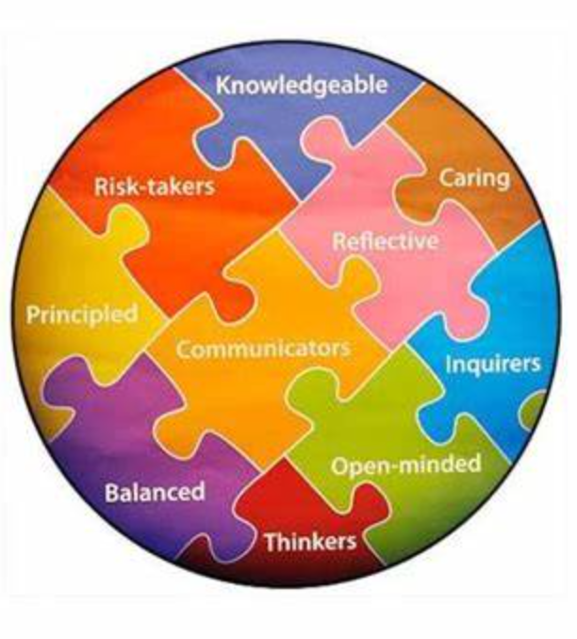
Willows Prep and the IB

Slide 7
IB Middle Years Program
IB Diploma
Program
Lower Middle School
5th Grade
6th Grade
Upper Middle School
7th Grade
8th Grade
Pre-DP High School
9th Grade
10th Grade
DP High School
11th Grade
12th Grade
The Student Academic Experience

Slide 8
Language & Literature

Slide 9
Language & Literature
Course Description

Slide 10
Language & Literature Sample Textbooks
Chengli and the Silk Road Caravan
The Egypt Game
The Inquisitor’s Tale
Hildi Kang
Approximate Cost: $10
Zilpha Keatley Snyder
Approximate Cost: $8
Adam Gidwitz
Approximate Cost: $9

Slide 11
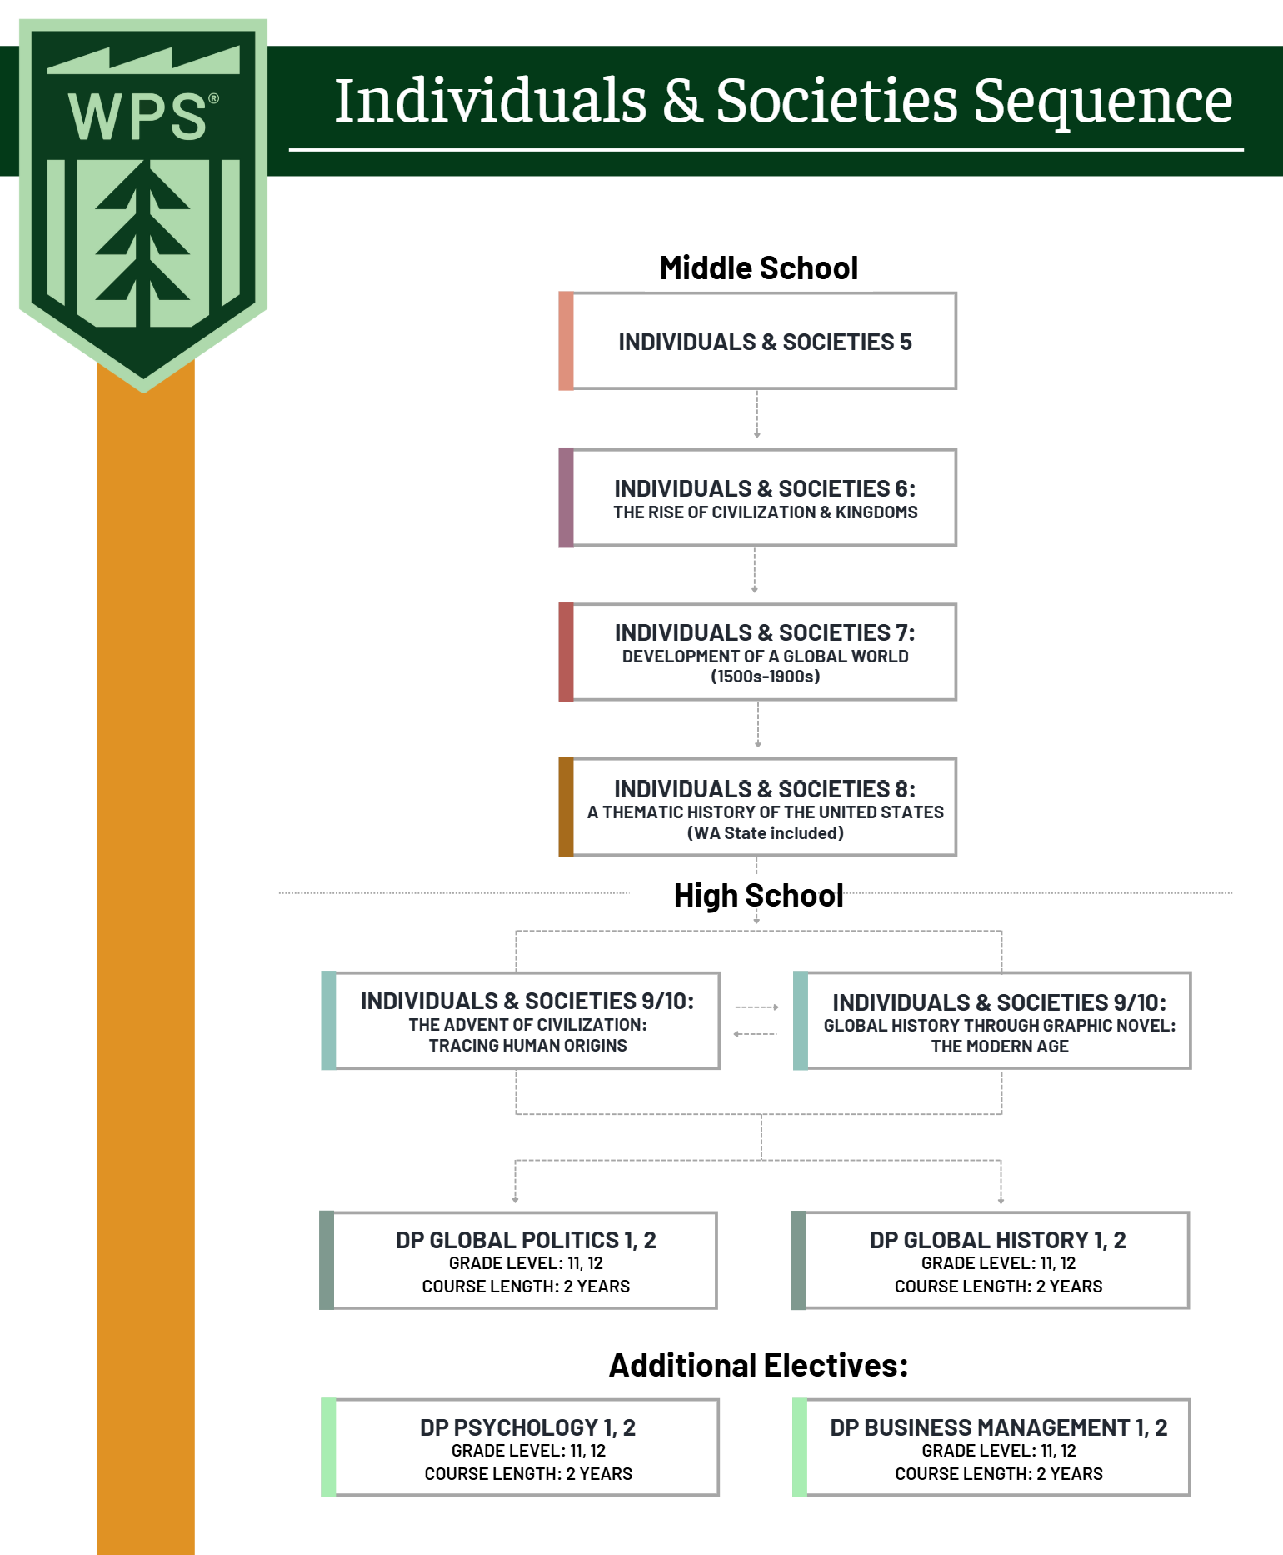
Individuals & Societies Course Sequence

Slide 12
Individuals & Societies
Course Sequence

Slide 13
Individuals & Societies Textbook
The Verge: Reformation, Renaissance, and the Forty Years That Shook The World
Patrick Wyman
Approximate Cost: $20

Slide 14
Language Acquisition

Slide 15
Language Acquisition
Course Description

Slide 16
Language Acquisition Textbooks
Reporteros 1A + 12-Month Online Access
Reporteros 1B Workbook
Klett World Languages
Approximate Cost: $90
Klett World Languages
Approximate Cost: $20

Slide 17
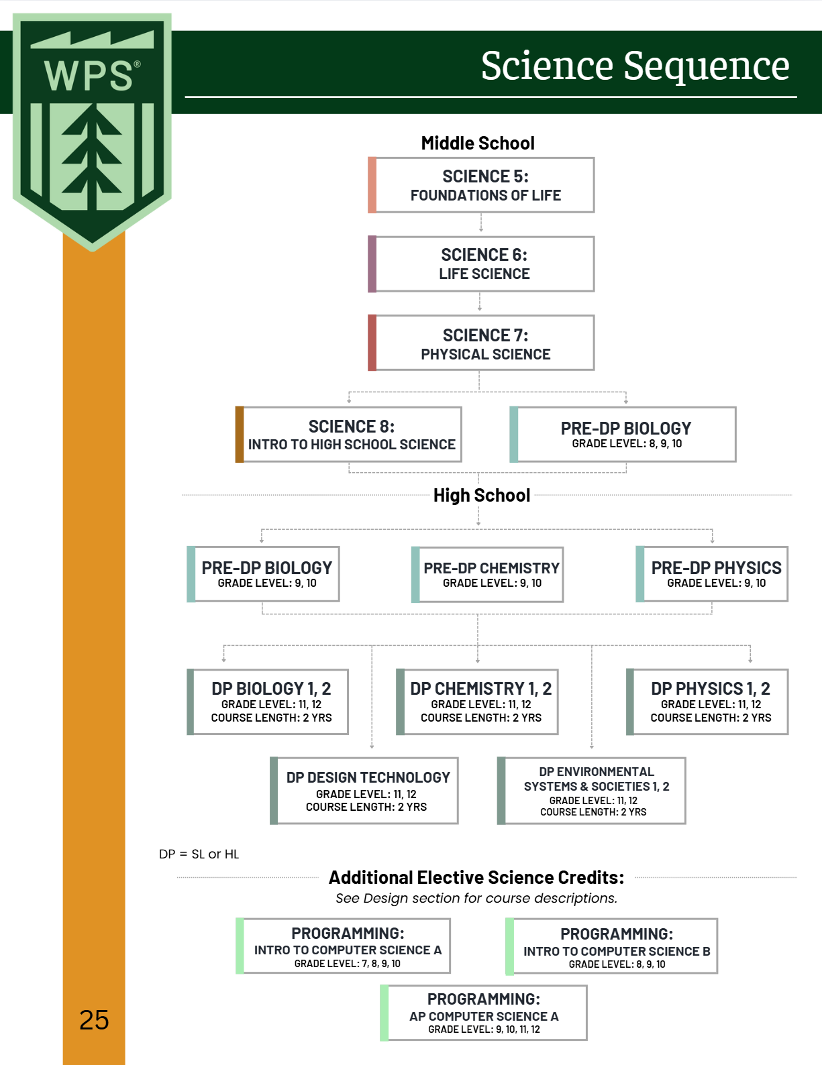
Sciences Course Sequence

Slide 18
Science
Course Description

Slide 19
Science Textbooks
MYP Life Sciences
MYP Physical and Earth Sciences
Andrew Allot
Approximate Cost: $55
Gary Horner
Approximate Cost: $45

Slide 20
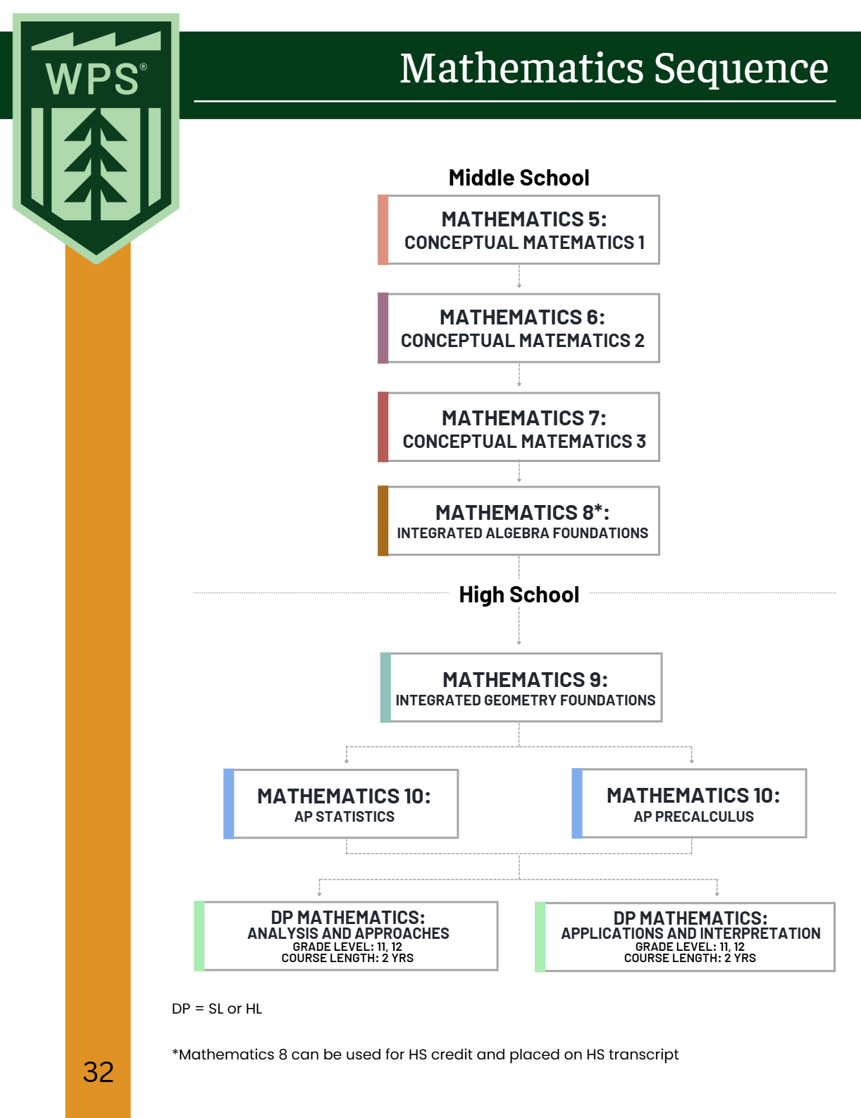
Mathematics Course Sequence

Slide 21
Mathematics
Course Description

Slide 22
Mathematics Textbook
MYP Mathematics Year 2
Marlene Torres-Skoumal, Rose Harrison, Clara Huizink, Aidan Sproat
Approximate Cost: $50

Slide 23
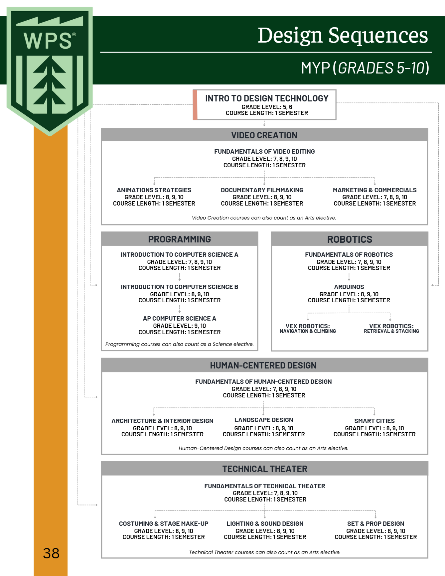
Design Technology Course Sequence

Slide 24
Design Technology
Course Description

Slide 25
Visual & Performing Arts

Slide 26
Performing Arts
Course Description

Slide 27
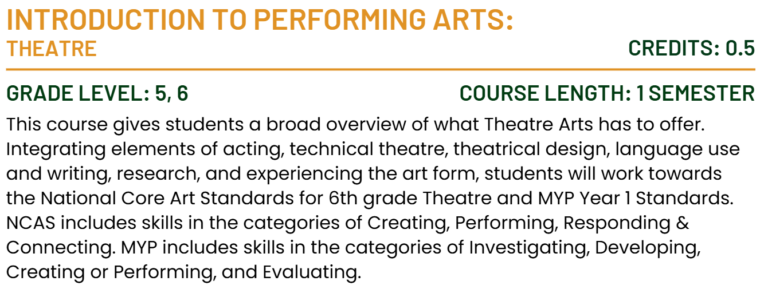
Performing Arts
Course Description

Slide 28
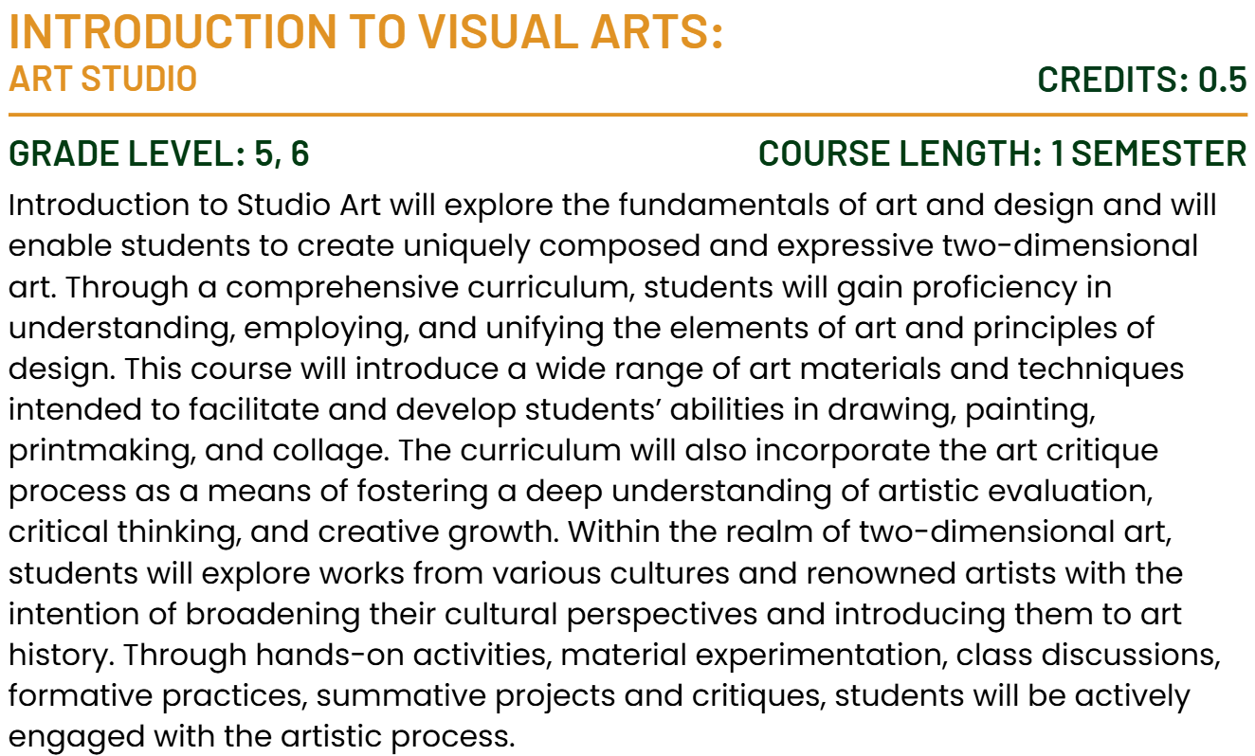
Visual Arts
Course Description

Slide 29
Physical and Health Education

Slide 30
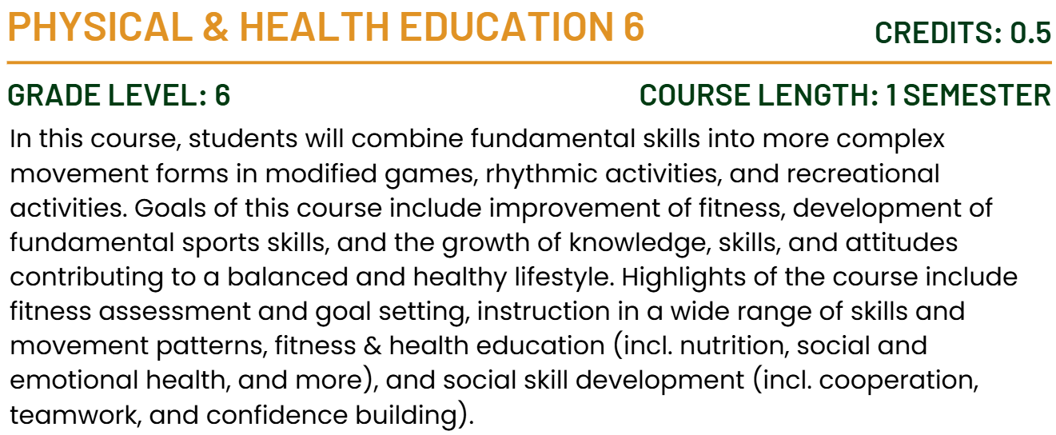
Physical & Health Education
Course Description

Slide 31
Skills for Learning & Inquiry
Course Description

Slide 32
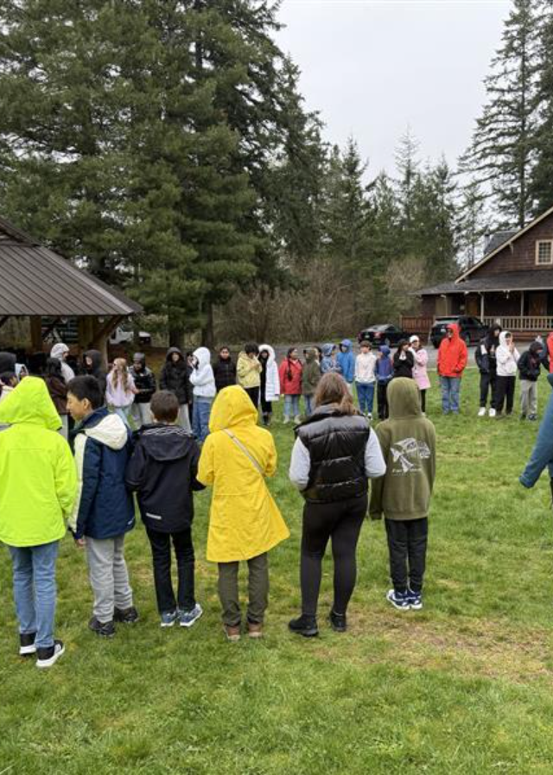
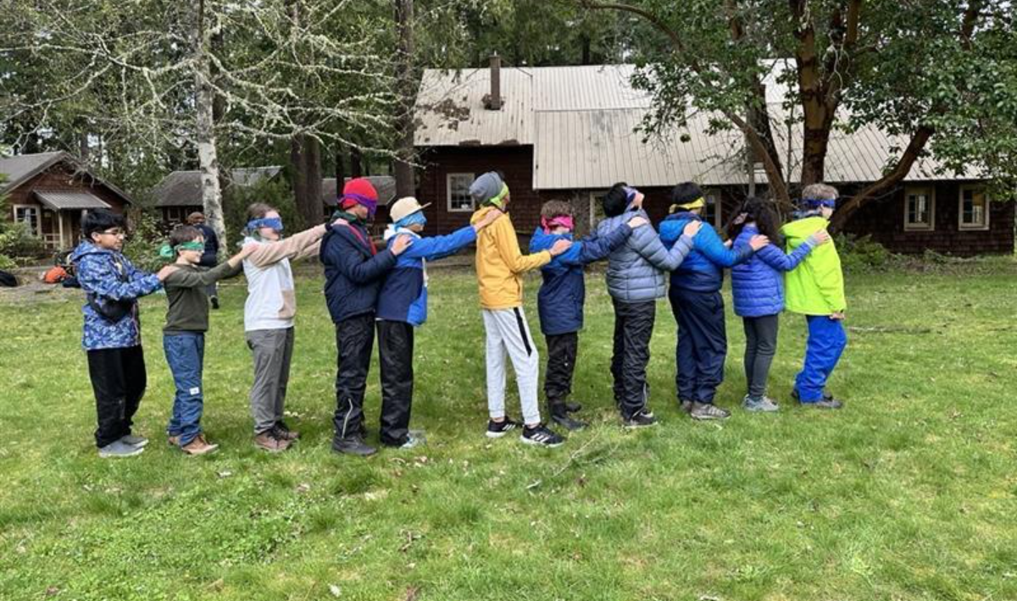
Experiential Education
6th Grade Overnight Trip
Mount Rainier Institute

Slide 33
Academic Support Program
Who does this program benefit?
Students who enroll in the Academic Support Program offerings benefit from consistent, individualized support, in one or more of the following areas, including:
Organization and planning (e.g., consistently losing materials, trouble breaking tasks into steps)
Time and task management (e.g., procrastinating, underestimating how long tasks take, frequently missing deadlines)
Task Initiation (e.g., knowing what needs to be done but unable to get started)
Attention and Focus (e.g., easily distracted, difficulty sustaining focus on non-preferred tasks)
Managing the demands of a rigorous academic environment beyond the support typically available in a traditional classroom setting
Self-monitoring

Slide 34
Daily Elective Course
Daily Class – elective course credit
Develop self-awareness of strengths and challenges in executive functioning.
Strategies for Success
Build practical skills in organization, task initiation, task prioritization, ask and assignment breakdown, time management, goal setting, and self-regulation, etc.
students are learning to apply these skills to their existing coursework from their content area classes
Organization and materials management of current course load.
Notes:
Students work on goals based on their own specific learning profile. Additionally, the group setting allows them to work collaboratively on similar assignments or learn different strategies from peers. Initial emphasis is on developing habits for tracking assignments, time management, willingness to ask for and accept help, and metacognition. Once students have established regular habits around turning assignments in on time, higher order study skills are introduced. Rather than a separate study skills curriculum (e.g. stand-alone unit on note taking or mnemonic memory strategies), students are learning to apply these skills to their existing coursework from their content area classes. While the teacher can help support students in their content area classes, the class does not provide basic skill remediation, and teachers are not necessarily content area specialists across subjects.
The teacher serves as a key advocate for students, helping them navigate their learning accommodations and effectively communicate with their teachers. They often act as the connection between students, families, and teachers. By working closely with classroom teachers, the strategies for success teacher stays informed about assignment expectations and help ensure that each student's unique learning profile is understood and supported. They also maintain regular communication with parents to provide updates on assignment completion, academic progress, and overall support needs.

Slide 35
Weekly Student Check-in
Weekly 1:1 Meeting (~20 minutes)
Academic Organization – equip students with tools to manage assignments and deadlines
Personalized guidance – address unique needs or concerns students may have regarding their coursework
Skill development – foster self-advocacy, time management, and problem-solving skills.
Accountability – encourage students to take ownership of their learning by tracking their progress.
Build trust and rapport to create a safe space for academic growth and open communication.
Notes:
Weekly check-ins are designed to provide targeted, individualized support for your student through regular, structured meetings with students, ensuring they stay on track with their academic responsibilities and feel supported in their learning journey.
Grade and Assignment Tracking
Review grades and progress in all classes.
Identify missing assignments or upcoming deadlines.
Help prioritize tasks and develop action plans for success.
1:1 Support
Provide a dedicated space to discuss challenges or concerns.
Share resources and strategies for academic improvement.
Celebrate successes to promote motivation and confidence.
The teacher serves as a key advocate for students, helping them navigate their learning accommodations and effectively communicate with their teachers. They often act as the connection between students, families, and teachers. By working closely with classroom teachers, the strategies for success teacher stays informed about assignment expectations and help ensure that each student's unique learning profile is understood and supported. They also maintain regular communication with parents to provide updates on assignment completion, academic progress, and overall support needs.

Slide 36
Social Skills Group
Foundational Social Skills
Starting conversations
Active Listening
Non-verbal communication
Expressing feelings
Giving and receiving compliments
Peer interactions
Building Relationships
Making and keeping friends
Conflict resolution
Empathy and perspective-taking
Managing emotions
Anxiety in social situations
Managing frustration or anger
Navigating peer pressure
Self-advocacy
Groups meet once a week during Lunch and/or Recess
(25-45 minutes)

Slide 37
After School Support
Introduce organizational tools (planners, digital apps like Google Calendar, task lists).
Practice setting up a planner or digital calendar with upcoming tasks and due dates.
Practice routine skills of checking grades, assignments.
Assignment tracking & prioritization
Homework support
1-3x A Week
Mon, Tue - 3:30-4:30pm
Wed – 2:30-3:30pm

Slide 38
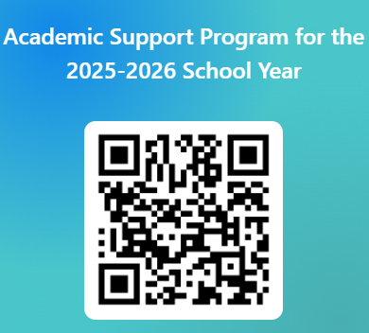
The offerings within the Academic Support Program are fee-based opportunities. Please indicate your interest using the QR code (right) or e-mail (below) and the Director of Student Support will contact you to answer questions and determine if the option(s) is right for your child before finalizing enrollment.
Caitlin Bank
cbank@willowsprep.com
https://forms.office.com/r/wA3Q0ETgYc

