Slide 1
Overview of 8th Grade Curriculum

Slide 2
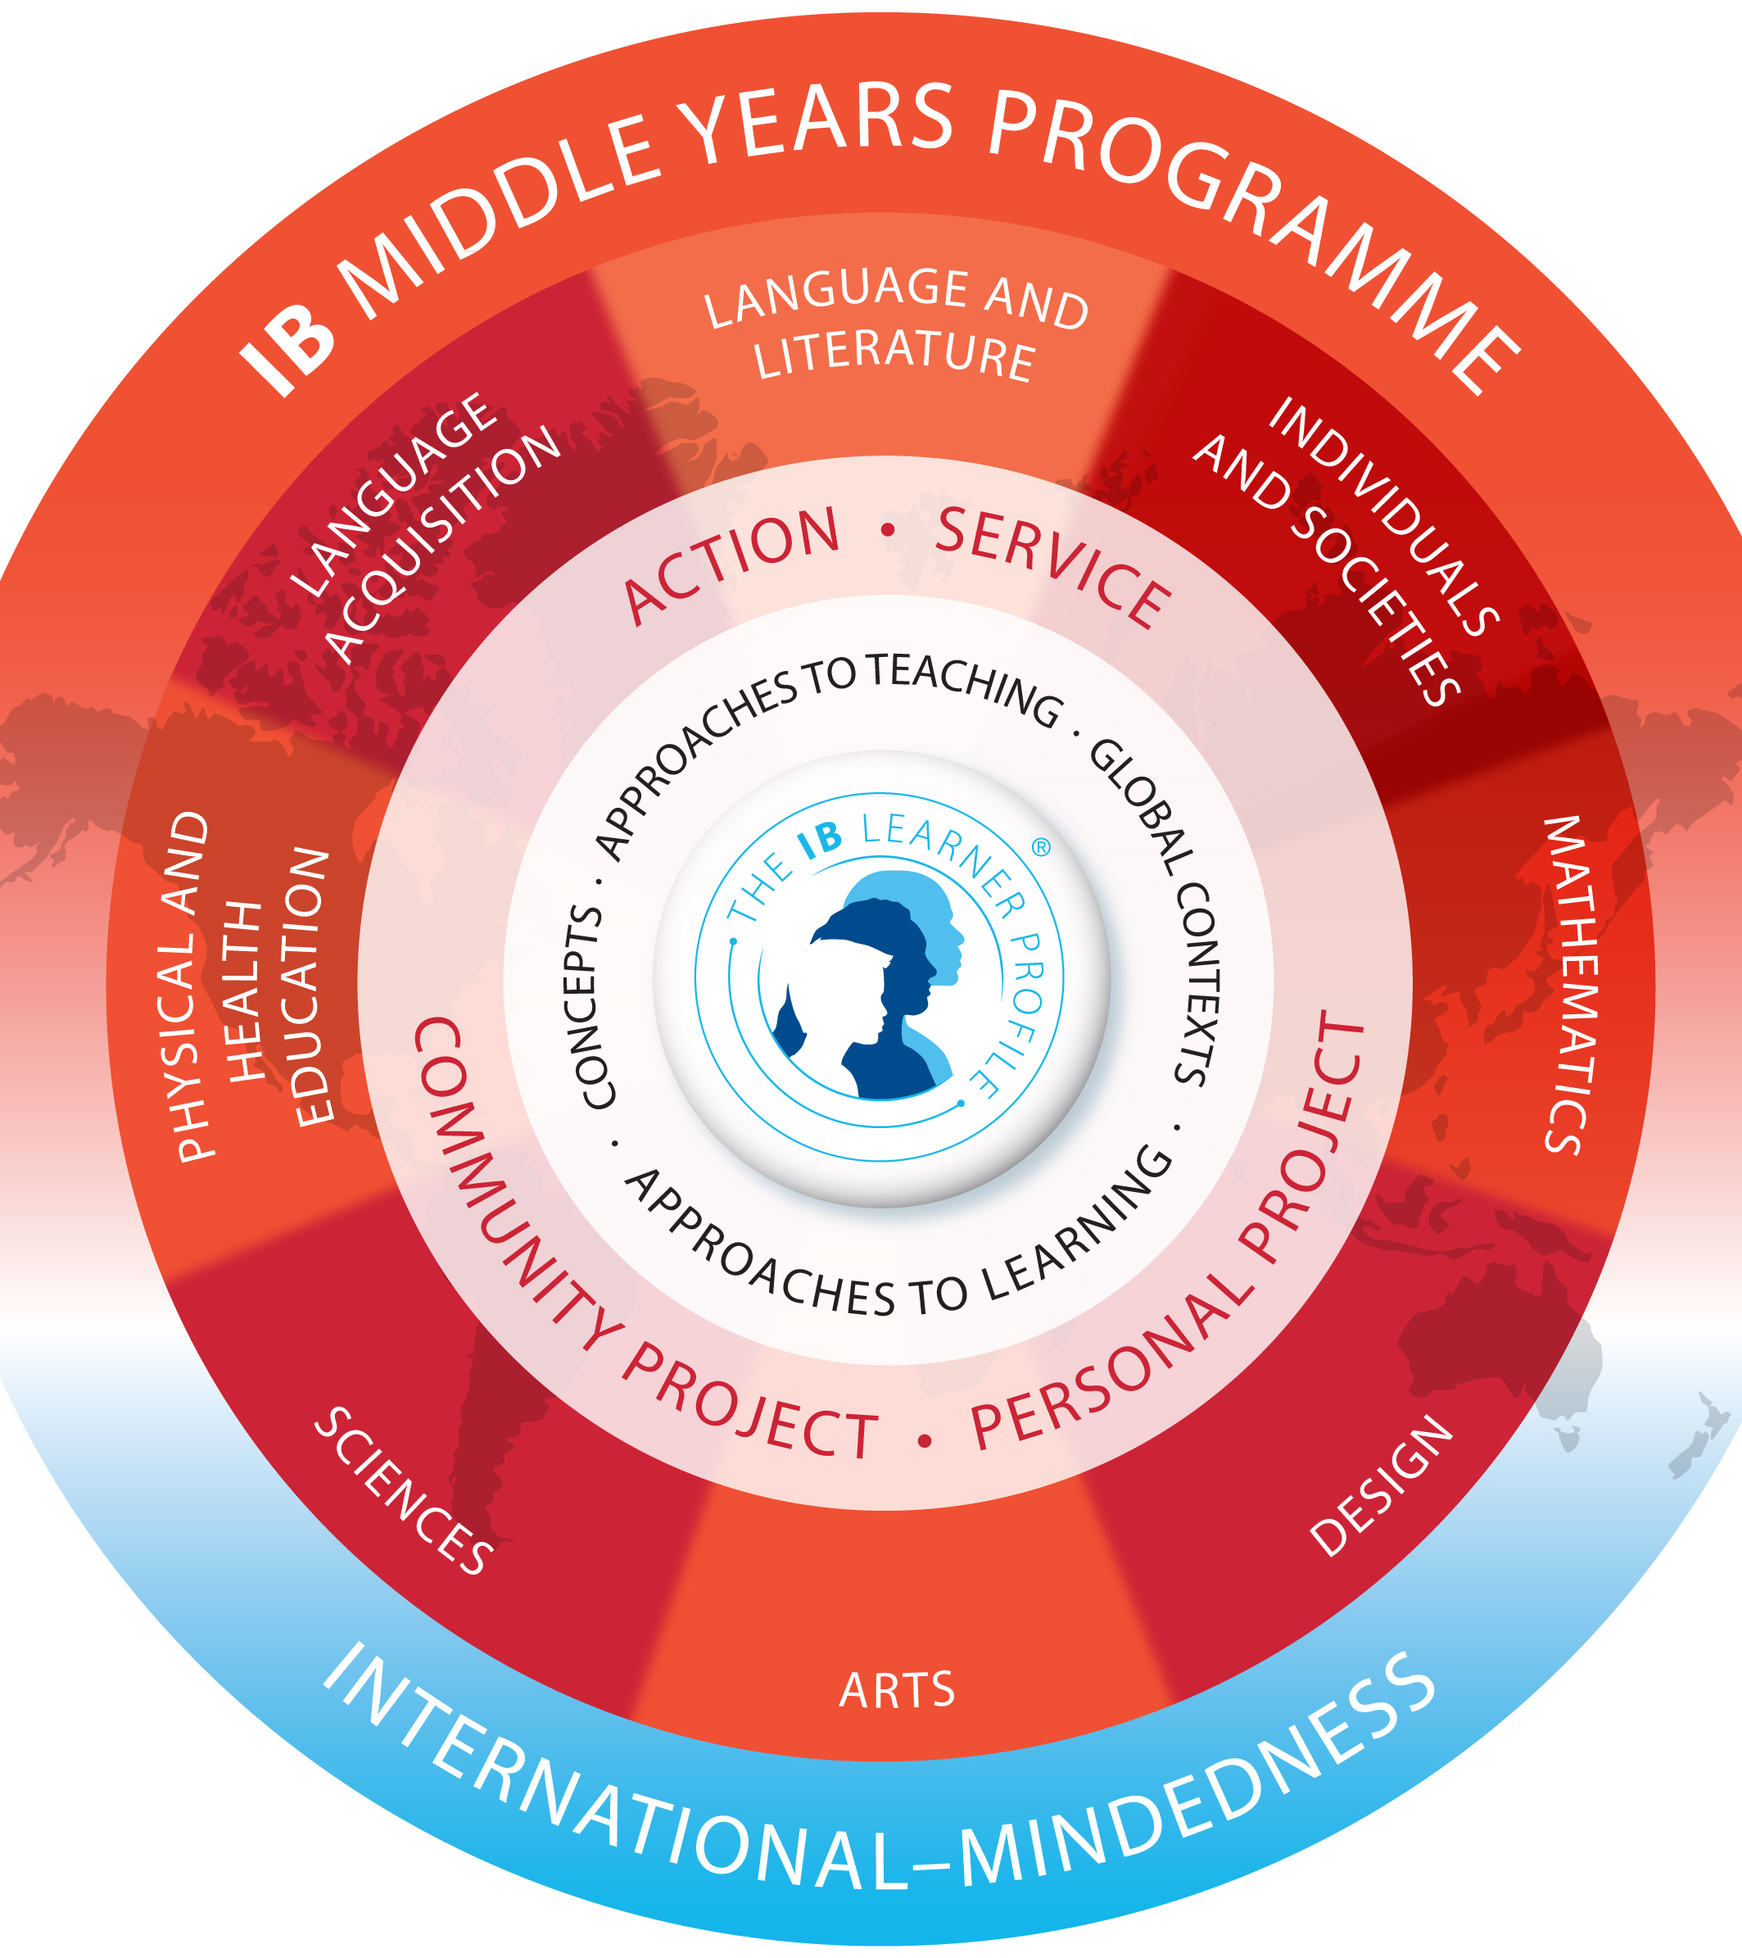
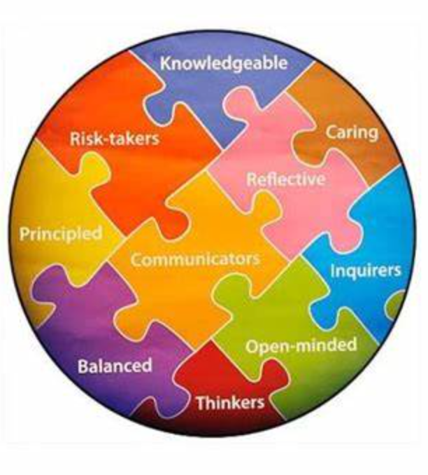
Willows Prep and the IB

Slide 3
IB Middle Years Program
IB Diploma
Program
Lower Middle School
5th Grade
6th Grade
Upper Middle School
7th Grade
8th Grade
Pre-DP High School
9th Grade
10th Grade
DP High School
11th Grade
12th Grade
The Student Academic Experience

Slide 4
Language & Literature

Slide 5
Language & Literature
Course Description

Slide 6
Language & Literature Sample Textbooks
The House on Mango Street
The Distance Between Us
All American Boys
Animal Farm
Sandra Cisneros
Approximate Cost: $8
Reyna Grande
Approximate Cost: $8
Jason Reynolds, Brendan Kiely
Approximate Cost: $9
George Orwell
Approximate Cost: $6

Slide 7
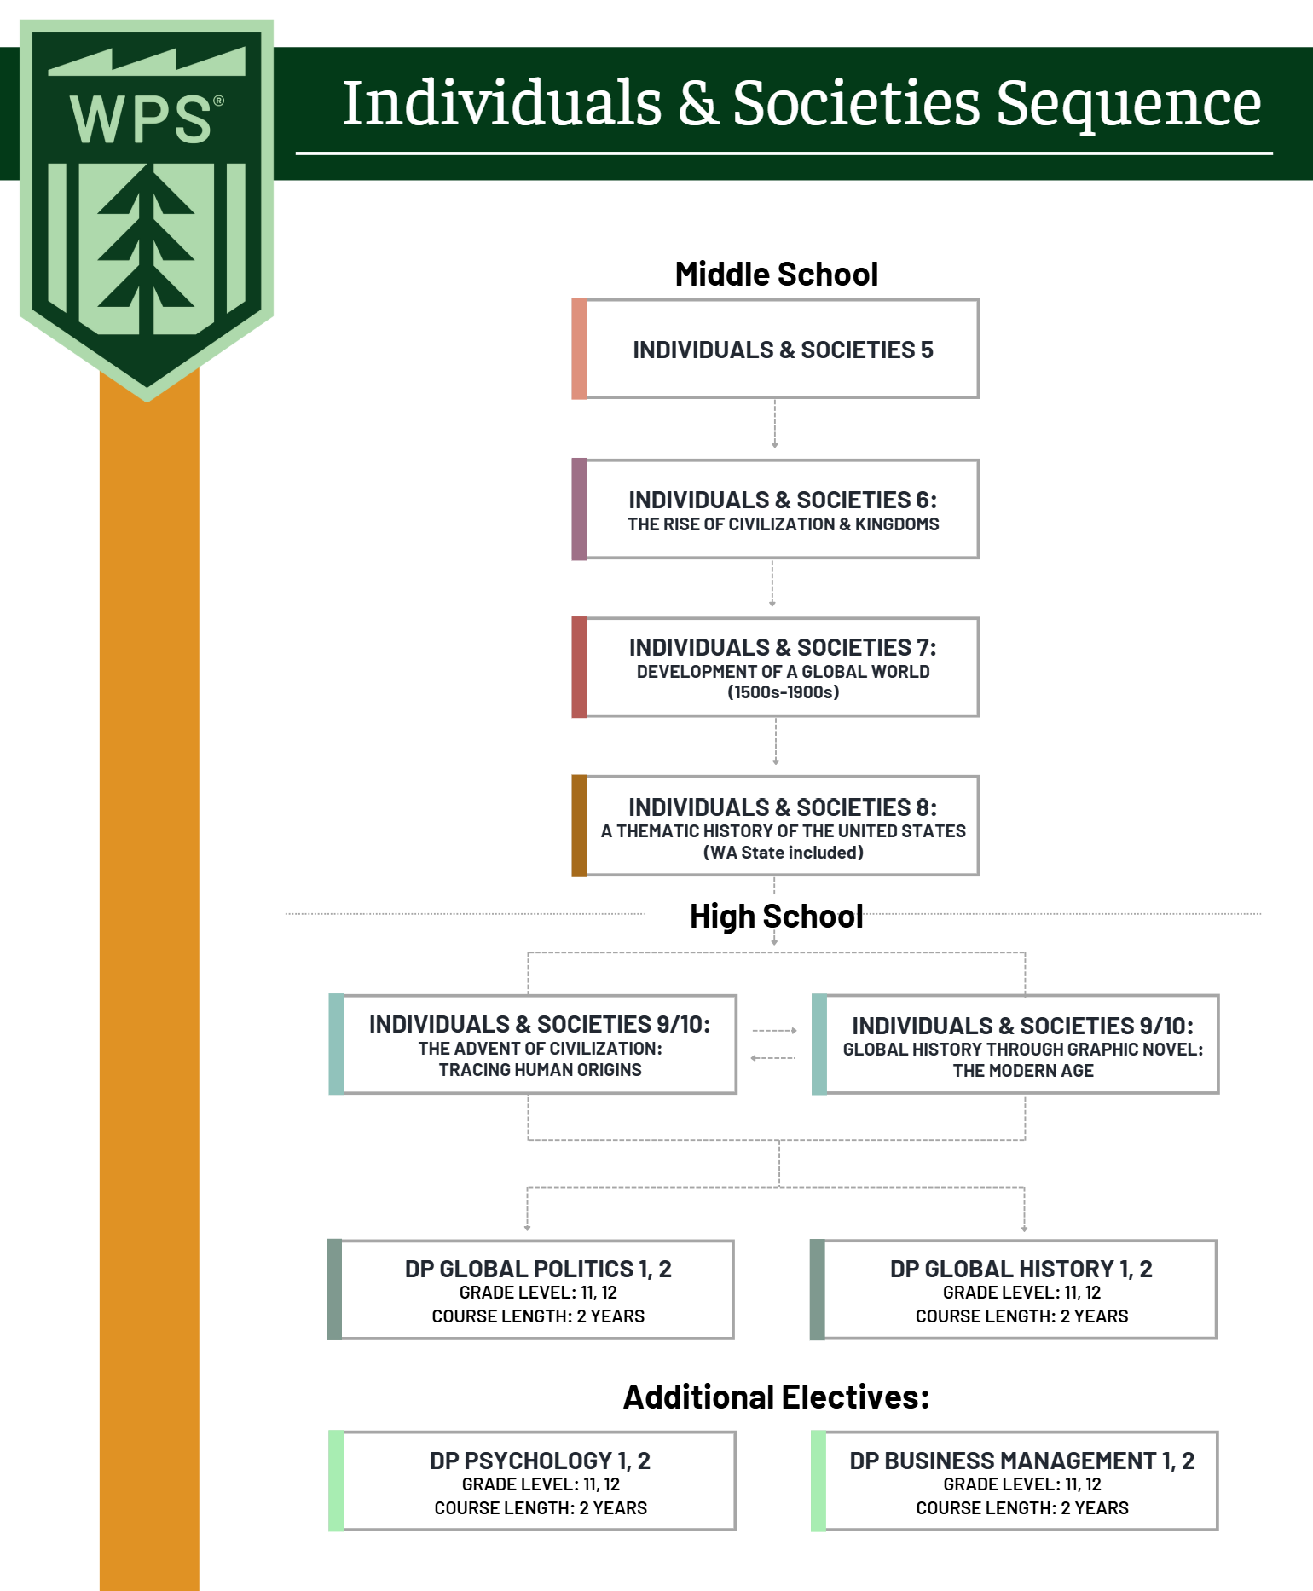
Individuals & Societies Course Sequence

Slide 8
Individuals & Societies
Course Sequence

Slide 9
Language Acquisition

Slide 10
Language Acquisition
Course Description

Slide 11
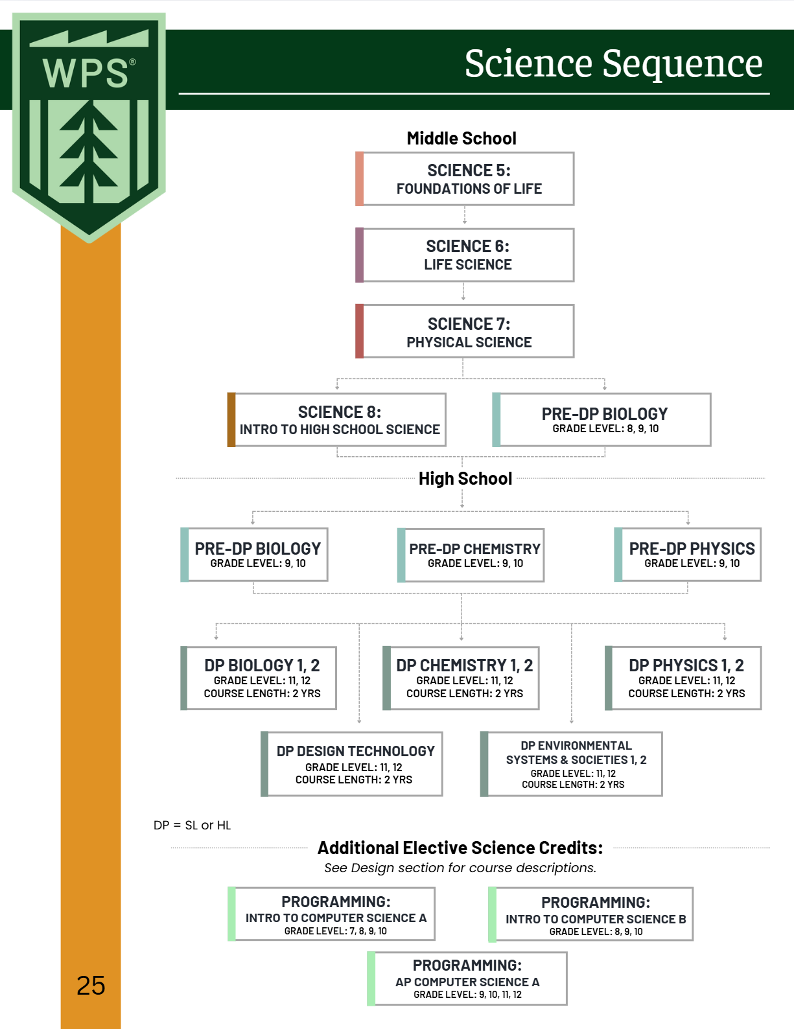
Sciences Course Sequence

Slide 12
Science
Course Description

Slide 13
Science
Course Description

Slide 14
Science 8: Introduction to High School Sciences
Pre-DP Biology 9/10
Middle School Science Course
Introduces students to:
Pre-DP Biology
Pre-DP Chemistry
Pre-DP Physics
Allows students completing high school at WPS to take 2 Pre-DP science courses before choosing their DP Science course(s) for 11th and 12th grade
Workload and expectations aligned with 8th grade courses
High School Science Course
WA State requires a minimum of 3 years of high school science, and 2 must be lab courses
Focused on general high school Biology
Allows students completing high school at WPS to take 3 Pre-DP science courses before choosing their DP Science course(s) for 11th and 12th grade
Workload and expectations aligned with high school courses

Slide 15
Science Textbooks
MYP Biology
Andrew Allott, David Mindorff
Approximate Cost: $45

Slide 16
Mathematics Course Sequence

Slide 17
Integrated Mathematics vs Traditional Sequencing

Slide 18
Mathematics
Course Description

Slide 19
Mathematics Textbook
MYP Mathematics Year 4/5 Standard
MYP Mathematics Year 4/5 Extended
Rose Harrison, Clara Huizink, Aidan Sproat, Marlene Torres-Skoumal
Approximate Cost: $45
Rose Harrison, Clara Huizink, Aidan Sproat, Marlene Torres-Skoumal
Approximate Cost: $45

Slide 20
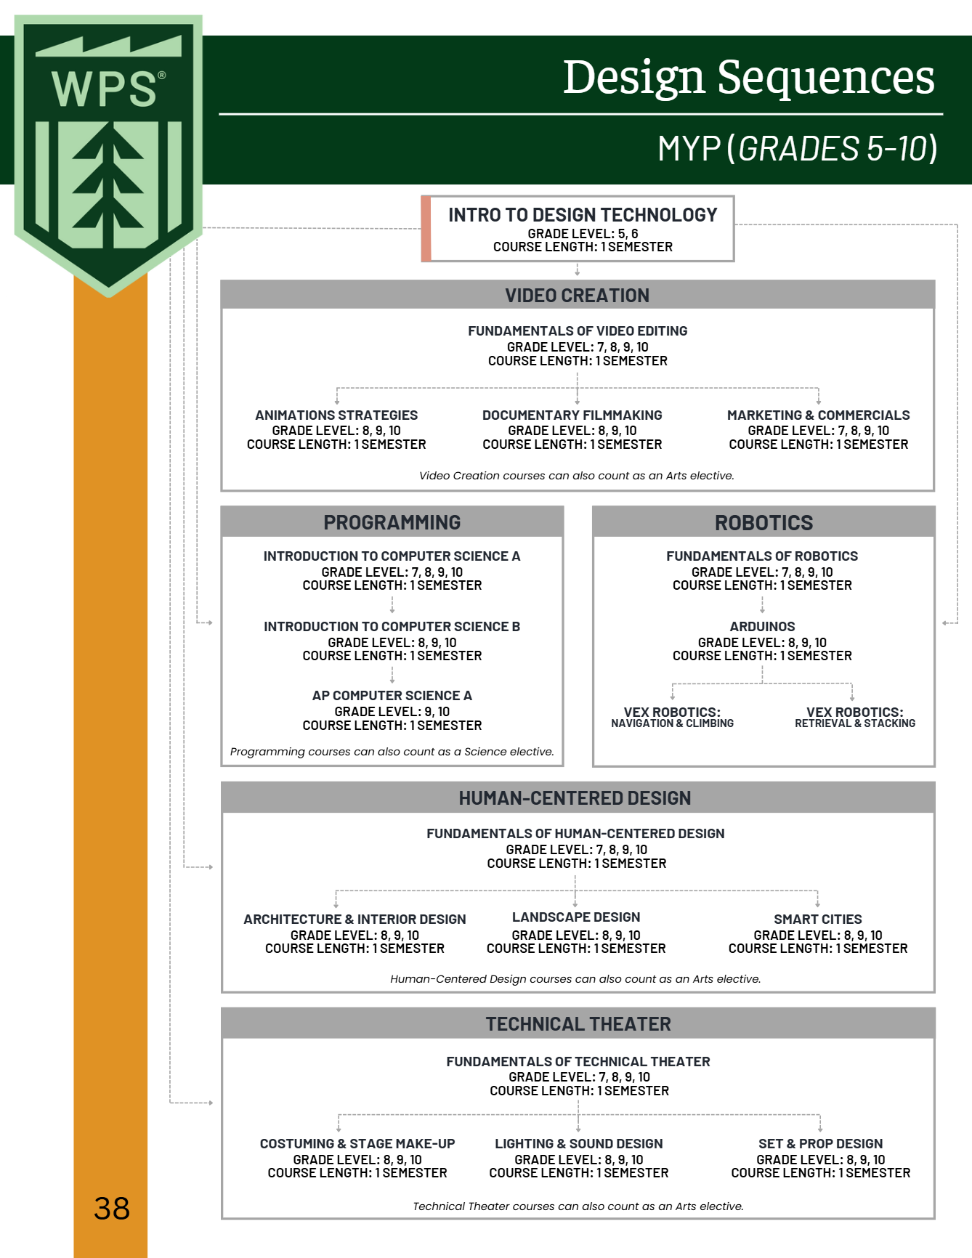
Design Technology Course Sequence

Slide 21
Design Technology
Course Description

Slide 22
Design Technology
Course Description

Slide 23
Design Technology
Course Description

Slide 24
Design Technology
Course Description

Slide 25
Design Technology
Course Description

Slide 26
Design Technology
Course Description

Slide 27
Design Technology
Course Description

Slide 28
Visual & Performing Arts

Slide 29
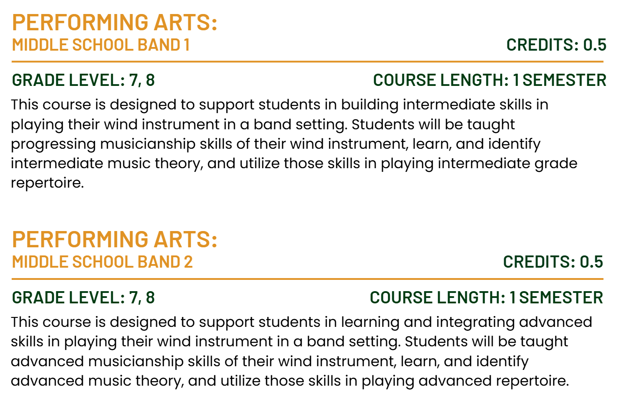
Performing Arts
Course Description

Slide 30
Performing Arts
Course Description

Slide 31
Performing Arts
Course Description

Slide 32
Performing Arts
Course Description

Slide 33
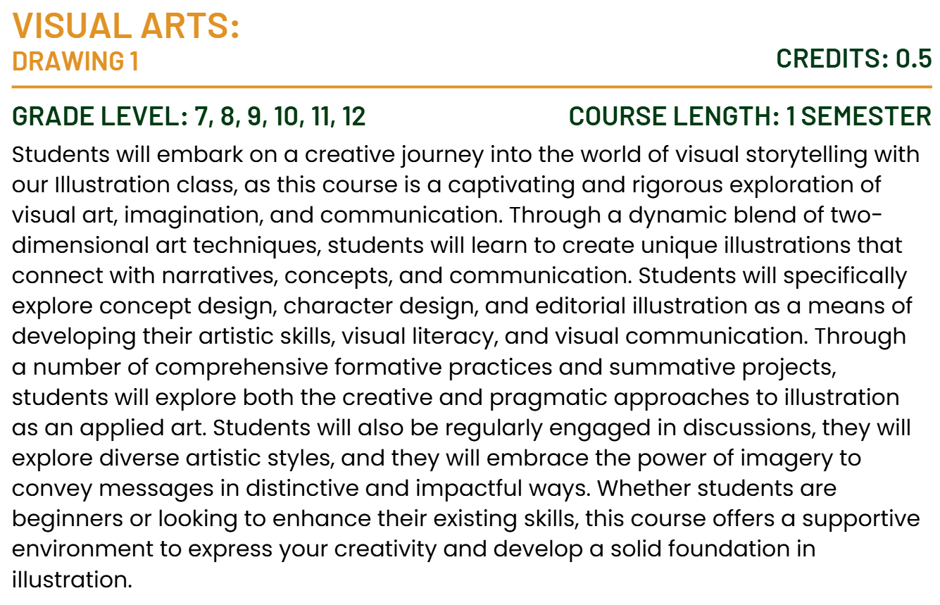
Visual Arts
Course Description

Slide 34
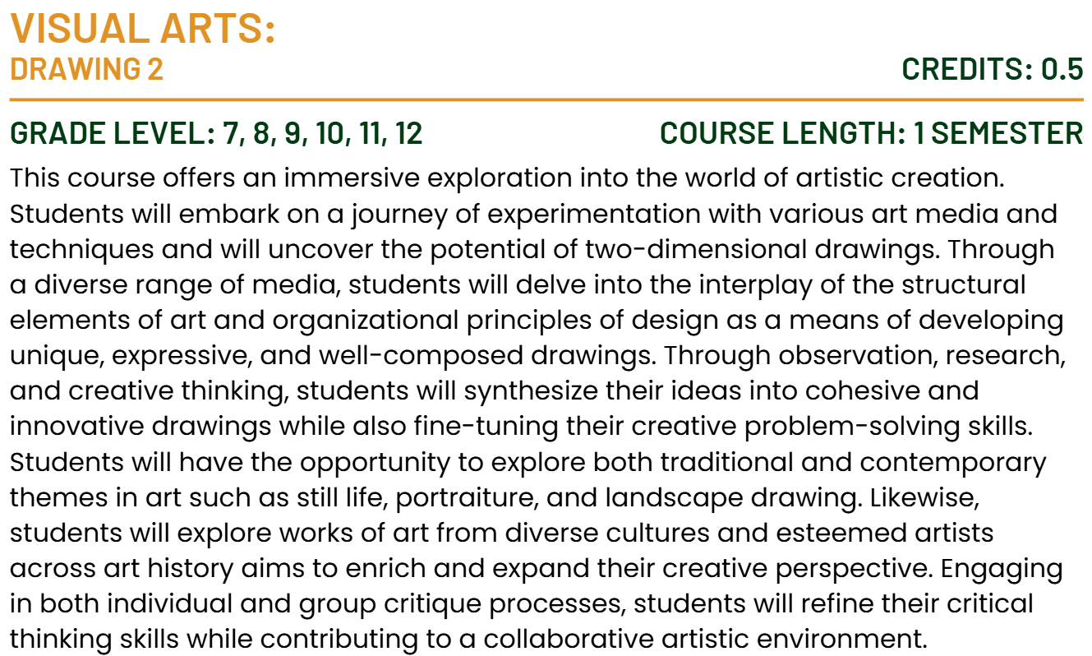
Visual Arts
Course Description

Slide 35
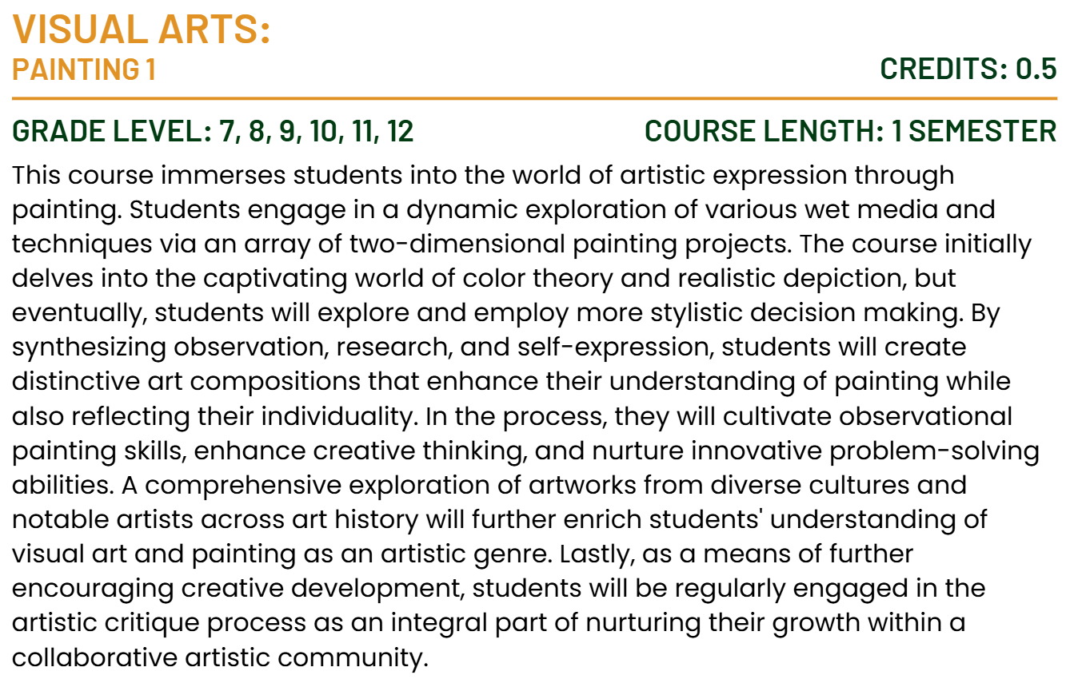
Visual Arts
Course Description

Slide 36
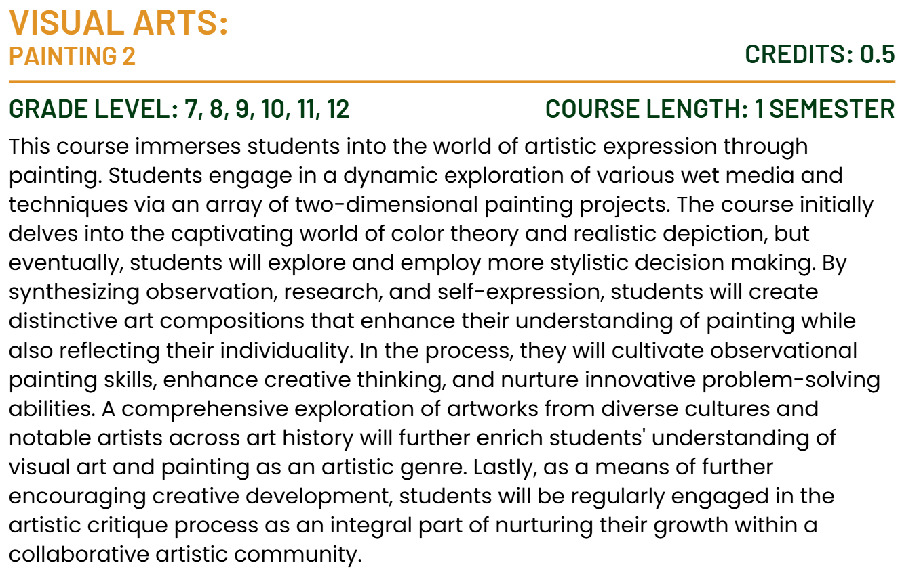
Visual Arts
Course Description

Slide 37
Physical and Health Education

Slide 38
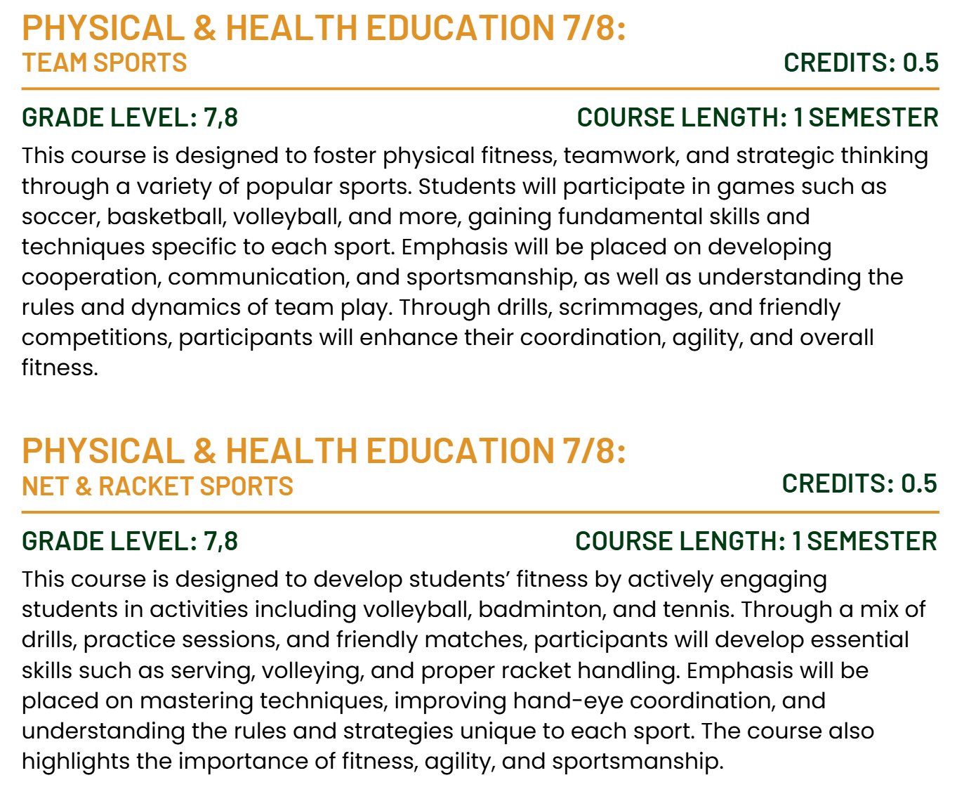
Physical & Health Education
Course Description

Slide 39
Physical & Health Education
Course Description

Slide 40
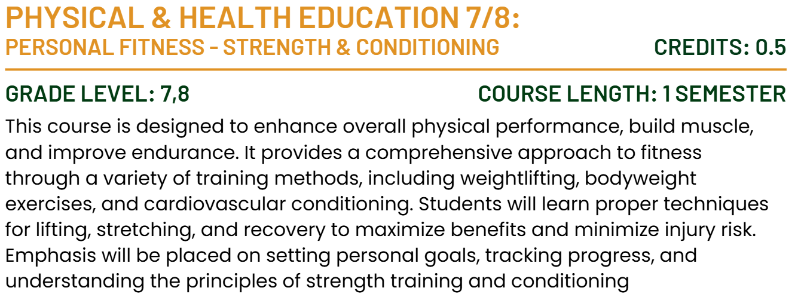
Physical & Health Education
Course Description

Slide 41
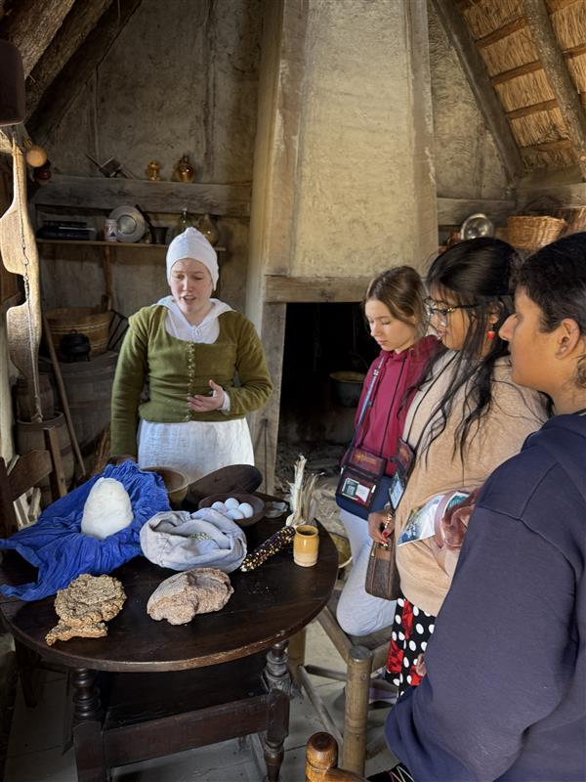
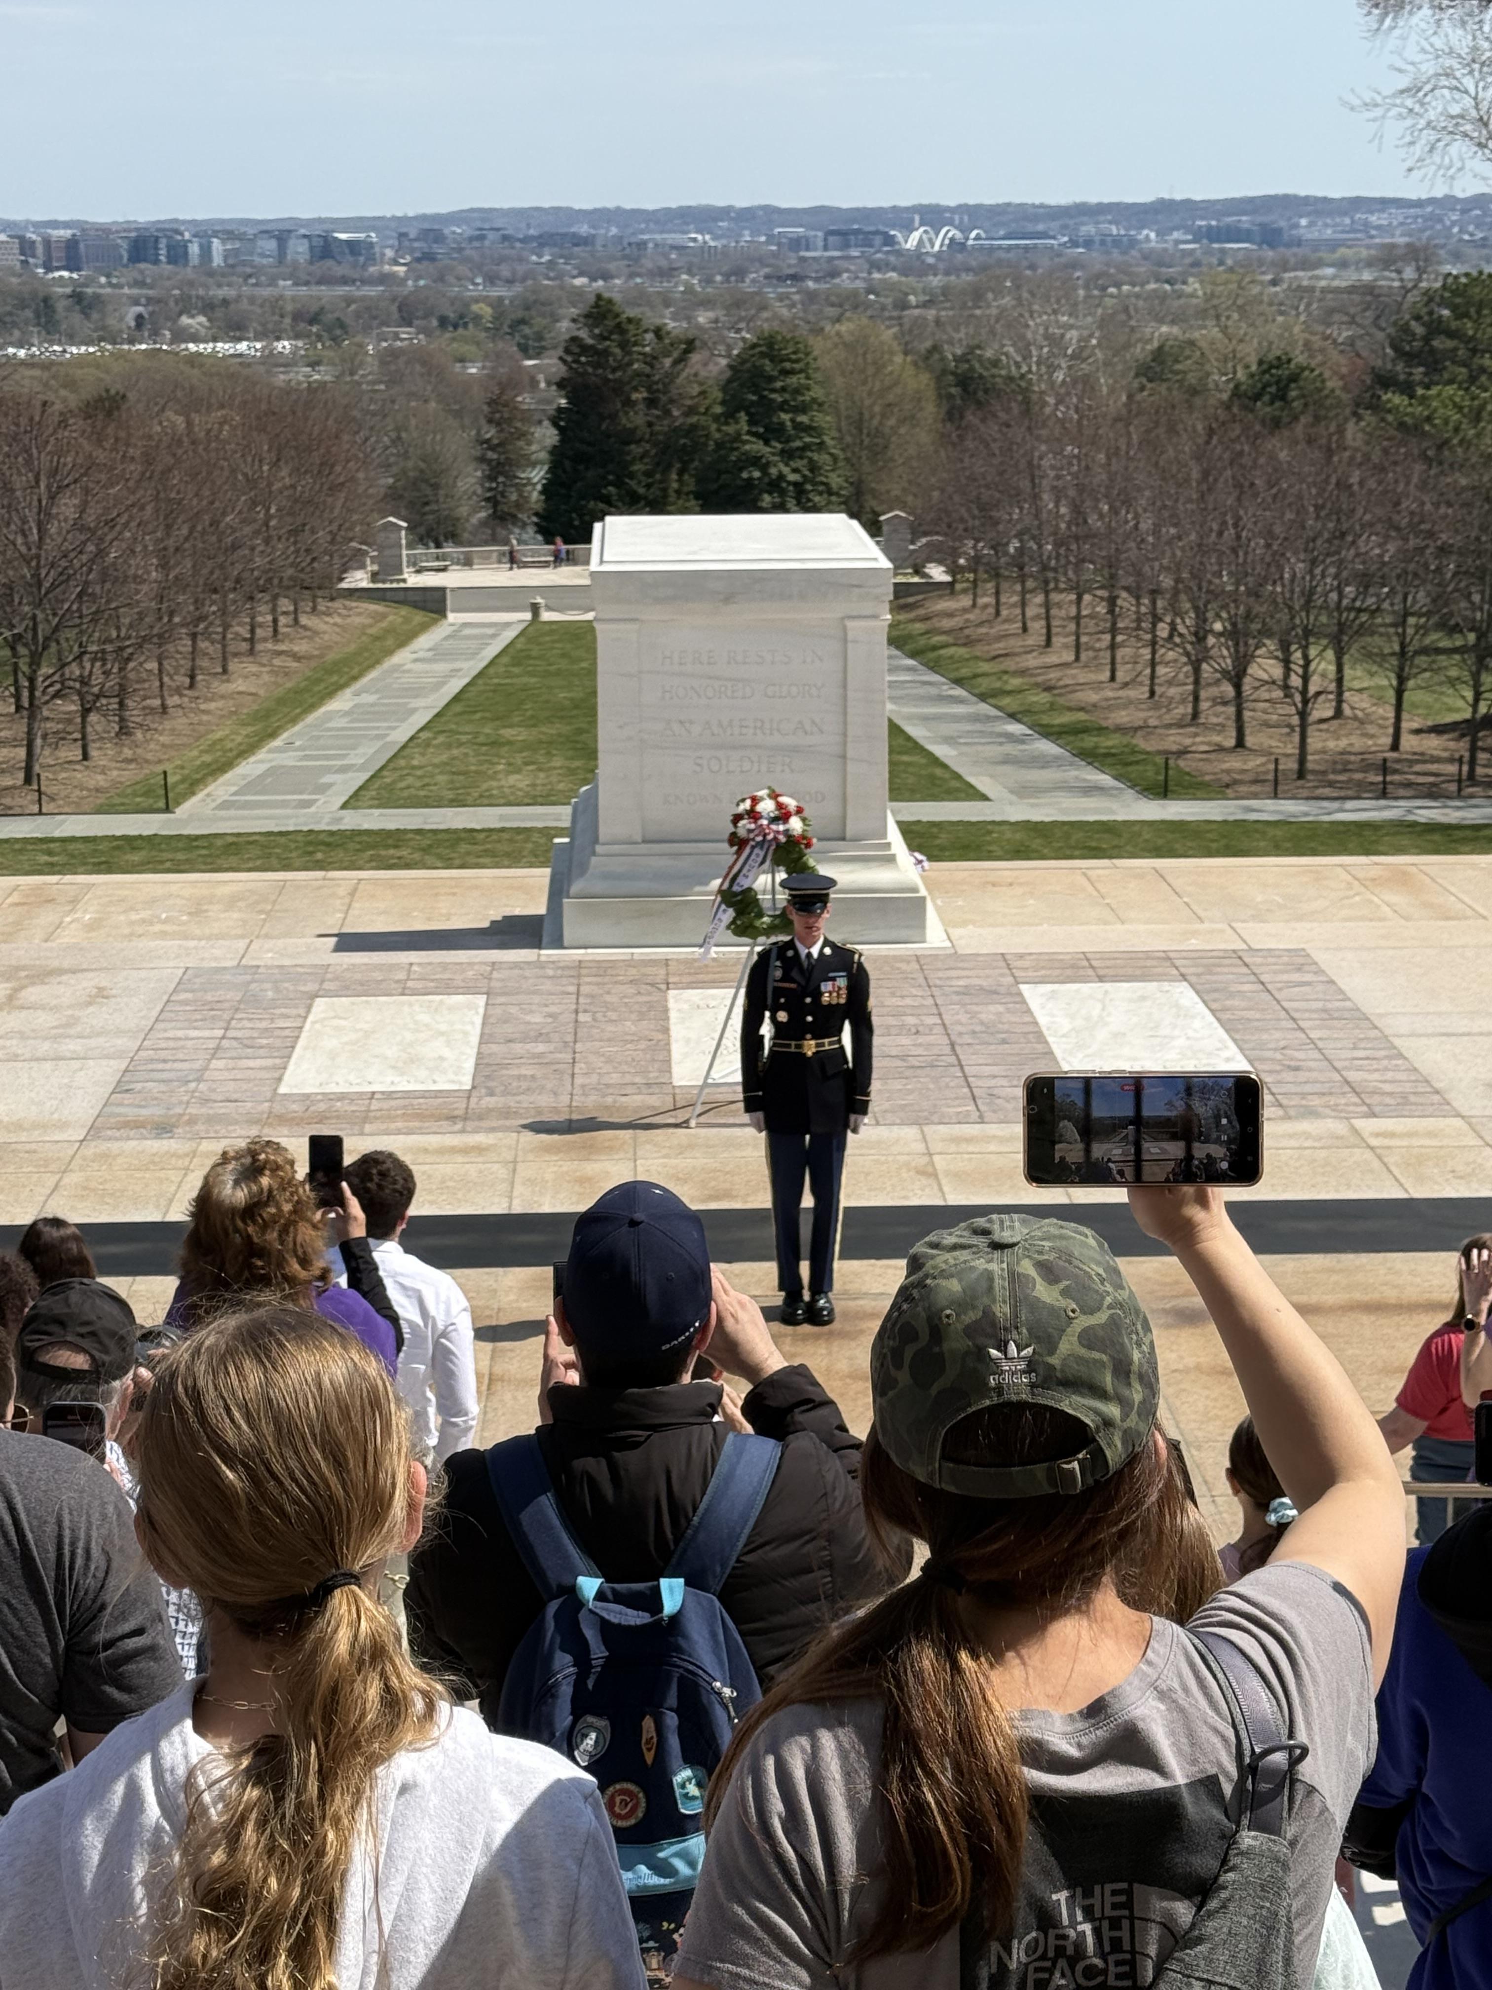
Experiential Education
Overnight Trip
8th Grade
East Coast
Experiential Education
8th Grade
Overnight Trip
East Coast

Slide 42
Academic Support Program
At Willows Preparatory School, we are committed to supporting the diverse learning needs of our students in an inclusive and welcoming environment. Our Student Support team partners with students, families, and faculty to provide guidance on learning differences, executive functioning, testing and classroom accommodations. We offer flexible levels of support to meet individual needs—ranging from daily structured executive functioning and study skills classes to weekly check-ins and coaching, and to as-needed consultations. These supports are offered by quarter or semester. We believe every student learns differently and strive to create a community where a variety of strengths and approaches are recognized and supported.
Notes:
Whether you child has had a 504 plan, IEP, or a formal diagnosis, or has none of the above, but would benefit from direct instruction in executive functioning skills, this program is for them.
The Director of Student Support serves as a key advocate for students, helping them navigate their learning accommodations and effectively communicate with their teachers. They act as the connection between students, families, and teachers. By working closely with classroom teachers, she stays informed about assignment expectations and help ensure that each student's unique learning profile is understood and supported. They also maintain regular communication with parents to provide updates on assignment completion, academic progress, and overall support needs.

Slide 43
Academic Support Program
Who does this program benefit?
Students who enroll in the Academic Support Program offerings benefit from consistent, individualized support, in one or more of the following areas, including:
Organization and planning (e.g., consistently losing materials, trouble breaking tasks into steps)
Time and task management (e.g., procrastinating, underestimating how long tasks take, frequently missing deadlines)
Task Initiation (e.g., knowing what needs to be done but unable to get started)
Attention and Focus (e.g., easily distracted, difficulty sustaining focus on non-preferred tasks)
Managing the demands of a rigorous academic environment beyond the support typically available in a traditional classroom setting
Self-monitoring

Slide 44
Daily Elective Course
Daily Class – elective course credit
Develop self-awareness of strengths and challenges in executive functioning.
Strategies for Success
Build practical skills in organization, task initiation, task prioritization, ask and assignment breakdown, time management, goal setting, and self-regulation, etc.
students are learning to apply these skills to their existing coursework from their content area classes
Organization and materials management of current course load.
Notes:
Students work on goals based on their own specific learning profile. Additionally, the group setting allows them to work collaboratively on similar assignments or learn different strategies from peers. Initial emphasis is on developing habits for tracking assignments, time management, willingness to ask for and accept help, and metacognition. Once students have established regular habits around turning assignments in on time, higher order study skills are introduced. Rather than a separate study skills curriculum (e.g. stand-alone unit on note taking or mnemonic memory strategies), students are learning to apply these skills to their existing coursework from their content area classes. While the teacher can help support students in their content area classes, the class does not provide basic skill remediation, and teachers are not necessarily content area specialists across subjects.
The teacher serves as a key advocate for students, helping them navigate their learning accommodations and effectively communicate with their teachers. They often act as the connection between students, families, and teachers. By working closely with classroom teachers, the strategies for success teacher stays informed about assignment expectations and help ensure that each student's unique learning profile is understood and supported. They also maintain regular communication with parents to provide updates on assignment completion, academic progress, and overall support needs.

Slide 45
Weekly Student Check-in
Weekly 1:1 Meeting (~20 minutes)
Academic Organization – equip students with tools to manage assignments and deadlines
Personalized guidance – address unique needs or concerns students may have regarding their coursework
Skill development – foster self-advocacy, time management, and problem-solving skills.
Accountability – encourage students to take ownership of their learning by tracking their progress.
Build trust and rapport to create a safe space for academic growth and open communication.
Notes:
Weekly check-ins are designed to provide targeted, individualized support for your student through regular, structured meetings with students, ensuring they stay on track with their academic responsibilities and feel supported in their learning journey.
Grade and Assignment Tracking
Review grades and progress in all classes.
Identify missing assignments or upcoming deadlines.
Help prioritize tasks and develop action plans for success.
1:1 Support
Provide a dedicated space to discuss challenges or concerns.
Share resources and strategies for academic improvement.
Celebrate successes to promote motivation and confidence.
The teacher serves as a key advocate for students, helping them navigate their learning accommodations and effectively communicate with their teachers. They often act as the connection between students, families, and teachers. By working closely with classroom teachers, the strategies for success teacher stays informed about assignment expectations and help ensure that each student's unique learning profile is understood and supported. They also maintain regular communication with parents to provide updates on assignment completion, academic progress, and overall support needs.

Slide 46
Social Skills Group
Foundational Social Skills
Starting conversations
Active Listening
Non-verbal communication
Expressing feelings
Giving and receiving compliments
Peer interactions
Building Relationships
Making and keeping friends
Conflict resolution
Empathy and perspective-taking
Managing emotions
Anxiety in social situations
Managing frustration or anger
Navigating peer pressure
Self-advocacy
Groups meet once a week during Lunch and/or Recess
(25-45 minutes)

Slide 47
After School Support
Introduce organizational tools (planners, digital apps like Google Calendar, task lists).
Practice setting up a planner or digital calendar with upcoming tasks and due dates.
Practice routine skills of checking grades, assignments.
Assignment tracking & prioritization
Homework support
1-3x A Week
Mon, Tue - 3:30-4:30pm
Wed – 2:30-3:30pm

Slide 48
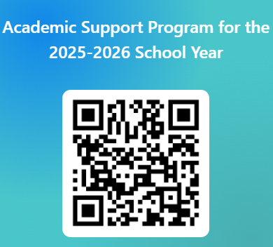
The offerings within the Academic Support Program are fee-based opportunities. Please indicate your interest using the QR code (right) or e-mail (below) and the Director of Student Support will contact you to answer questions and determine if the option(s) is right for your child before finalizing enrollment.
Caitlin Bank
cbank@willowsprep.com
https://forms.office.com/r/wA3Q0ETgYc

