Slide 1

Spring Curriculum Night 2025
Rising 9th and 10th Grade

Slide 2

Agenda
Overview of 9th and 10th Grade Curriculum
Overview of Devices for 2025-2026
Overview of the Student Support Program
Questions and Answers

Slide 3
Overview of 9th and 10th Grade Curriculum

Slide 4
IB Middle Years Program
IB Diploma
Program
Lower Middle School
5th Grade
6th Grade
Upper Middle School
7th Grade
8th Grade
Pre-DP High School
9th Grade
10th Grade
DP High School
11th Grade
12th Grade
The Student Academic Experience

Slide 5

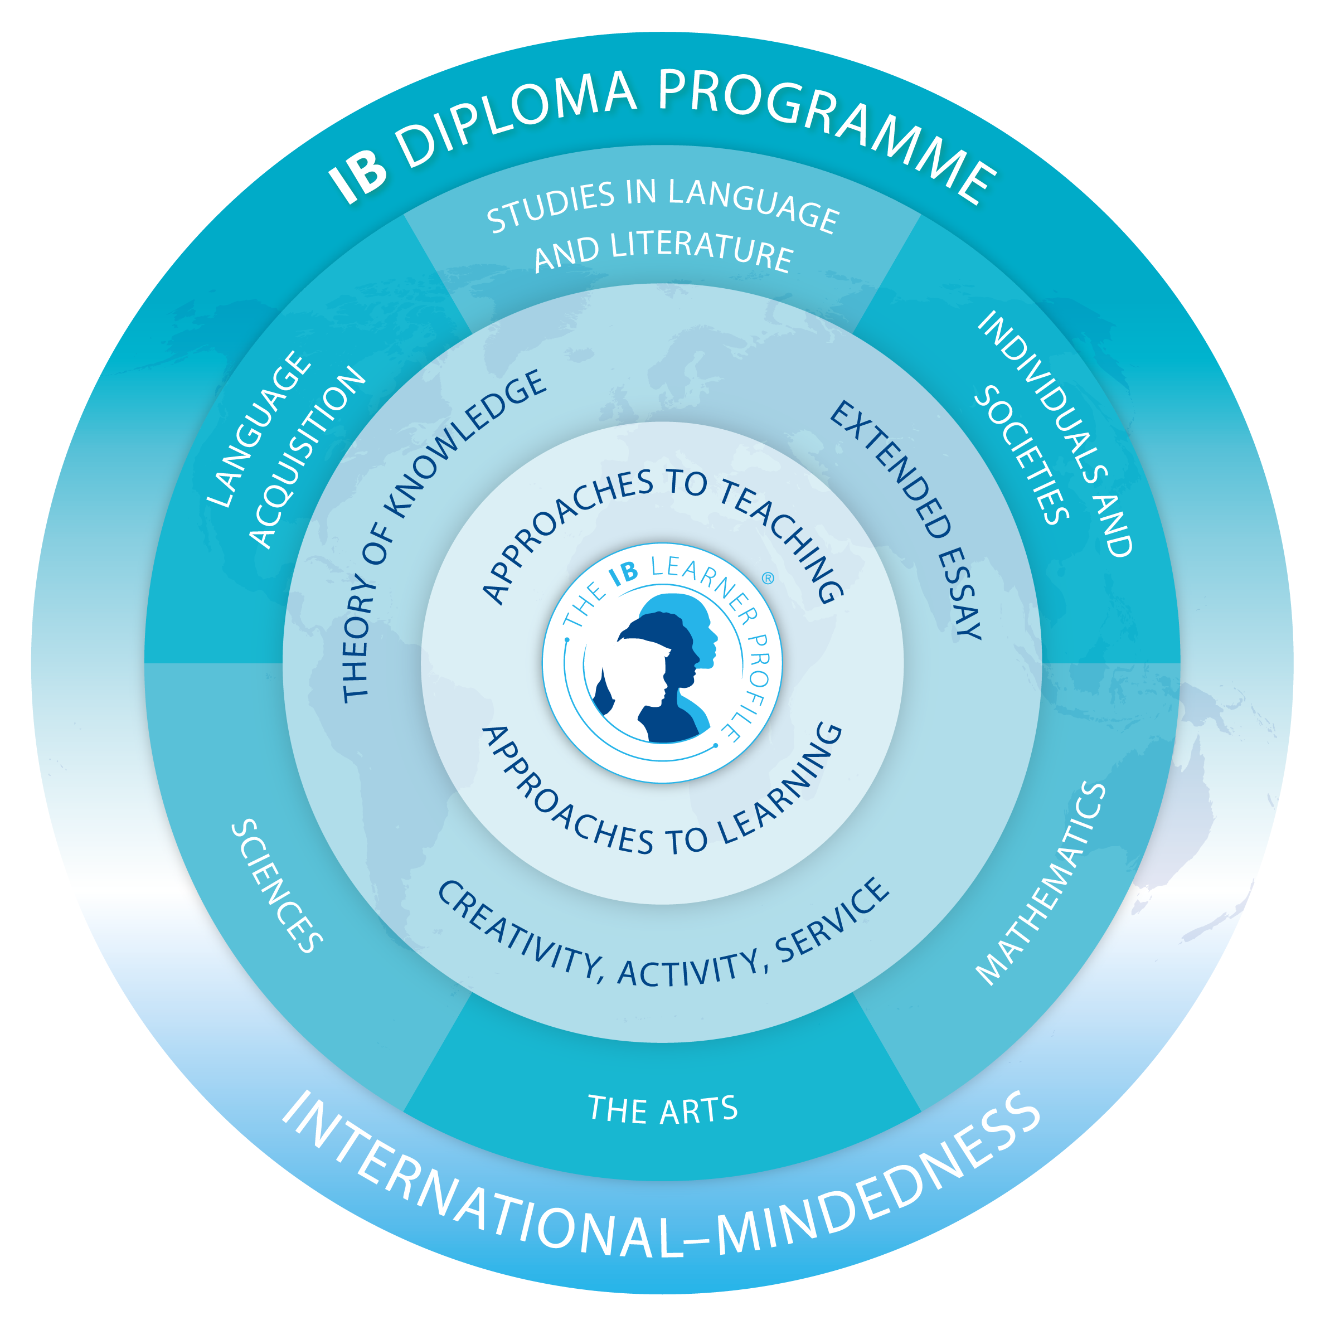
High School IB Alignment
Willows Preparatory School
Middle Years Programme (MYP)
9th & 10th Grade
Diploma Programme (DP)
11th & 12th Grade

Slide 6

What is the IB Diploma Programme?
The IB Diploma Programme is an academically challenging and balanced programme of education, with final examinations, that prepares students aged 16 to 19 for success at university and in life beyond. It has been designed to address the intellectual, social, emotional and physical well-being of students. The programme has gained recognition and respect from the world’s leading universities.
All WPS 11th and 12th grade courses are designed for the Diploma Programme.

Slide 7
Language & Literature

Slide 8
Language & Literature
Course Description

Slide 9


Language & Literature
Sample Textbooks
Klara and the Sun
A View From the Stars
Kazuo Ishiguro
Approximate Cost: $15
Cixin Liu
Approximate Cost: $17

Slide 10
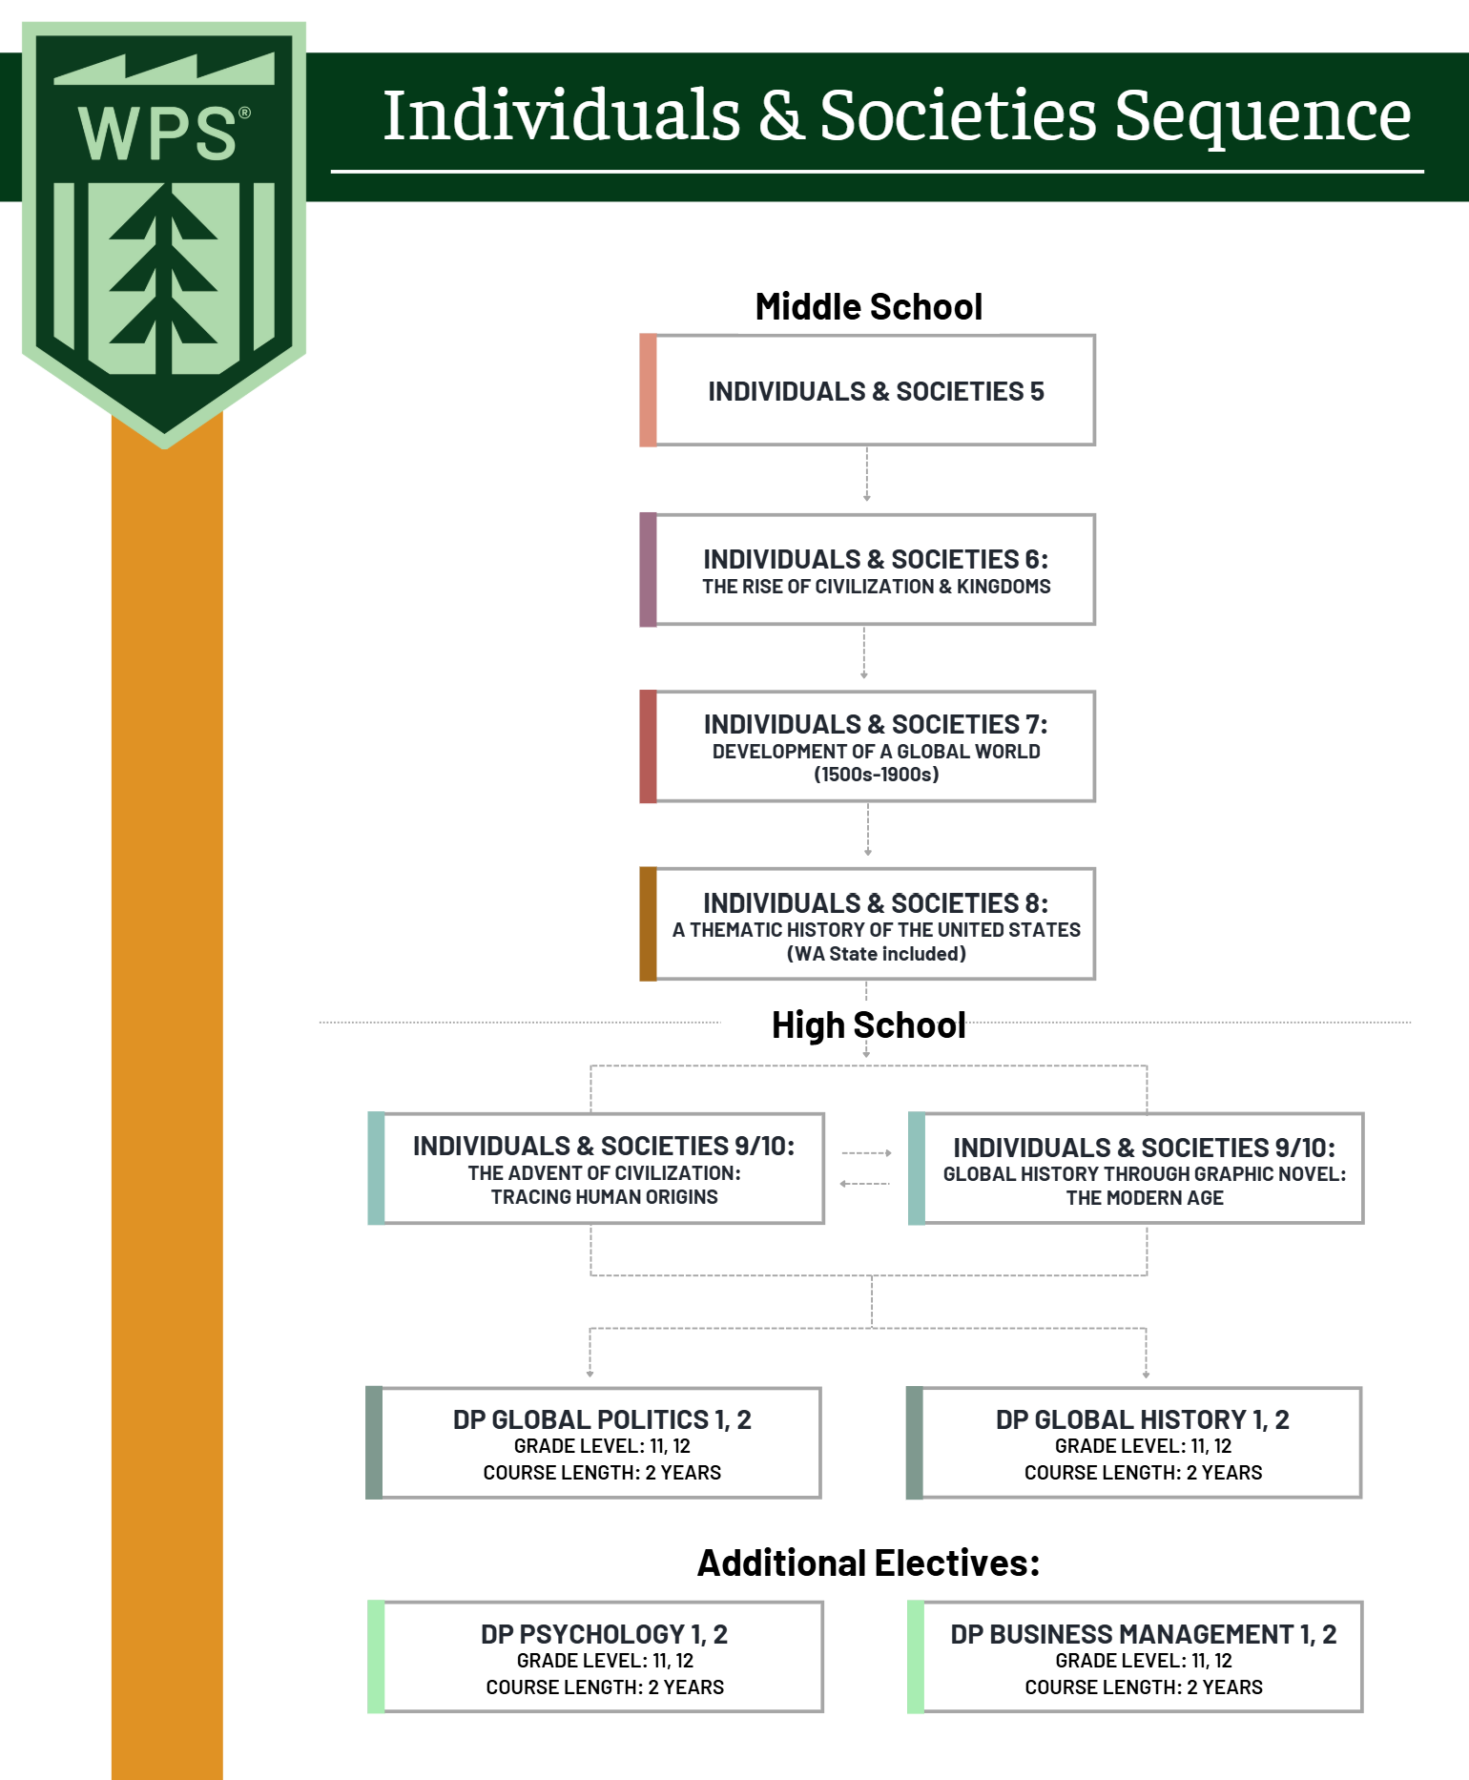
Individuals & Societies Course Sequence

Slide 11
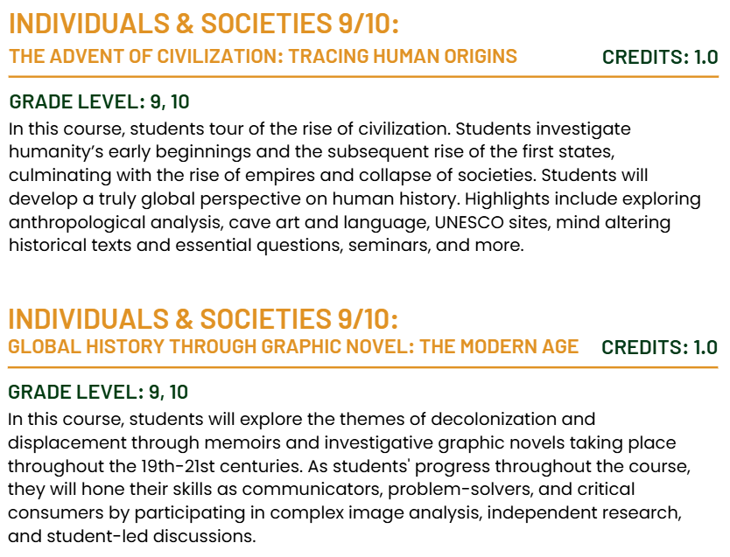
Individuals & Societies
Course Sequence

Slide 12

Individuals & Societies
Sample Textbook
Paying the Land
Joe Sacco
Approximate Cost: $20

Slide 13
Language Acquisition

Slide 14
Language Acquisition
Course Description

Slide 15




Language Acquisition
Textbooks
Reporteros 2 Workbook
Reporteros 3 Workbook
Reporteros 2 + 12-Month
Online Access
Reporteros 3 + 12-Month
Online Access
Klett World Languages
Approximate Cost: $130
Klett World Languages
Approximate Cost: $25
Klett World Languages
Approximate Cost: $130
Klett World Languages
Approximate Cost: $25

Slide 16
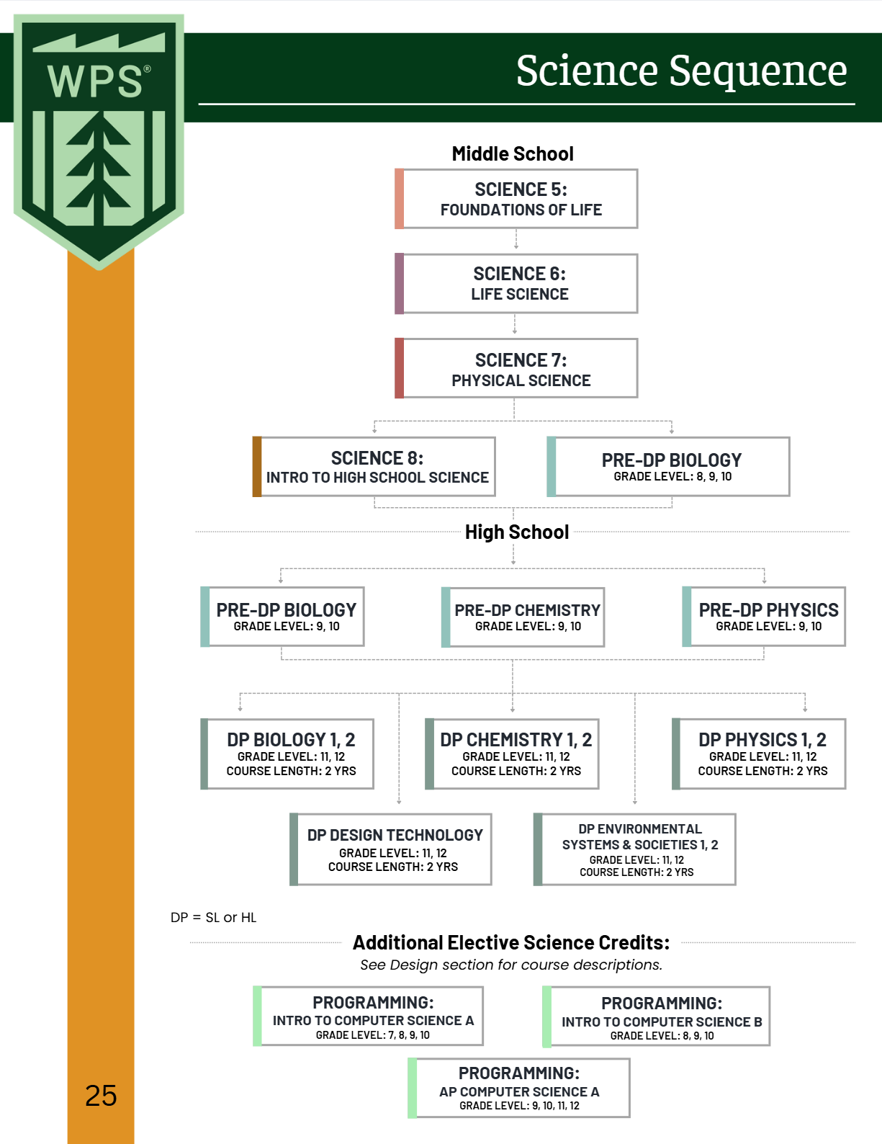
Sciences Course Sequence

Slide 17
Science
Course Description

Slide 18
Science
Course Description

Slide 19



Science
Textbooks
MYP Biology
MYP Chemistry
MYP Physics
Andrew Allott, David Mindorff
Approximate Cost: $45
Gary Horner
Approximate Cost: $45
Andrew Allott, David Mindorff
Approximate Cost: $45

Slide 20
Mathematics Course Sequence

Slide 21
Integrated Mathematics vs Traditional Sequencing

Slide 22
Mathematics
Course Description

Slide 23
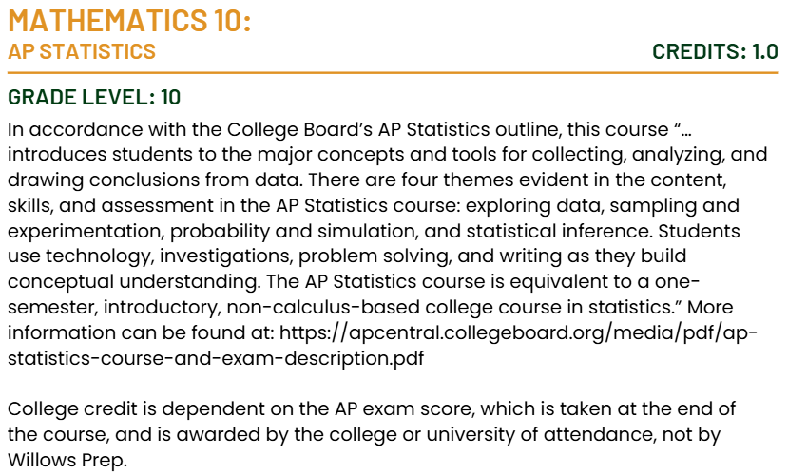
Mathematics
Course Description

Slide 24
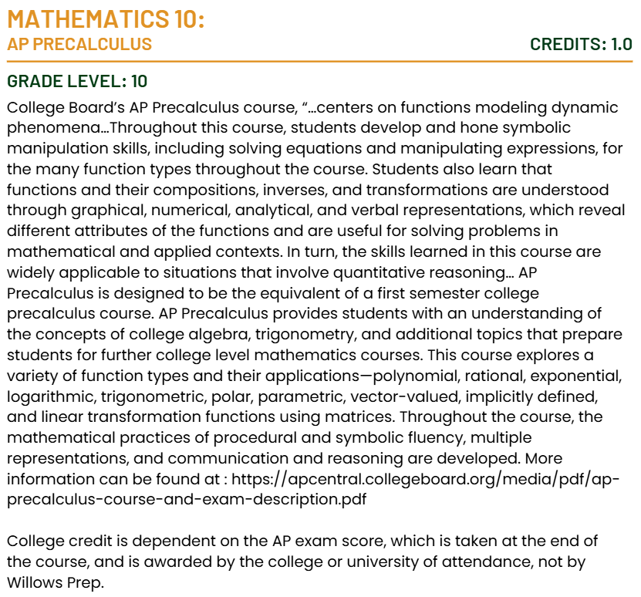
Mathematics
Course Description

Slide 25


Mathematics
Sample Textbooks
MYP Mathematics Year 4/5 Standard
MYP Mathematics Year 4/5 Extended
Rose Harrison, Clara Huizink, Aidan Sproat, Marlene Torres-Skoumal
Approximate Cost: $45
Rose Harrison, Clara Huizink, Aidan Sproat, Marlene Torres-Skoumal
Approximate Cost: $45

Slide 26
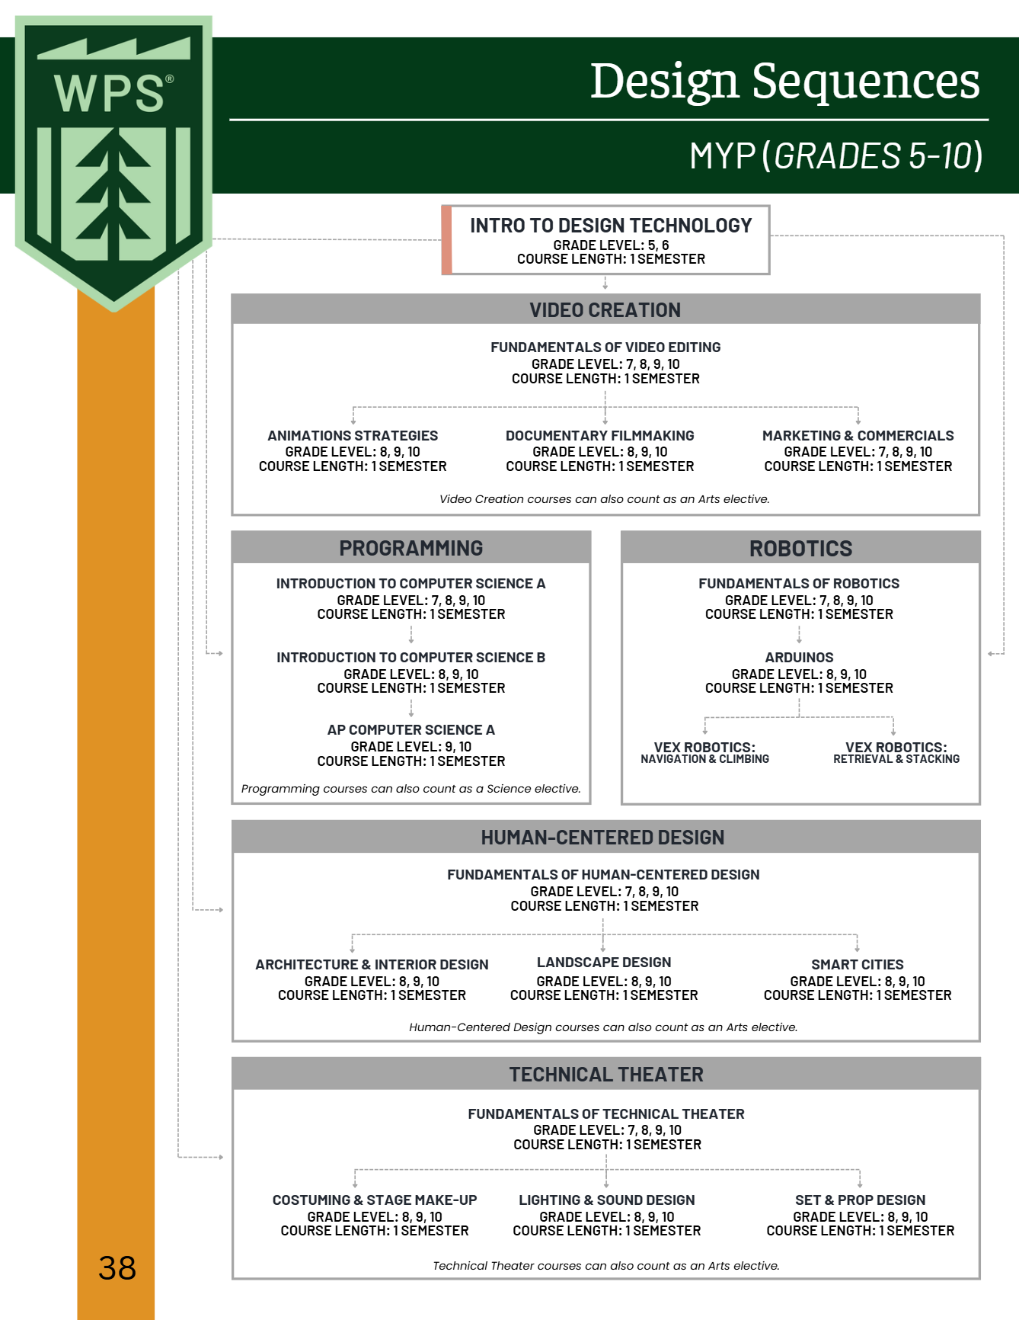
Design Technology Course Sequence

Slide 27
Visual & Performing Arts

Slide 28
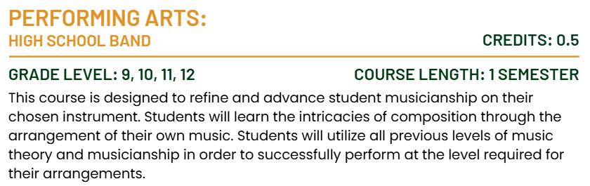
Performing Arts
Course Description

Slide 29
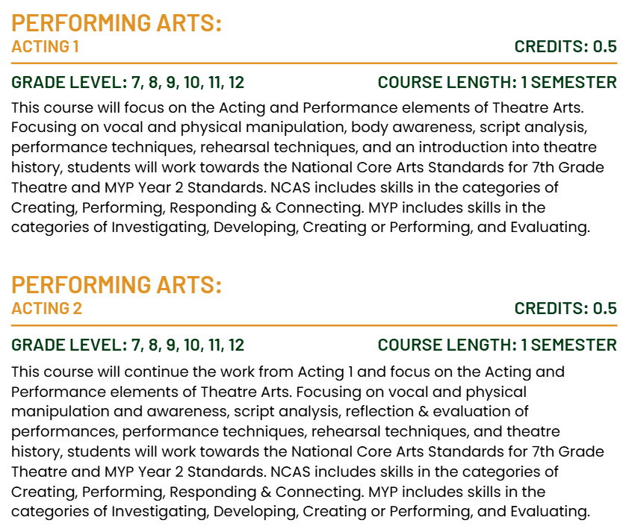
Performing Arts
Course Description

Slide 30
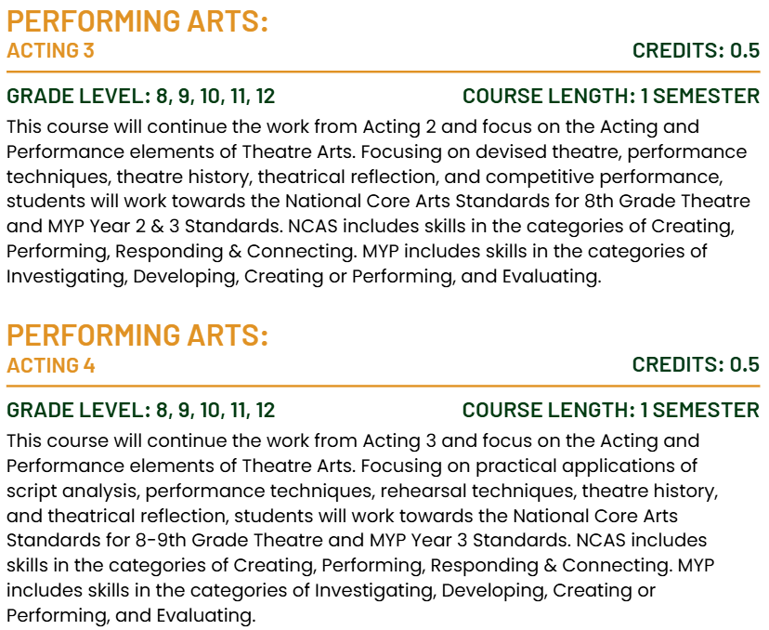
Performing Arts
Course Description

Slide 31
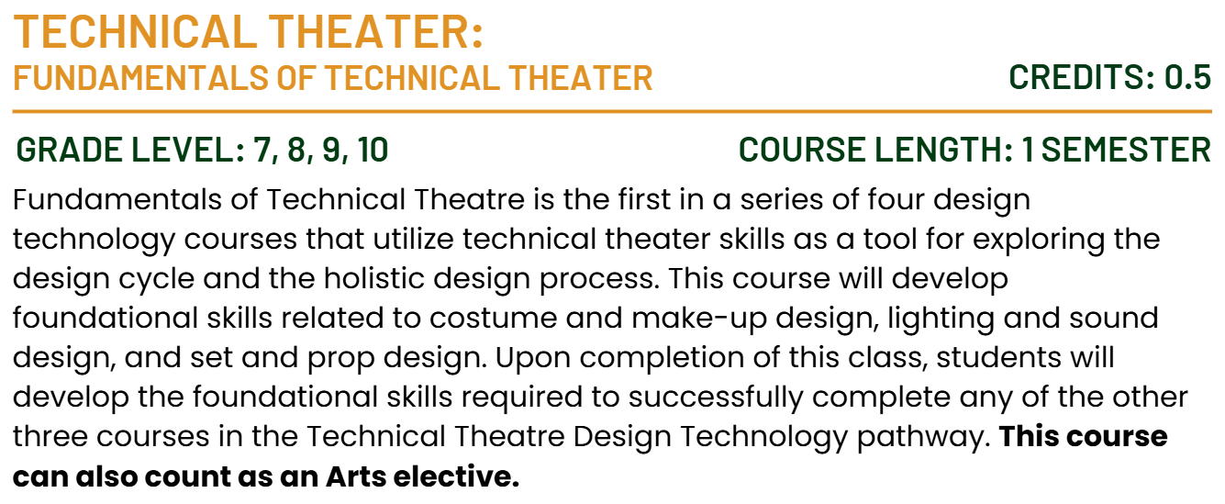
Performing Arts
Course Description

Slide 32
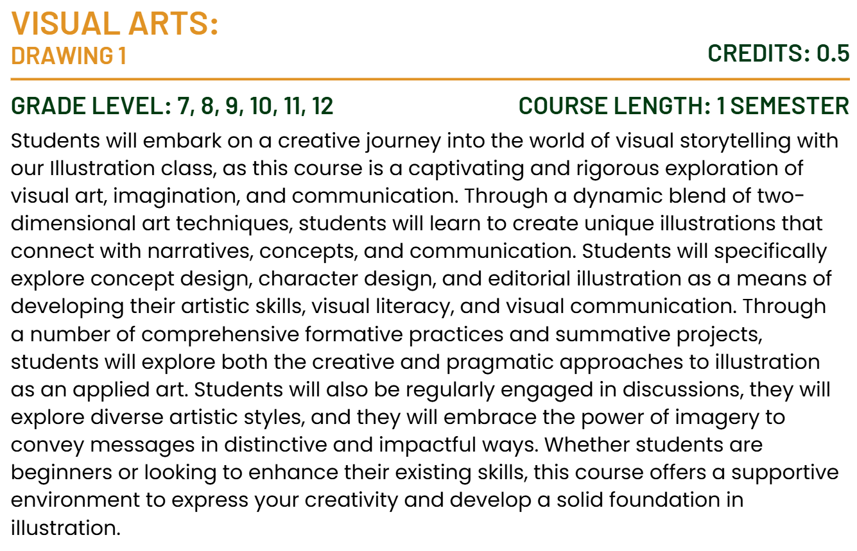
Visual Arts
Course Description

Slide 33
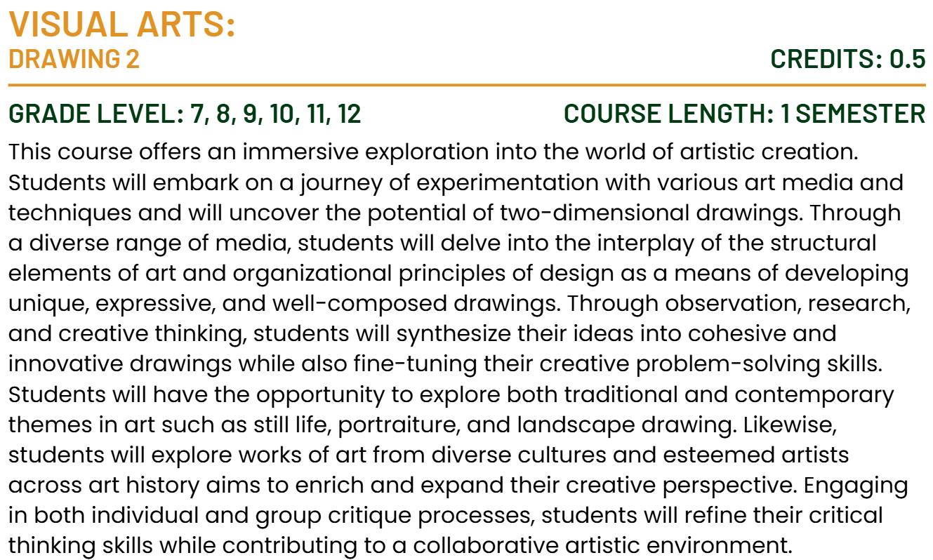
Visual Arts
Course Description

Slide 34
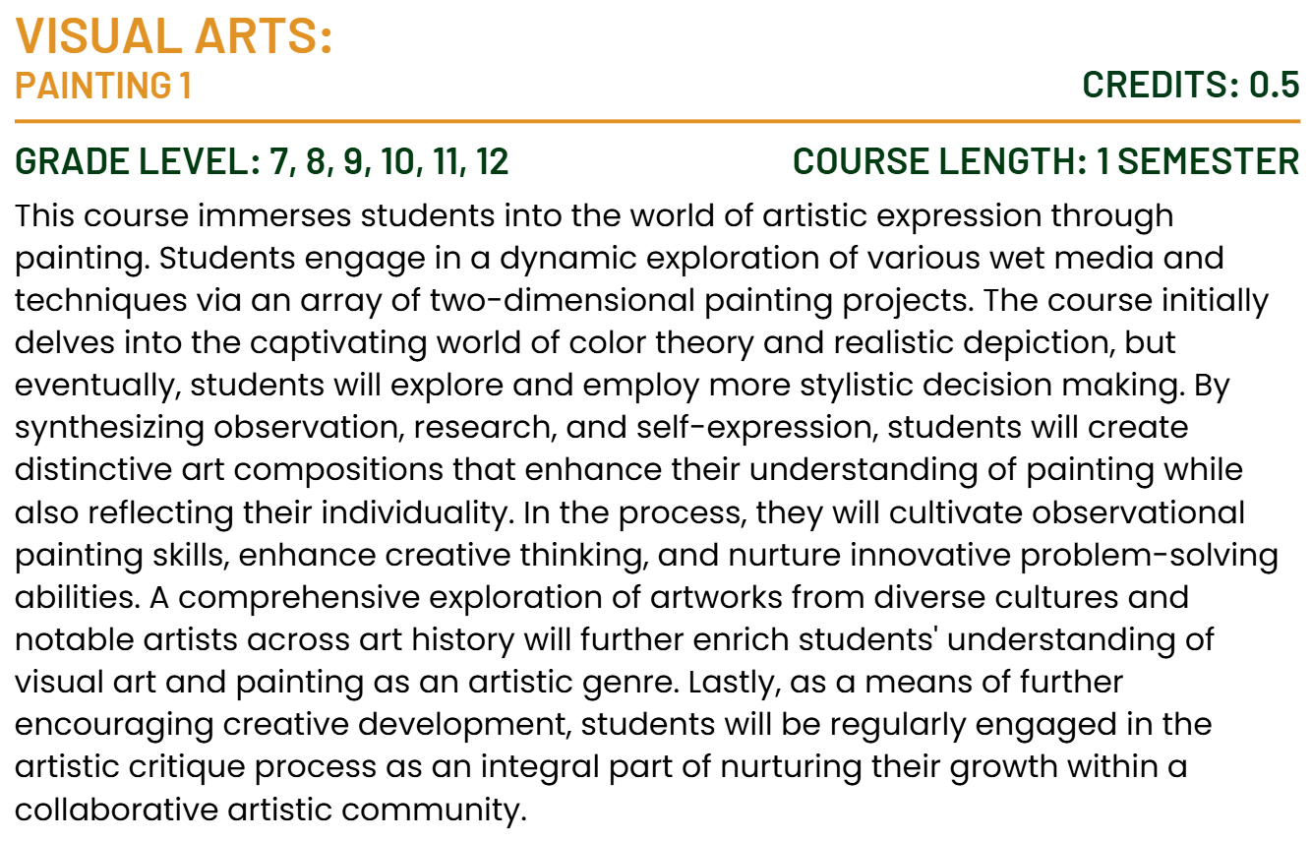
Visual Arts
Course Description

Slide 35
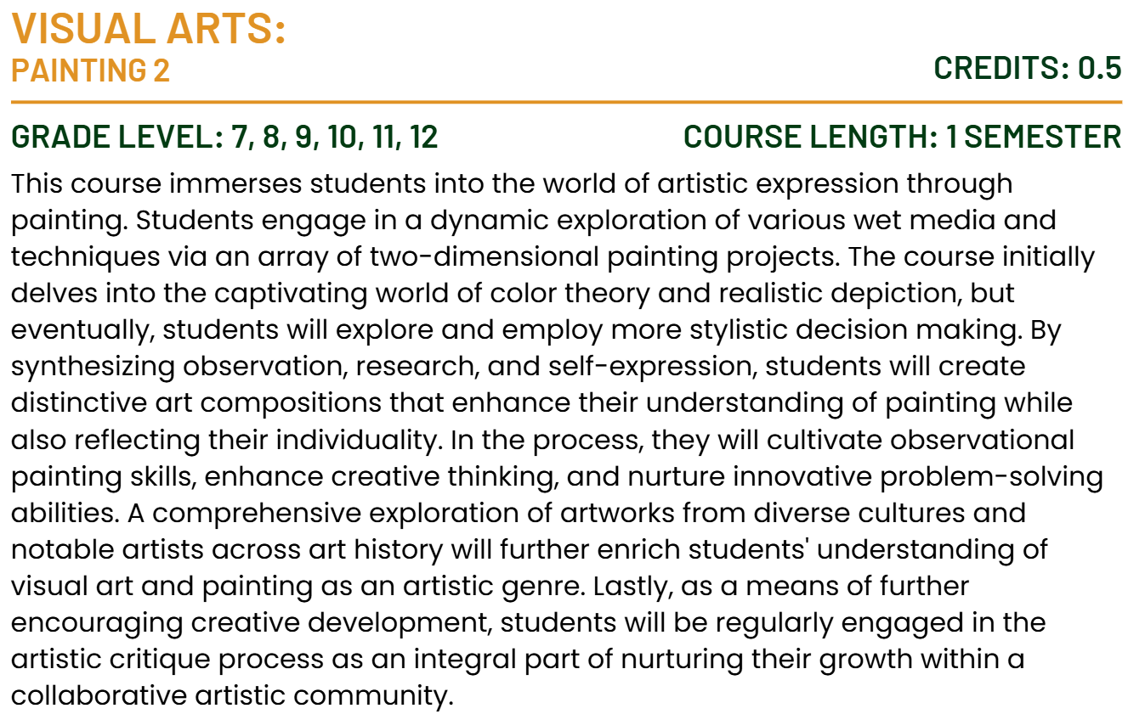
Visual Arts
Course Description

Slide 36
Physical and Health Education

Slide 37
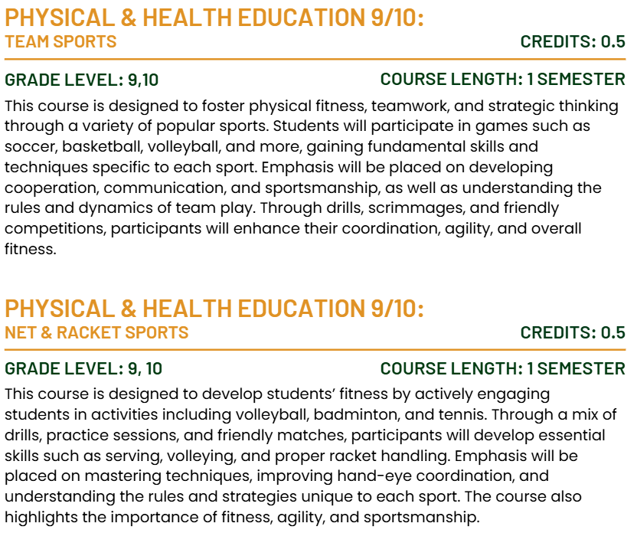
Physical & Health Education
Course Description

Slide 38
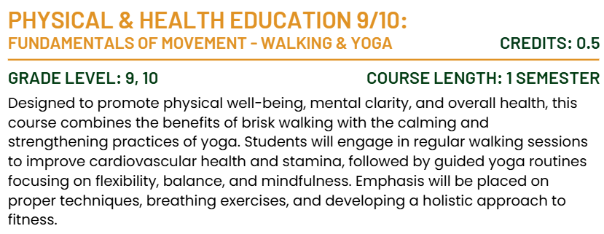
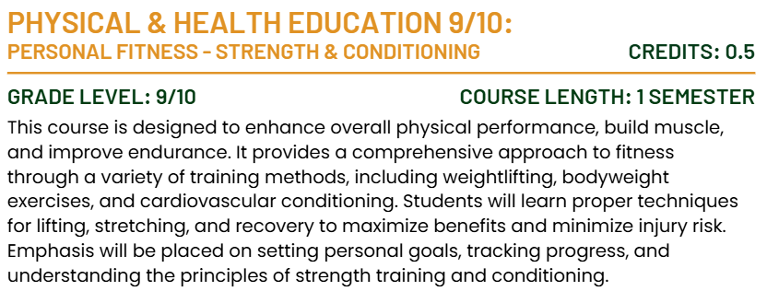
Physical & Health Education
Course Description

Slide 39

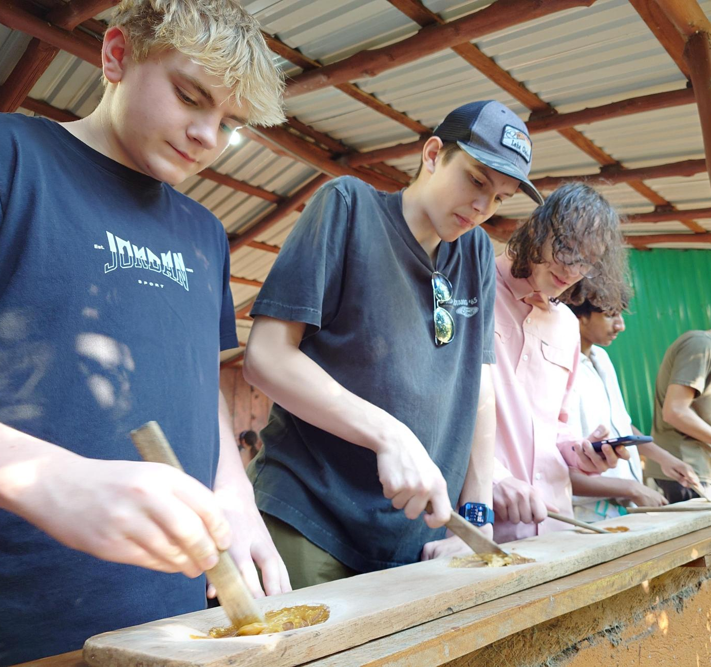

Experiential Education
High School Overnight Trip
Costa Rica

Slide 40

Technology at
Willows Prep

Slide 41

Devices
2025-2026
5th and 6th Grade
Lenovo devices
Owned by families but purchased through Willows Prep
Windows Pro
Accidental Warranty - does not include damage through carelessness or play
Managed through Microsoft Intune for policies and software installation
Filtering on-site through the Firewall
Cloud Filtering being deployed for 25-26
Aware Software being deployed for 25-26
7th – 12th Grade
BYOD
Owned by families
Recommended device
Not managed through Microsoft Intune

Slide 42




Student Agreements
Internet Use Agreement
Describes the policies for Internet use.
Student Agreement
Acknowledgement of Filtering software, Aware software, data responsibilities and consequences of device misuse. AI philosophy for school use.
Student Access Contract
Seeking family consent to create accounts for students below the age of 13 in compliance with the COPPA* act.
Students and Families will sign a Student Agreement, an Internet Use Agreement and a Student Access Contract to use technology on the Willows Prep campus.
During the first weeks of school, students will participate in a presentation on device care and responsibilities.
*COPPA – Children’s Online Privacy Protection Rule - prohibits unfair or deceptive acts or practices in connection with the collection, use, and/or disclosure of personal information from and about children on the Internet

Slide 43
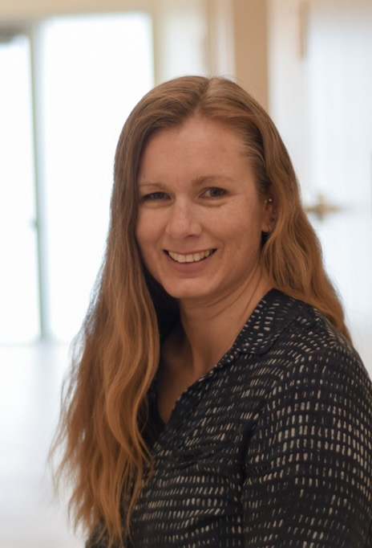
Get in touch
Amanda Lawrie-Hall
Director of Technology
Computer help can be found in the Library or the Tech Desk across from the Front Desk
Contact via email at
tech@willowsprep.com

Slide 44

Academic Support Program
At Willows Preparatory School, we are committed to supporting the diverse learning needs of our students in an inclusive and welcoming environment. Our Student Support team partners with students, families, and faculty to provide guidance on learning differences, executive functioning, testing and classroom accommodations. We offer flexible levels of support to meet individual needs—ranging from daily structured executive functioning and study skills classes to weekly check-ins and coaching, and to as-needed consultations. These supports are offered by quarter or semester. We believe every student learns differently and strive to create a community where a variety of strengths and approaches are recognized and supported.
Notes:
Whether you child has had a 504 plan, IEP, or a formal diagnosis, or has none of the above, but would benefit from direct instruction in executive functioning skills, this program is for them.
The Director of Student Support serves as a key advocate for students, helping them navigate their learning accommodations and effectively communicate with their teachers. They act as the connection between students, families, and teachers. By working closely with classroom teachers, she stays informed about assignment expectations and help ensure that each student's unique learning profile is understood and supported. They also maintain regular communication with parents to provide updates on assignment completion, academic progress, and overall support needs.

Slide 45
Academic Support Program
Who does this program benefit?
Students who enroll in the Academic Support Program offerings benefit from consistent, individualized support, in one or more of the following areas, including:
Organization and planning (e.g., consistently losing materials, trouble breaking tasks into steps)
Time and task management (e.g., procrastinating, underestimating how long tasks take, frequently missing deadlines)
Task Initiation (e.g., knowing what needs to be done but unable to get started)
Attention and Focus (e.g., easily distracted, difficulty sustaining focus on non-preferred tasks)
Managing the demands of a rigorous academic environment beyond the support typically available in a traditional classroom setting
Self-monitoring

Slide 46
Daily Elective Course
Daily Class – elective course credit
Develop self-awareness of strengths and challenges in executive functioning.
Strategies for Success
Build practical skills in organization, task initiation, task prioritization, ask and assignment breakdown, time management, goal setting, and self-regulation, etc.
students are learning to apply these skills to their existing coursework from their content area classes
Organization and materials management of current course load.
Notes:
Students work on goals based on their own specific learning profile. Additionally, the group setting allows them to work collaboratively on similar assignments or learn different strategies from peers. Initial emphasis is on developing habits for tracking assignments, time management, willingness to ask for and accept help, and metacognition. Once students have established regular habits around turning assignments in on time, higher order study skills are introduced. Rather than a separate study skills curriculum (e.g. stand-alone unit on note taking or mnemonic memory strategies), students are learning to apply these skills to their existing coursework from their content area classes. While the teacher can help support students in their content area classes, the class does not provide basic skill remediation, and teachers are not necessarily content area specialists across subjects.
The teacher serves as a key advocate for students, helping them navigate their learning accommodations and effectively communicate with their teachers. They often act as the connection between students, families, and teachers. By working closely with classroom teachers, the strategies for success teacher stays informed about assignment expectations and help ensure that each student's unique learning profile is understood and supported. They also maintain regular communication with parents to provide updates on assignment completion, academic progress, and overall support needs.

Slide 47

Weekly Student
Check-in
Weekly 1:1 Meeting (~20 minutes)
Academic Organization – equip students with tools to manage assignments and deadlines
Personalized guidance – address unique needs or concerns students may have regarding their coursework
Skill development – foster self-advocacy, time management, and problem-solving skills.
Accountability – encourage students to take ownership of their learning by tracking their progress.
Build trust and rapport to create a safe space for academic growth and open communication.
Notes:
Weekly check-ins are designed to provide targeted, individualized support for your student through regular, structured meetings with students, ensuring they stay on track with their academic responsibilities and feel supported in their learning journey.
Grade and Assignment Tracking
Review grades and progress in all classes.
Identify missing assignments or upcoming deadlines.
Help prioritize tasks and develop action plans for success.
1:1 Support
Provide a dedicated space to discuss challenges or concerns.
Share resources and strategies for academic improvement.
Celebrate successes to promote motivation and confidence.
The teacher serves as a key advocate for students, helping them navigate their learning accommodations and effectively communicate with their teachers. They often act as the connection between students, families, and teachers. By working closely with classroom teachers, the strategies for success teacher stays informed about assignment expectations and help ensure that each student's unique learning profile is understood and supported. They also maintain regular communication with parents to provide updates on assignment completion, academic progress, and overall support needs.

Slide 48
Social Skills Group
Foundational Social Skills
  Starting conversations
  Active Listening
  Non-verbal communication
  Expressing feelings
  Giving and receiving compliments
  Peer interactions
Building Relationships
  Making and keeping friends
  Conflict resolution
  Empathy and perspective-taking
Managing emotions
  Anxiety in social situations
  Managing frustration or anger
  Navigating peer pressure
  Self-advocacy
Groups meet once a week during Lunch and/or Recess
(25-45 minutes)

Slide 49
After School Support
Introduce organizational tools (planners, digital apps like Google Calendar, task lists).
Practice setting up a planner or digital calendar with upcoming tasks and due dates.
Practice routine skills of checking grades, assignments.
Assignment tracking & prioritization
Homework support
1-3x A Week
Mon, Tue - 3:30-4:30pm
Wed – 2:30-3:30pm

Slide 50
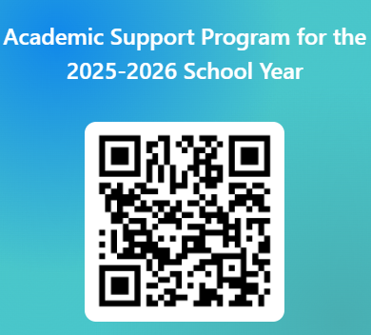
The offerings within the Academic Support Program are fee-based opportunities. Please indicate your interest using the QR code (right) or e-mail (below) and the Director of Student Support will contact you to answer questions and determine if the option(s) is right for your child before finalizing enrollment.
Caitlin Bank
cbank@willowsprep.com
https://forms.office.com/r/wA3Q0ETgYc

Slide 51


